Slide 1
OXSTAT Meeting
Louise Linsell, Senior Medical Statistician
National Perinatal Epidemiology Unit
(NPEU) CTU
11 July 2017

Slide 2
OXSTAT Meeting
Louise Linsell | Senior Medical Statistician and NIHR Doctoral Fellow, NPEU CTU
Ed Juszczak | Director of NPEU CTU
Derrick Bennett | Senior Statistician, CTSU
Lucy Davies | Statistician, CTSU

Slide 3





Departments with CTUs in Oxford

Slide 4


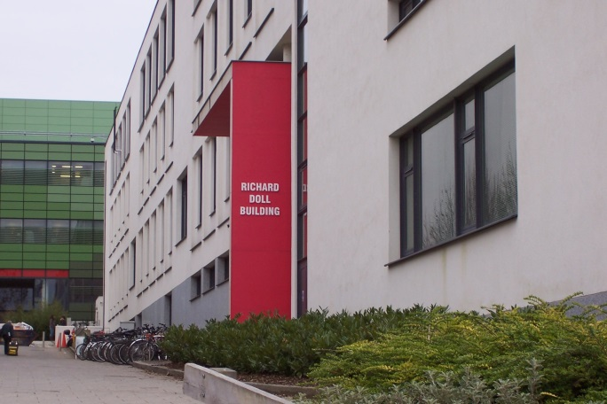
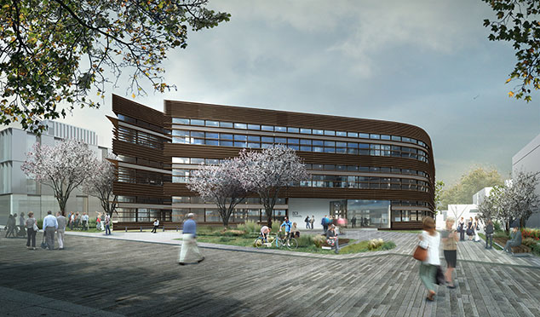

CTUs/Med Stats Hubs in Oxford
Richard
Doll
Building
Big Data Institute

Slide 5

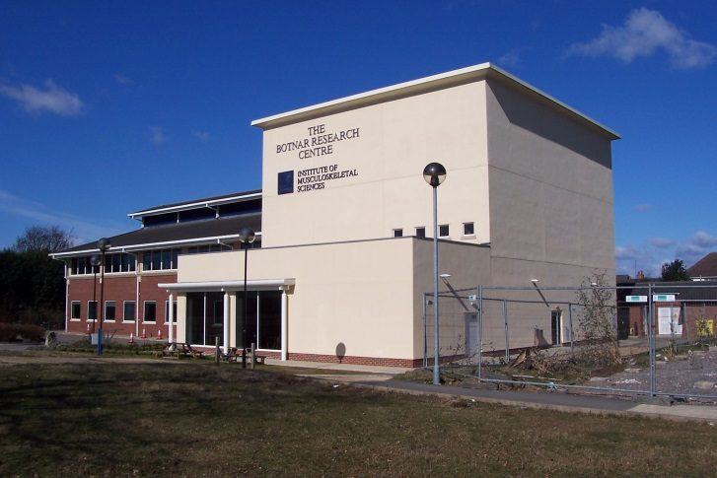


CTUs/Med Stats Hubs in Oxford
Botnar Research Centre

Slide 6


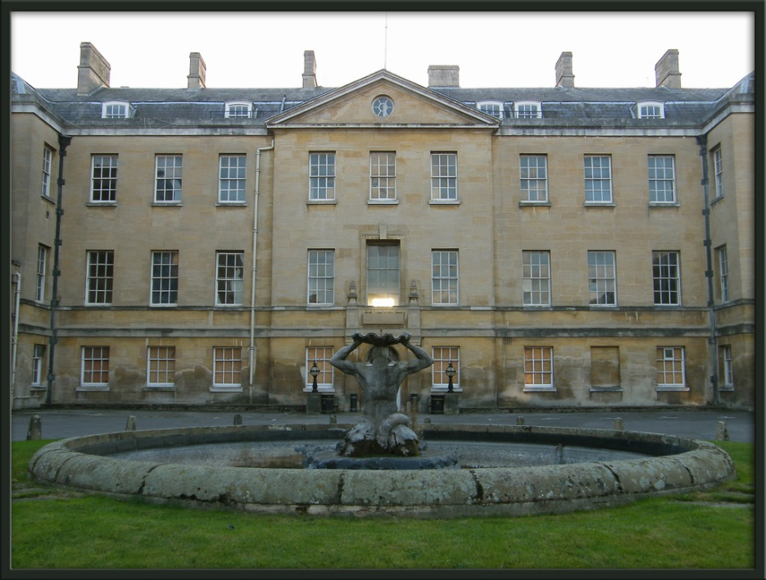
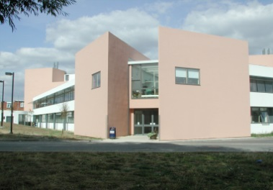
CTUs/Med Stats Hubs in Oxford
Radcliffe Infirmary
OCDEM, Churchill Campus

Slide 7
CTUs/Med Stats Hubs in Oxford
Medical Sciences Division
Nuffield Department of Population Health
Nuffield Department of Primary Care Health Sciences
Radcliffe Department of Medicine
NPEU
CTSU
CEU
Nuffield Department of Orthopaedics, Rheumatology and Musculoskeletal Sciences
OCTRU
CSM
SITU
PHC CTU
DTU

Slide 8

What is the remit of OXSTAT?
Communication
Networking
Collaboration

Slide 9
What is the remit of OXSTAT?
Aimed at early/mid-career medical statisticians working in clinical trials/epidemiology in Oxford
Meet 3-4 times per year for @1-1.5 hours
Each unit takes a turn in hosting
One volunteer from each unit to be on organising group

Slide 10

NPEU CTU
Who are we and what do we do?

Slide 11

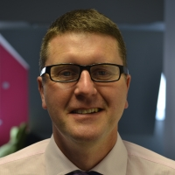
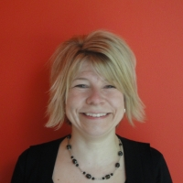

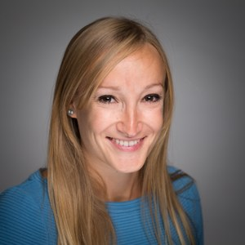
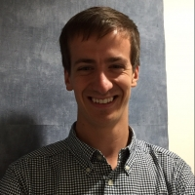

NPEU CTU Statisticians
Louise Linsell
Senior Statistician
Jenny Bell
Medical Statistician
Ed Juszczak,
Associate Professor
& CTU Director
Chris Partlett
Medical Statistician
Virginia Chiocchia
Medical
Statistician

Slide 12
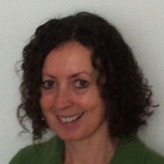
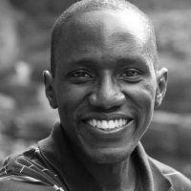
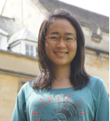

Other Npeu Statisticians…
Maria Quigley
Professor of Statistical Epidemiology
Charles Opondo
Researcher in Statistics & Epidemiology
Yangmei Li
Epidemiologist/Health Services Researcher

Slide 13
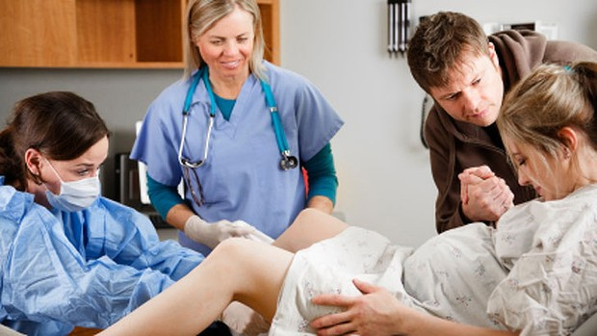
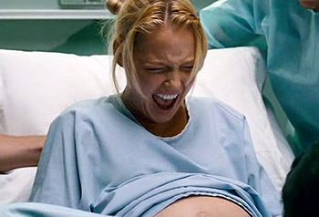
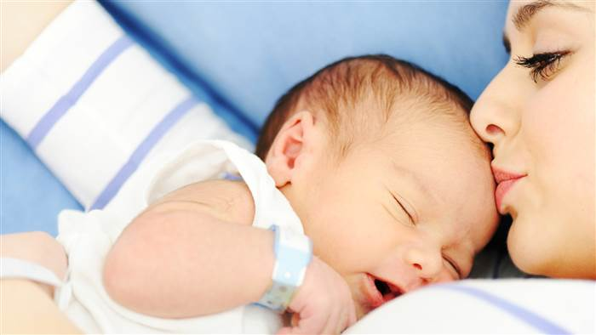
NPEU CTU – successful in a challenging environment

Slide 14
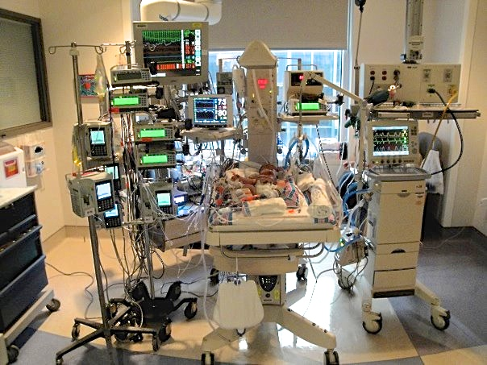
NPEU CTU – successful in a challenging environment

Slide 15
Types of trial
Usually large pragmatic, multicentre, phase-III trials
Usually 2-arm parallel group, but also cluster randomised, factorial, stepped-wedge, re-randomisation, crossover, multi-arm
Feasibility studies
Some early phase trials – becoming more common
Interventions: drugs, supplements, feeding, monitoring, oxygen levels, procedures
Some epidemiology and methodology

Slide 16
Issues and challenges…
Consent in emergency situations
Clustering due to multiple birth
Composite outcomes
Loss to follow-up
Transfers outside of the recruiting hospital

Slide 17


Trials in setup
N = 94
N = 1020

Slide 18








Trials recruiting
877 / 3424
22 / 730
9 / 93
1364 / 2200
147 / 1,086
443 / 900
234 / 580
9 / 156

Slide 19

Trial in follow-up
1,228 / 2,804

Slide 20





Trials in analysis or dissemination

Slide 21
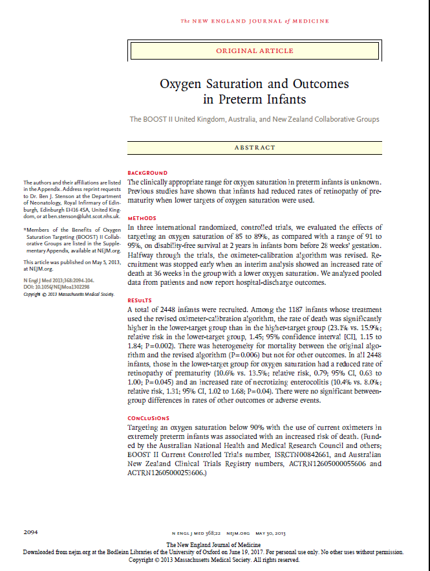
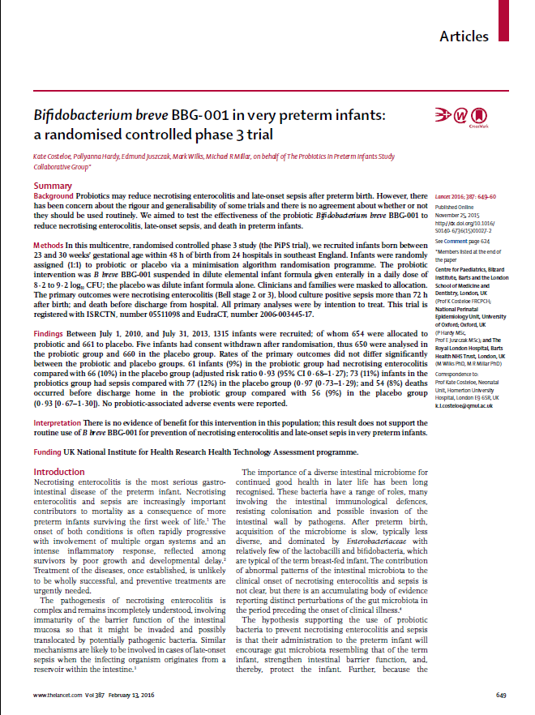
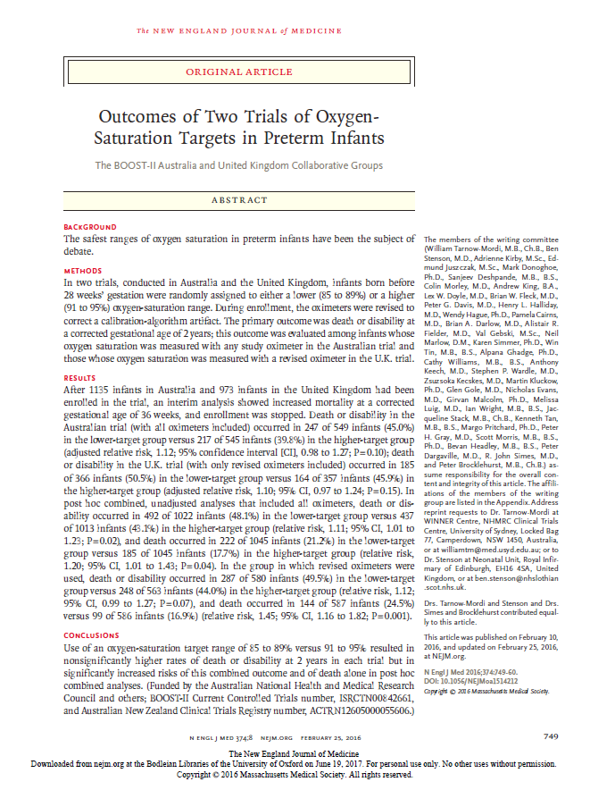
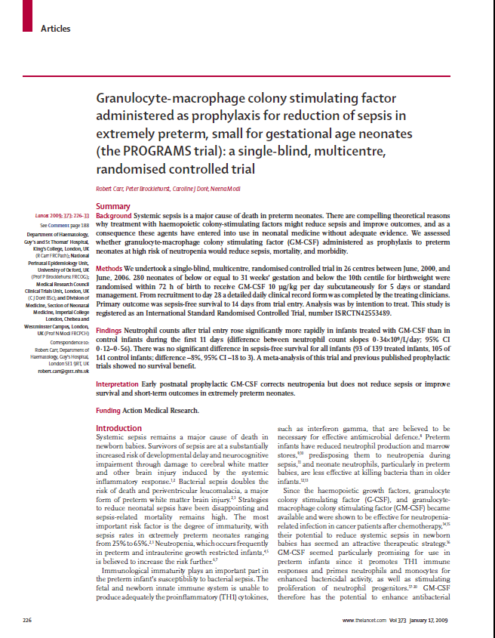
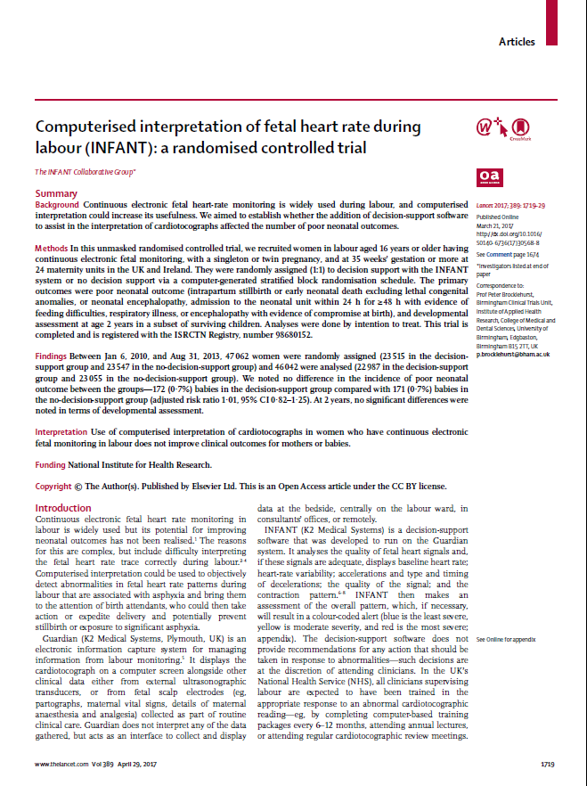
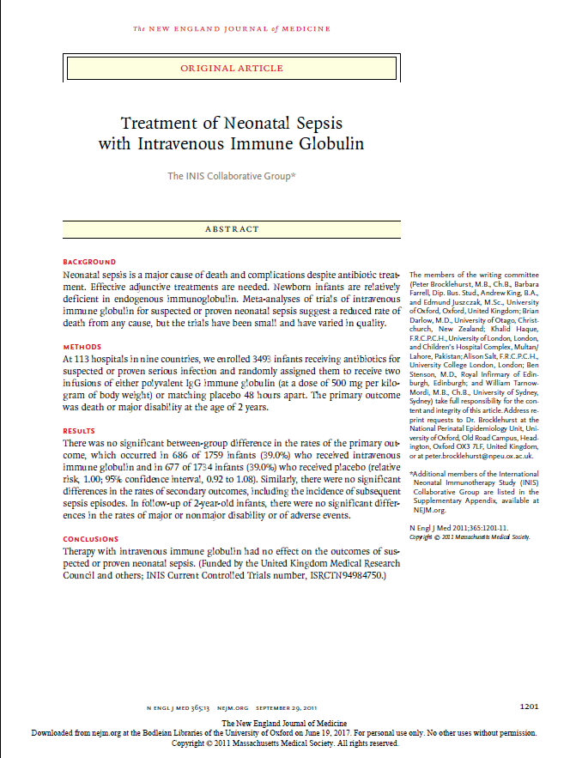
Publications

Slide 22

NPEU website:
https://www.npeu.ox.ac.uk/
Follow us on Twitter:
#NPEU_CTU

Slide 23


Slide 24
Don’t forget!
Logo competition
Volunteers from each CTU/research unit

