Slide 1




Building a RESEARCH CAREER
A PERSONAL Experience
Jemma C Hopewell, PhD FESC
Associate Professor of Genetic Epidemiology & Clinical Trials
British Heart Foundation Basic Science Research Fellow
OXSTAT/ECRN Meeting - July 2018

Slide 2
Overview
Setting the scene: My personal career journey
How did I get started? What were key steps along the way?
The role of personal funding (grants, promotion, etc.)
Developing independence (team building, publication, etc.)
NOTE: The following reflects personal experience and opinion

Slide 3

Jemma C Hopewell
PhD Biostatistics (Cardiovascular focus)
University of Cambridge
CTSU, NDPH, University of Oxford
Medical Statistician
Senior Medical Statistician
Developing a team
BHF Centre for Research Excellence
Intermediate Fellowship (2 yr)
University Research Lecturer
Senior Scientist in Genetic Epidemiology & Clinical Trials
BHF Intermediate Basic Science
Research Fellowship (4 yr)
Associate Professorship

Slide 4



Where did I start? With a little soul searching…
What’s my role? What are my interests?
What do I want?
What are my life aims?
Where is my career going? Where do I want it to go?
Do I want a fellowship? Why? What focus?
Do I want to develop a team? Why?
Where do I want to be?
Why? What are the hurdles?

Slide 5
What am I? What’s my role?
Genetic Epidemiologist
Population Health Scientist
Clinical Trials
Statistician
Cardiovascular Scientist
Cardiovascular Scientist
& PI
Collaborative
Scientist
‘Big Data’
Scientist
Statistical
Scientist

Slide 6
What am I? What’s my role?
Developing international collaborations
Developing research proposals, generating funding and impact
Genetic Epidemiologist
Population Health Scientist
Clinical Trials
Statistician
Teaching, citizenship
Cardiovascular Scientist
Leading a team
Cardiovascular Scientist
& PI
Collaborative
Scientist
‘Big Data’
Scientist
Statistical
Scientist
Representing national and international bodies
Contributing to SABs & Scientific Steering Committees

Slide 7
What am I? What’s my role?
Genetic Epidemiologist
Population Health Scientist
Clinical Trials
Statistician
Cardiovascular Scientist
& PI
Collaborative
Scientist
‘Big Data’
Scientist
Statistical
Scientist

Slide 8
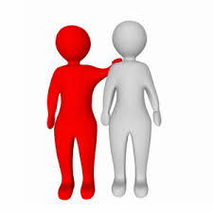

Developing independence:
Steps on a path to personal fellowships
My focus when forming a fellowship proposal was on:
Developing a personal path that would lead to growing independence and expertise, whilst benefitting from support and advice from others (and not just from those directly around you).
Identifying a research area with objectives that built on my existing skill set and experience, with an impact on and relevance to patient care.
Rationalising the choice of institution – the science needed to come first. Why Oxford?

Slide 9
Representing my personal profile
Some of my key considerations in making funding applications:
I’m not a clinician or laboratory scientist, so where do I fit in? Some elements of my profile and science were likely to be less familiar to funders, so ensuring clear explanations was important.
A clearly laid out CV and the confidence and ability to represent my unique skill set, research achievements , as well as my past, present and future research ideas.
How best to represent high impact international collaborative reports that include hundreds of authors.

Slide 10

Representing collaborative efforts
The best science involves collaboration - this can mean large-scale high impact efforts that take many years but for which first/senior authorship is not possible.
However, simultaneously, you’re trying to illustrate your leadership and development as an independent researcher – it can be hard to strike a balance.
Balance
“I” and “We”
We
Make sure the collaborative science is adequately recognised
Clearly describe contributions
I
We

Slide 11
Publish or perish – is that true?
  Publish high quality, robust research – this can take some time but is a good career investment.
  Focus on relevant questions – just because you can do something doesn’t mean you should.
  Know your topic and the literature. However, don’t try and mimic others without appropriate rationale (albeit that doesn’t mean don’t learn from others!).
  Be willing to give your opinion and have the insights to back-up your perspective.

Slide 12
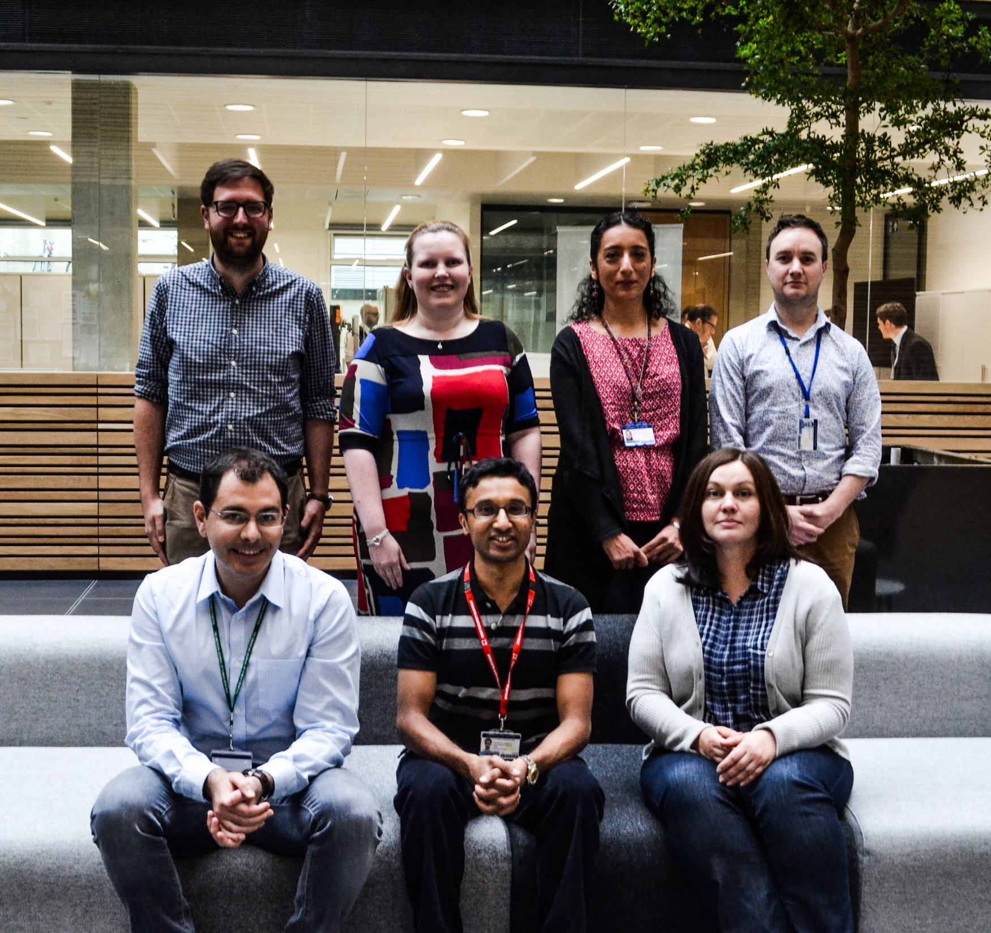
Moving forward research plans:
Building a team
Elsa
Valdes-Marquez

Slide 13
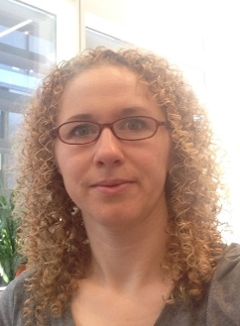
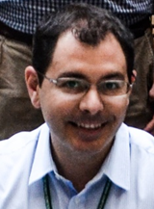
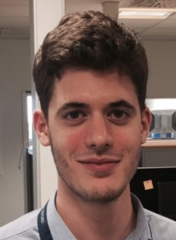
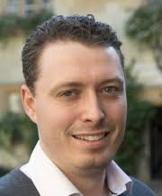
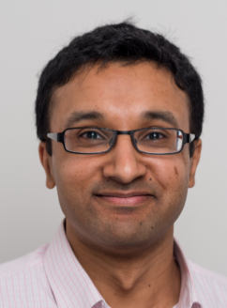
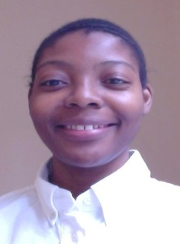
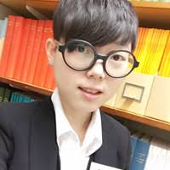
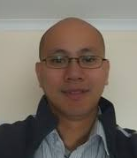
Building a multidisciplinary team
Elsa
Valdes-Marquez
Alex
Stiby
Adam
Von Ende
Maysson
Ibrahim
Federico
Murgia
Evangelos
Oikonomou
Fielder
Camm
Parag
Gajendragadkar
Lerato
Magosi
Katerina
Lind
Past team members
+++ statistical training fellows, interns and MSc students
Hanning Zhu
KingWai Lau

Slide 14
Achieving balance
All careers involve a level of compromise – you need to decide for yourself what balance is appropriate for you.

Slide 15
Achieving balance
All careers involve a level of compromise – you need to decide for yourself what balance is appropriate for you.
Take opportunities that arise – but you don’t need to say ‘yes’ to absolutely everything. Make informed choices.
Don’t expect to be ‘given’ authorship/roles/promotion/staff – take pride in earning your role, and in representing yourself well, whilst also acknowledging others appropriately.

Slide 16
Achieving balance
All careers involve a level of compromise – you need to decide for yourself what balance is appropriate for you.
Take opportunities that arise – but you don’t need to say ‘yes’ to absolutely everything. Make informed choices.
Don’t expect to be ‘given’ authorship/roles/promotion/a team – take pride in earning progression, and in representing yourself well, whilst also acknowledging others appropriately.
There is no ideal career path – reflect on what you want to achieve, what you like and are good at, and how to make progress.
If at first you don’t succeed, get feedback and improve your chances next time around. Persistence often pays off!

Slide 17
Tips on progressing as a statistical scientist
Create your own path
Work with and learn from others
Talk to your supervisor/mentors/peers
Focus on what you want to achieve and go for it!

Slide 18
Acknowledgements
Fellowship mentors
Professors Rory Collins & Sarah Parish
Colleagues who offered key advice and supported my agenda
Professors Hugh Watkins, Barbara Casadei, Keith Channon, & Martin Farrall, Mark Lathrop, Nilesh Samani, & Martin Dichgans +++
Key NDPH colleagues and collaborators
Professors Robert Clarke, Jane Armitage, Colin Baigent & Martin Landray +++
My team
The British Heart Foundation

