Slide 1
Implementing
central statistical monitoring
in multi-centre trials: example of a study within a trial
Elsa Valdés-Márquez
CTSU, NDPH, University of Oxford
OXSTAT meeting
04th July 2018

Slide 2
Outline
Motivation and guidance for quality assurance
The role of central statistical monitoring in multicentre clinical trials
Initial key risk indicator approach
Advanced key risk indicator approach
Conclusions

Slide 3
Reliable evidence and monitoring
Essential for appropriate decision making concerning the benefits and risk associated with clinical interventions.
Monitoring is used in trial to identify errors in trial conduct.
Monitoring can take different forms. For example, on-site monitoring and/or central statistical monitoring.

Slide 4
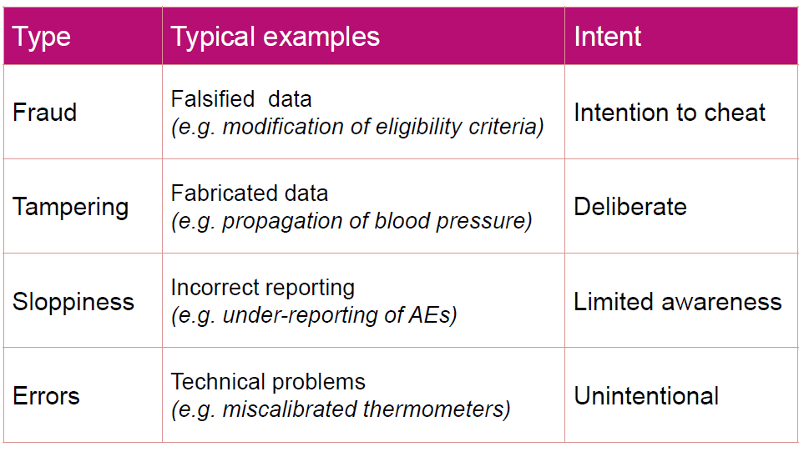
Type of data issues
Buyse M. Applied Clinical Trials, 2014

Slide 5
On-site monitoring visits: Criticism
Largely retrospective:
Too late to address any issues
Poorly focussed:
Emphasis on checking individual data points & documents
Unsustainable:
Inefficient and costly

Slide 6
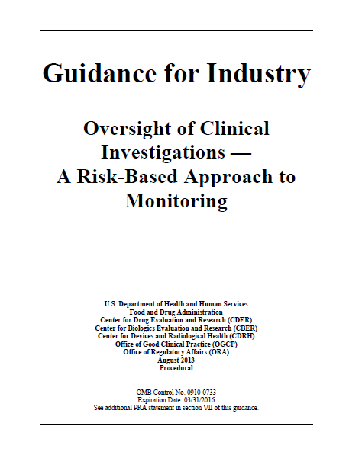
Risk-Based Monitoring

Slide 7
Central statistical monitoring
Central statistical monitoring (CSM) can be used to detect data issues and unusual sites and thereby help to:
Prioritize sites visits (and additional training)
Generate actionable objectives throughout the trial
Ensure overall data quality

Slide 8
Approaches to central statistical monitoring
Hypothesis-driven/supervised: Small number of variables mostly likely to affect reliability/safety of the trial. Also, known as key risk indicators (KRIs).
Hypothesis-free/unsupervised: Large number of tests of all available variables in the dataset.

Slide 9
Approaches to central statistical monitoring
Hypothesis-driven/supervised: Small number of variables mostly likely to affect reliability/safety of the trial. Also, known as key risk indicators (KRIs).
Hypothesis-free/unsupervised: Large number of tests of all available variables in the dataset.

Slide 10
CSM in cardiovascular mega-trials
Large-scale multicentre cardiovascular trials (e.g. THRIVE, REVEAL)
Large number of sites across different countries
Systematic differences across countries (stratify analysis needed)
Typically 10-200 participants per site
Long follow-up period
Electronic case report forms (eCRF)

Slide 11
Initial KRI approach
Select KRIs relevant to the trial
E.g. visit duration, serious adverse event (SAE) rates,
compliances, etc.
Sites assessment per KRI:
Select a summary measure of interest
For each site, calculate a summary measure such as mean, variance, proportion, rate. E.g. SAE rate.
Identify extreme sites
Define a KRI specific critical threshold, giving sites passing this threshold a score of 1 (0 otherwise). E.g. give sites with a low SAE
reporting rate relative to comparable sites a score of 1.
Sites classification:
Create a summary score for each site based on the sum of the individual KRI score (weighting each KRI as appropriate)

Slide 12
Initial KRI approach
Select KRIs relevant to the trial
E.g. visit duration, serious adverse event (SAE) rates,
compliances, etc.
Sites assessment per KRI:
Select a summary measure of interest
For each site, calculate a summary measure such as mean, variance, proportion, rate. E.g. SAE rate.
Identify extreme sites
Define a KRI specific critical threshold, giving sites passing this threshold a score of 1 (0 otherwise). E.g. give sites with a low SAE
reporting rate relative to comparable sites a score of 1.
Sites classification:
Create a summary score for each site based on the sum of the individual KRI score (weighting each KRI as appropriate)

Slide 13
Initial KRI approach
Select KRIs relevant to the trial
E.g. visit duration, serious adverse event (SAE) rates,
compliances, etc.
Sites assessment per KRI:
Select a summary measure of interest
For each site, calculate a summary measure such as mean, variance, proportion, rate. E.g. SAE rate.
Identify extreme sites
Define a KRI specific critical threshold, giving sites passing this threshold a score of 1 (0 otherwise). E.g. give sites with a low SAE
reporting rate relative to comparable sites a score of 1.
Sites classification:
Create a summary score for each site based on the sum of the individual KRI score (weighting each KRI as appropriate)

Slide 14
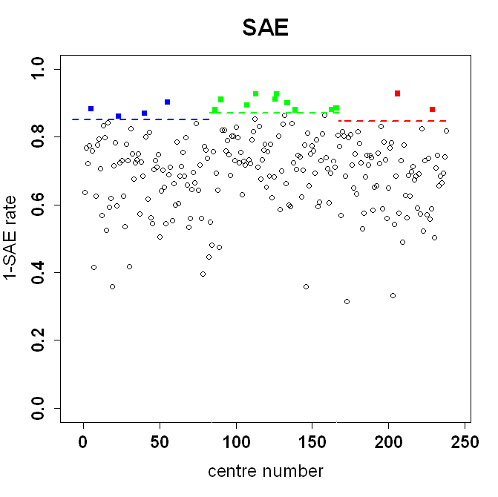
Application in a multicentre trial
Example of KRI: Under-reporting SAEs
Thresholds depend on region
Site
A site deviates excessively from comparable sites if the SAE rate < predefined threshold

Slide 15
Application in a multicentre trial
Example of summary score:
A score based on the (weighted) sum of the individual KRI score
Site | Scores for KRIs |  |  |  |  | Summary score
 | Visit Duration | ALT | Non-compliance | SAE | Muscle Symptom
A3 | 1 | 0.50 | 0 | 0 | 0.83 | 2.33
A55 | 0 | 0.25 | 0 | 1 | 1.00 | 2.25
A24 | 1 | 0 | 0 | 0 | 1.00 | 2.00
B139 | 1 | 0.75 | 0 | 1 | 1 | 3.75
B163 | 1 | 0.50 | 0.33 | 1 | 0.67 | 3.50
B134 | 1 | 0.25 | 0 | 1 | 0.86 | 3.11
C206 | 1 | 0.50 | 0 | 1 | 0.86 | 3.36
C199 | 0 | 0.50 | 1 | 0 | 0.86 | 2.36
C193 | 0 | 0.25 | 0.86 | 0 | 1.00 | 2.11
Individual KRIs weights account for their relative importance to the CSM process

Slide 16
Advantages and limitations of KRI approach
Easy to interpret
Tailored to each trial
Variable weighting is flexible
Criteria/scoring subjective
Size of sites is not considered

Slide 17
Progress in KRI approach
Select KRIs relevant to trial
Create a summary measure of interest
Site
assessment
per KRI
Identify extreme sites
Sites classification

Slide 18
Progress in KRI approach
Select KRIs relevant to trial
Create a summary measure of interest
Site
assessment
per KRI
Identify extreme sites
Objective p-value to indicate how extreme a site is relative to comparable sites
Sites classification
Based on a combined p-value across KRIs

Slide 19
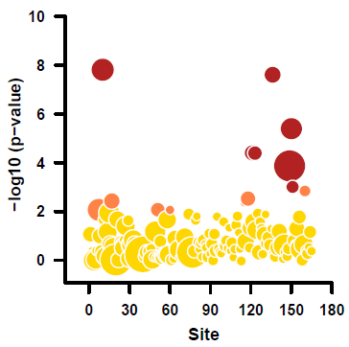
Application in a multicentre trial
On-site visit priority:
Red: High; Orange: Medium; and Yellow: Low

Slide 20
Conclusions
Centre statistical monitoring helps to prioritize on-site visits; identify training areas, and ensure overall data quality in multicentre trials
We have developed a KRI approach for cardiovascular trials and on-site visits provided empirical validation.
General approach can be extended to other large trials; plans to release a R-packages will facilitate this.

Slide 21
Acknowledgements
Jemma C Hopewell, PI
On-site monitoring: Carol Knot
CTSU trial teams:
Martin Landray
Louise Bowman
Jane Armitage

