Slide 1


Setting up safety stopping boundaries for a phase II trial:
the
trial
12 February 2018
Jennifer Bell, Medical Statistician

Slide 2
The Poppi trial
A blinded randomised placebo-controlled trial investigating the efficacy of morphine analgesia for procedural pain in infants
Pre-term babies often need a lot of painful procedures. Pain can have both immediate & long-term negative consequences – yet it is often under-treated
Clinical intervention – heel lance followed by ROP screening
Pain is measured by a pain score (PIPP-R), brain activity & muscle activity
Risk of morphine – increased hypotension & respiratory depression
Notes:
Premature babies requiring intensive neonatal care – highest burden of pain.
Infant receiving intensive care – ave. 10 painful procedures/day. Specific analgesia is provided <25% of the time
Heel lance – baby’s heel pricked, for routine blood samples.
Retinopathy of Prematurity (ROP) screening - highly invasive, distressing, painful - repeatedly performed on premature infants.
(ROP - eye disease can lead to blindness if untreated.)
But inadequate pain relief.
Increased pain scores & likelihood of apnoeic episodes in the 24 hr period after screening reported.
Poppi trial - Measure pain scores by behaviour, gestational age, heart rate, oxygen saturations and facial expressions.
Morphine – could be efficacious for pain relief, but risks = increased hypotension & respiratory depression (apnoeas) – this means the infant stops breathing for too long, ~20 seconds

Slide 3
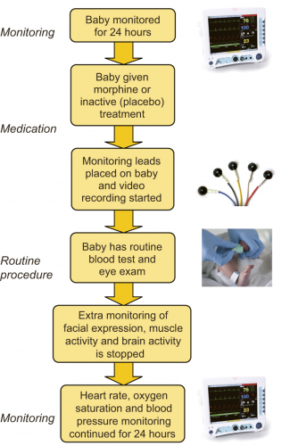
The Poppi trial
Notes:
Babies are preterm (born < 32 wks)
1 hr after IMP, clinical intervention

Slide 4
The Poppi trial
Target sample size: 156
Co-primary outcomes:
  PIPP-R score during 30 sec period after ROP screening
  Magnitude of nociceptive-specific brain activity evoked by heel lance
Safety outcomes:
  incidences of apnoea requiring intervention with NeoPuff or ‘bag and mask’
  incidences of hypotension requiring treatment with inotropes
  in the 24 hours following administration of the intervention
A stopping boundary was specified based on the first safety outcome, as a binary outcome
Notes:
Sample size for the Poppi trial was calculated for efficacy for the primary and co-primary outcomes

Slide 5
What is a stopping boundary?
A rule or guide to signal when we should consider stopping a trial
In this trial, it is a stopping boundary for safety
  Can also be for efficacy or futility, or a combination
Safety analyses planned every 25 babies with outcome data
(6 analyses in total)

Slide 6
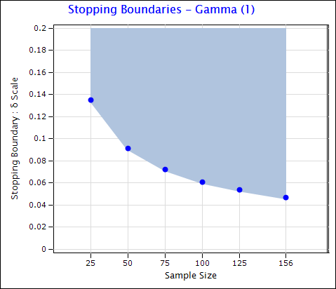
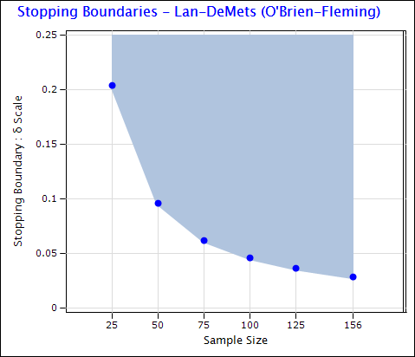
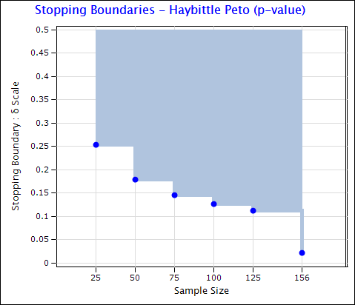
What is a stopping boundary?
1
2
3
We may choose to be less risk-averse at the beginning, and more conservative afterwards, or vice versa, or anywhere in between
Notes:
Some examples – they can be specified very differently.
Needs to reflect how the DMC would make these decisions.
If serious concern, we don’t want the boundary to allow us to continue and unnecessarily put more babies at risk
But – may not want to recommend we stop TOO easily either

Slide 7
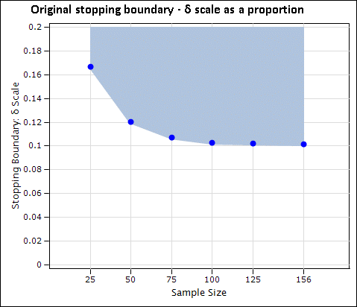
How it works (real boundary, example data)
δ = difference in proportions of the event of interest between the trial groups
= P(event in morphine group) – P(event in placebo group)
Notes:
X-axis – Number of babies in each analysis, so the number we have collected outcome data for
Y-axis – difference in the proportion of babies with apnoea requiring neopuff/ bag&mask 24hrs post-intervention
Blue – stopping boundary

Slide 8
How it works (real boundary, example data)
The test statistic is plotted at each analysis.
If below the shaded area, no safety concerns flagged – recommend continuing…
δ = difference in proportions of the event of interest between the trial groups
= P(event in morphine group) – P(event in placebo group)
Notes:
This is the boundary that was chosen (data points are fake)

Slide 9
How it works (real boundary, example data)
The test statistic is plotted at each analysis.
If below the shaded area, no safety concerns flagged – recommend continuing…
δ = difference in proportions of the event of interest between the trial groups
= P(event in morphine group) – P(event in placebo group)
… but if in the shaded area, recommend stopping the trial due to safety concerns

Slide 10
How did we get there?
Selection:
Hypothetical safety scenarios discussed with Poppi investigators
  - e.g. “Say there are 2 events in group A & 1 event in group B, out of 25 babies – would you stop?”
Narrowed down to three stopping boundary options
DMC chose one of three options presented to them (with examples of when the boundary would and wouldn’t recommend stopping)
Notes:
How do we begin to specify this? There is no algorithm to tell us what the right decision is.
An important decision like this shouldn’t be guided by an arbitrary boundary –
The boundary should be guided by how the experts would make this decision.
Had to elicit the information from the experts, and convert this into an algorithm.
Selection: Pragmatic process
To understand what tolerance for risk should be, to give us a starting point for discussions with DMC. Plotted their preferences and matched boundaries to them.
Options – ended up with 3. More risk-averse, less risk averse, and one in the middle
DMC chose the one in the middle. Given scenarios on which to base their decision.

Slide 11
Hypothetical safety scenarios
We will present some trial safety event scenarios, and at each stage ask for your view on whether you would be concerned enough about safety to stop
  Yes, No or Maybe
Then, 3 stopping boundaries that most closely match those decisions will be formed
The DMC will select one of these to use for the trial
Notes:
This is what was presented to the Poppi investigators.
They were then given 8 scenarios – these are some examples.

Slide 12
Scenario 2
Hypothetical safety scenarios
N | Morphine n (%) | Placebo n (%) | Difference (%) | Stop?
25 | 1 (7.7) | 0 (0.0) | 7.7
Notes:
These scenarios ranged from the less extreme…

Slide 13
Scenario 2
Hypothetical safety scenarios
N | Morphine n (%) | Placebo n (%) | Difference (%) | Stop?
25 | 1 (7.7) | 0 (0.0) | 7.7
50 | 2 (8.0) | 0 (0.0) | 8.0

Slide 14
Scenario 2
Hypothetical safety scenarios
N | Morphine n (%) | Placebo n (%) | Difference (%) | Stop?
25 | 1 (7.7) | 0 (0.0) | 7.7
50 | 2 (8.0) | 0 (0.0) | 8.0
75 | 3 (4.0) | 0 (0.0) | 4.0

Slide 15
Scenario 2
Hypothetical safety scenarios
N | Morphine n (%) | Placebo n (%) | Difference (%) | Stop?
25 | 1 (7.7) | 0 (0.0) | 7.7
50 | 2 (8.0) | 0 (0.0) | 8.0
75 | 3 (4.0) | 0 (0.0) | 4.0
100 | 4 (8.0) | 0 (0.0) | 8.0

Slide 16
Scenario 2
Hypothetical safety scenarios
N | Morphine n (%) | Placebo n (%) | Difference (%) | Stop?
25 | 1 (7.7) | 0 (0.0) | 7.7
50 | 2 (8.0) | 0 (0.0) | 8.0
75 | 3 (4.0) | 0 (0.0) | 4.0
100 | 4 (8.0) | 0 (0.0) | 8.0
125 | 5 (7.9) | 0 (0.0) | 7.9
Notes:
These scenarios ranged from the less extreme…

Slide 17
Scenario 5
Hypothetical safety scenarios
N | Morphine n (%) | Placebo n (%) | Difference (%) | Stop?
25 | 3 (23.1) | 1 (8.3) | 14.7
Notes:
To somewhere in the middle…

Slide 18
Scenario 5
Hypothetical safety scenarios
N | Morphine n (%) | Placebo n (%) | Difference (%) | Stop?
25 | 3 (23.1) | 1 (8.3) | 14.7
50 | 4 (16.0) | 1 (4.0) | 8.0

Slide 19
Scenario 5
Hypothetical safety scenarios
N | Morphine n (%) | Placebo n (%) | Difference (%) | Stop?
25 | 3 (23.1) | 1 (8.3) | 14.7
50 | 4 (16.0) | 1 (4.0) | 8.0
75 | 6 (15.8) | 1 (2.7) | 13.1

Slide 20
Scenario 5
Hypothetical safety scenarios
N | Morphine n (%) | Placebo n (%) | Difference (%) | Stop?
25 | 3 (23.1) | 1 (8.3) | 14.7
50 | 4 (16.0) | 1 (4.0) | 8.0
75 | 6 (15.8) | 1 (2.7) | 13.1
100 | 7 (14.0) | 2 (4.0) | 10.0

Slide 21
Scenario 5
Hypothetical safety scenarios
N | Morphine n (%) | Placebo n (%) | Difference (%) | Stop?
25 | 3 (23.1) | 1 (8.3) | 14.7
50 | 4 (16.0) | 1 (4.0) | 8.0
75 | 6 (15.8) | 1 (2.7) | 13.1
100 | 7 (14.0) | 2 (4.0) | 10.0
125 | 9 (14.3) | 2 (3.2) | 11.1
Notes:
To somewhere in the middle…

Slide 22
Scenario 8
Hypothetical safety scenarios
N | Morphine n (%) | Placebo n (%) | Difference (%) | Stop?
25 | 4 (30.8) | 0 (0.0) | 30.8
Notes:
To more extreme

Slide 23
Scenario 8
Hypothetical safety scenarios
N | Morphine n (%) | Placebo n (%) | Difference (%) | Stop?
25 | 4 (30.8) | 0 (0.0) | 30.8
50 | 7 (28.0) | 1 (4.0) | 24.0

Slide 24
Scenario 8
Hypothetical safety scenarios
N | Morphine n (%) | Placebo n (%) | Difference (%) | Stop?
25 | 4 (30.8) | 0 (0.0) | 30.8
50 | 7 (28.0) | 1 (4.0) | 24.0
75 | 8 (21.1) | 2 (5.4) | 15.6

Slide 25
Scenario 8
Hypothetical safety scenarios
N | Morphine n (%) | Placebo n (%) | Difference (%) | Stop?
25 | 4 (30.8) | 0 (0.0) | 30.8
50 | 7 (28.0) | 1 (4.0) | 24.0
75 | 8 (21.1) | 2 (5.4) | 15.6
100 | 9 (18.0) | 2 (4.0) | 14.0

Slide 26
Scenario 8
Hypothetical safety scenarios
N | Morphine n (%) | Placebo n (%) | Difference (%) | Stop?
25 | 4 (30.8) | 0 (0.0) | 30.8
50 | 7 (28.0) | 1 (4.0) | 24.0
75 | 8 (21.1) | 2 (5.4) | 15.6
100 | 9 (18.0) | 2 (4.0) | 14.0
125 | 11 (17.5) | 3 (4.8) | 12.6
Notes:
To more extreme

Slide 27
Plot the data
Notes:
Holding the control group number of events at different constants, plotted these data in terms of risk diff

Slide 28
Simplify
Matched as closely as possible to ‘real’ stopping boundaries using EAST software
Notes:
.. And narrowed down to 3 options, using the proportional differences. Cannot present a DMC with 8 options!
As you can see – the bottom one is more risk averse – doesn’t require a big difference to stop at look 1 (10%) – the top is less risk averse, requiring about 26% diff at look 1
EAST software – cannot specify a boundary like this, it is complete trial and error!

Slide 29
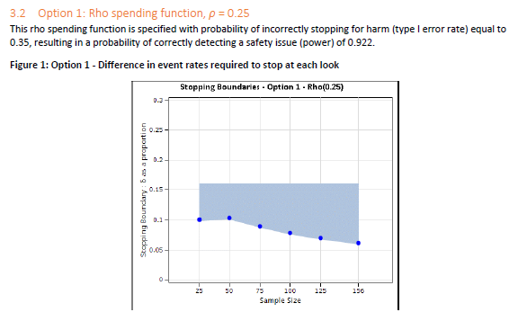
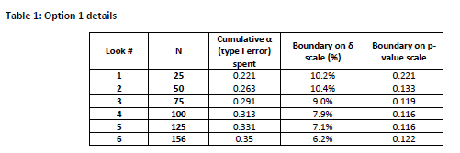
Present to DMC
Notes:
DMC received summary of 3 options – what the boundary would do at each look, in terms of % difference, and p-value.
Only 1 DMC member is a statistician (expert in stopping rules, who was consulted on this process)

Slide 30
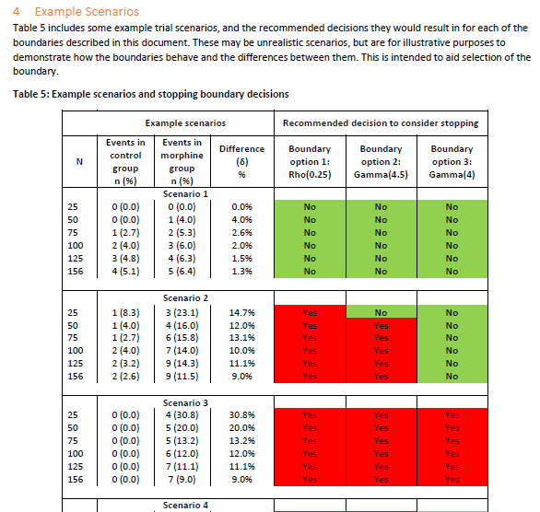
Present to DMC
Notes:
They saw each boundary in terms of 5 scenarios – when would each boundary recommend stopping?

Slide 31
Chosen stopping boundary
Gamma spending function, γ = 4.5
α = 0.2
Notes:
DMC selected the one in the middle.
Felt it was quite cautious in terms of what they would do, but they would rather be ‘alerted’ than not

Slide 32
Chosen stopping boundary
A type of α-spending function
(α = type I error rate = probability of stopping for harm)
Type I error rate (= 0.2) is spread over the number of safety analyses
Reduces the risk of stopping erroneously, accounting for multiple testing
Power = 81% (probability of correctly detecting safety issue)
Assumptions:
  Average event rate in placebo group = 7%
  Tolerated maximum difference between groups = 12% (on average)
Flexible to changes

Slide 33
Chosen stopping boundary
Properties of chosen boundary
Look # | N | Cumulative α (type I error) spent | Boundary on δ scale (%) | Boundary on p-value scale | Boundary on Z-scale
1 | 25 | 0.104 | 16.7% | 0.104 | 1.260
2 | 50 | 0.154 | 12.1% | 0.099 | 1.289
3 | 75 | 0.179 | 10.7% | 0.081 | 1.399
4 | 100 | 0.191 | 10.3% | 0.060 | 1.552
5 | 125 | 0.197 | 10.2% | 0.042 | 1.725
6 | 156 | 0.200 | 10.2% | 0.028 | 1.919
Notes:
At first look – p-value 0.104 required to stop, equates to difference of at least 16.7%
P-values get smaller, i.e. it gets harder to stop, as the trial goes on.

Slide 34
IMPORTANT!
A stopping boundary is a guide
If the stopping boundary is crossed, the trial does not automatically stop!
Agreed that other trial data would also inform the recommendation, including:
Clinical stability 24 hours before & after trial intervention
Process outcome (dosage)
Adverse Events (AEs)
Serious Adverse Events (SAEs)
Notes:
It would be possible for the stopping boundary to be crossed, and for the DMC to decide to recommend continuing the trial

Slide 35
Thank you for listening!
Any questions?
jennifer.bell@npeu.ox.ac.uk

