Slide 1
OXSTAT Meeting
Ly-Mee Yu, DPhil, Associate Professor
Deputy Director Academic
Lead Trial Statistician
12 February 2018

Slide 2



UKCRC Nº. 52
Primary Care and Vaccine Collaborative Clinical Trials Unit
Oxford Vaccine Centre
Prof Chris Butler
Prof Andy Pollard
Prof Adrian Hill

Slide 3
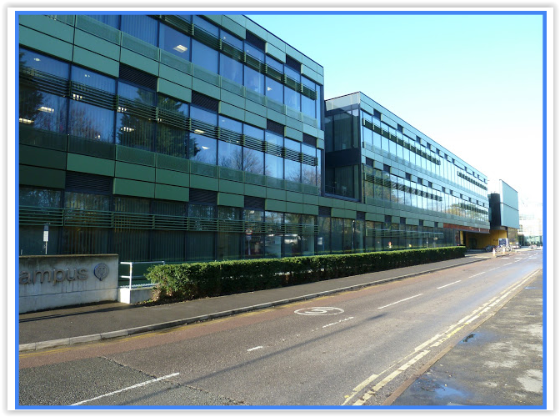
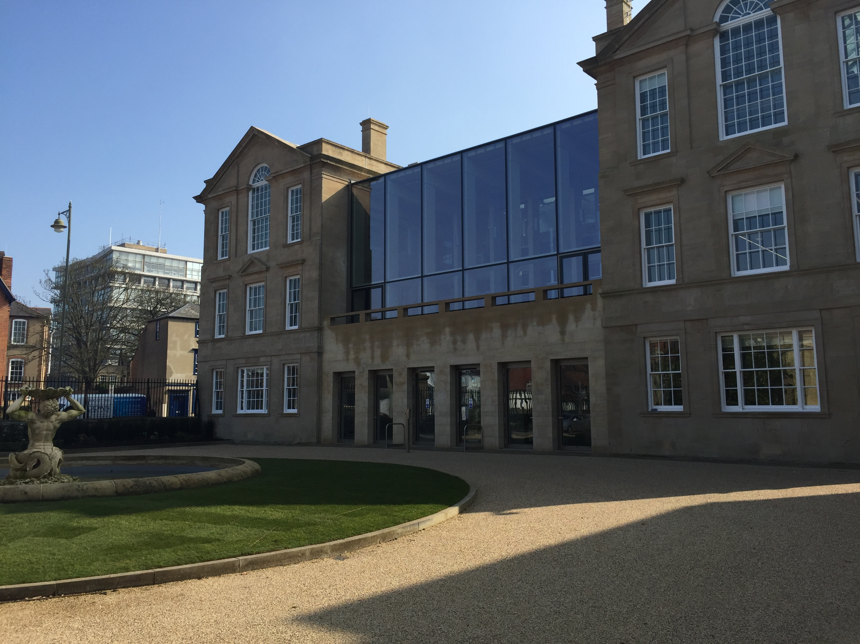
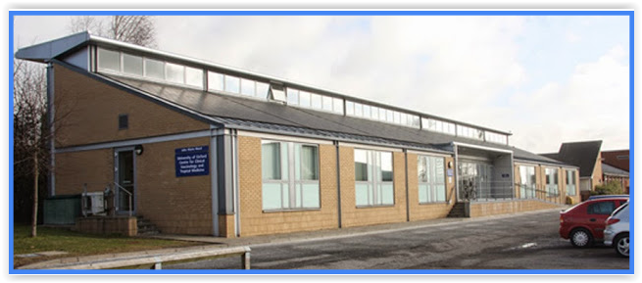

Slide 4
PC-CTU
NDPHCS Stats Group
CTU Director
Prof Chris Butler
Head of Stats
Prof Rafael Perera
Big Data (CPRD)
MaDOx
Ly-Mee Yu
Jill Mollison
Nicola Williams
Alecia Nickless
Ushma Galal
Vicky Harris
Joyce Klu
Sam Mort
Health Econ.
Clare Bankhead
Margaret Smith
Alice Fuller
Misghina Weldegiorgis
Richard Stevens
Emily McFadden
Jason Oke
Susannah Fleming
Julie McLellan
Kathy Taylor
Ben Feakins
Mei-Man Lee
Kirty Ravenhall
Yaling Yang
Lucy Abel
DPhil Students
MIC &Tobacco Addition
Sarah Stevens
Constantino Koshiaris
Merryn Voysey
Oluwaseun Esan
Jack O’Sullivan
Tom Fanshawe
Maria Vazquez
Jose Ordonez-Mena
Gea Holtman

Slide 5
PC-CTU
3 Themes:
    Cardiovascular and Renal
    Infectious Disease
    Health Behaviour and Others
31 ongoing studies
    10 in set-up
    21 recruiting

Slide 6
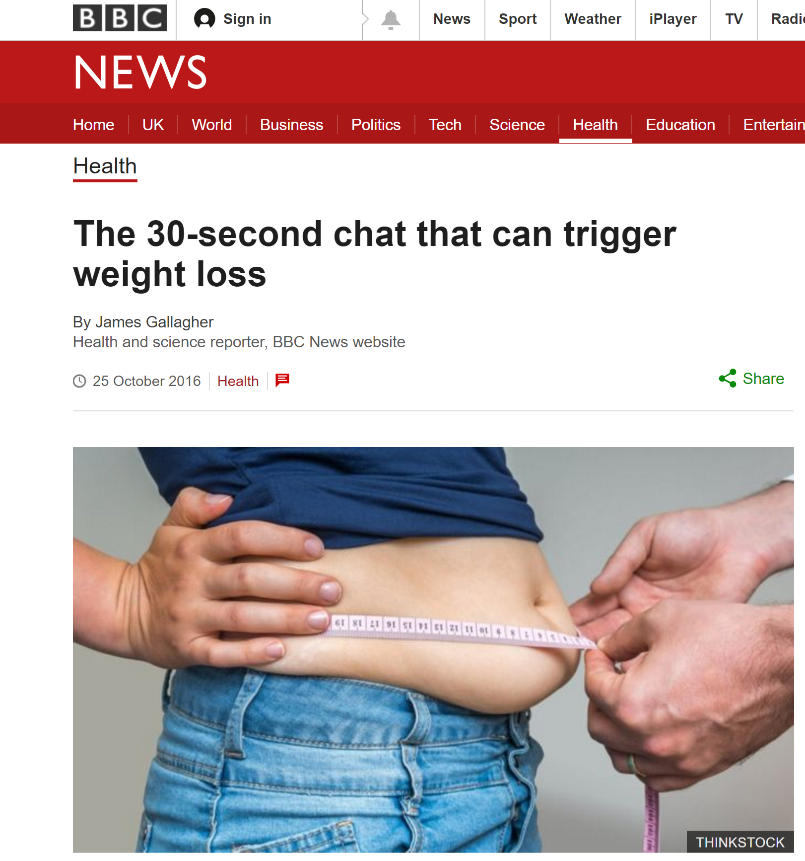

Slide 7





Slide 8


Slide 9
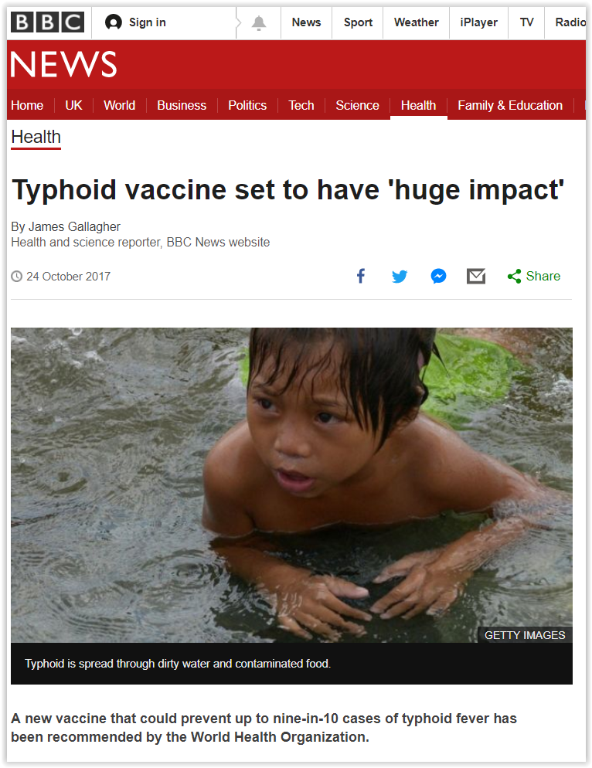

Slide 10

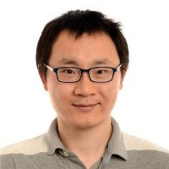
Typhoid Vaccine Acceleration Consortium (TyVAC): Bangladesh
Large effectiveness cluster randomised trial
150 clusters; 43,350 children
Direct and indirect vaccine effect
Senior Statistician: XinXue Liu

Slide 11
https://www.phc.ox.ac.uk/phctrials
https://www.phc.ox.ac.uk/research/medical-statistics
https://www.ovg.ox.ac.uk/
http://www.jenner.ac.uk/home

