Slide 1

ADEPT ENCORE
A nested case-control study analysis
Notes:
ADEPT ENCORE: Secondary analysis of trial data using a nested case-control study

Slide 2
Contents
ADEPT
ADEPT ENCORE
Nested case-control design
Discussion topics
Notes:
Talk first a little about the trial
Quickly discuss the motivation behind the secondary analysis
Briefly talk about the nested case-control design
Motivate (hopefully!) some discussion

Slide 3
Necrotising enterocolitis (NEC)
A serious condition that occurs when the intestinal tissue becomes damaged and begins to die.
Early vs Late feeding
404 preterm infants were randomised to commence milk feeds either:
Early: day 2 following birth
Late: day 6 following birth
Outcomes
Time to full enteral feeds
Necrotising enterocolitis (NEC)
Death before discharge
Infection
“Early introduction of enteral feeds in growth-restricted preterm infants results in earlier achievement of full enteral feeding and does not appear to increase the risk of NEC.”
In addition the daily feed logs collected a detailed account of the feed volume and type of feed given on each day.
Notes:
ADEPT: Trial with 404 preterm infants investigating the difference between starting feeds early (2 days after birth) or late (6 days after birth).
By starting feeds earlier, the hope is that the infant can be taken of intravenous lines more quickly and thereby reduce the threat of infection
However, there was (and still is to a certain extent) that feeding too quickly, too soon (before an infants gut has had a chance to develop) can increase the risk of serious gut problem
One of these is necrotising enterocolitis (NEC) which is where the intestinal tissue becomes damaged and begins to die.
The trial showed that full feeds could indeed be established sonner by starting feeds early, without any evidence of an increased risk in NEC
In addition, the trial collected extensive and detailed feed log data (nex slide)

Slide 4
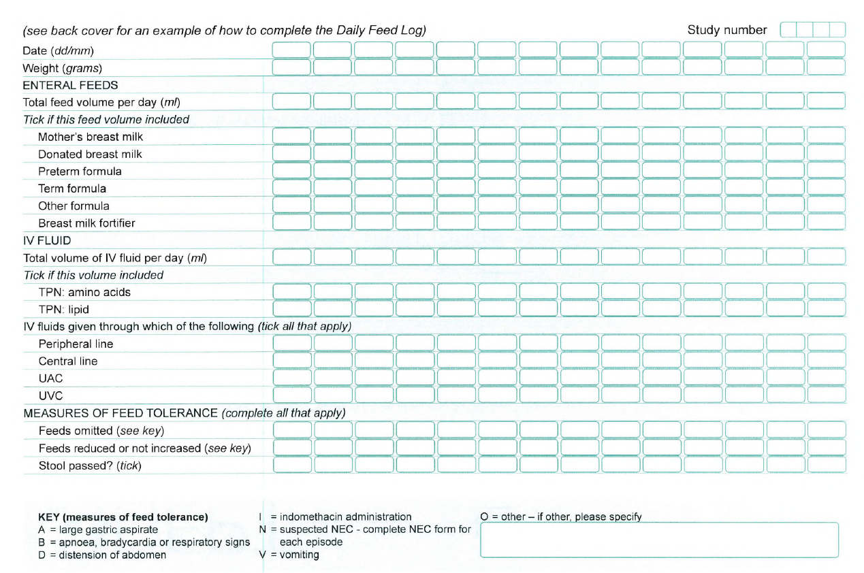
Notes:
As you can see from the daily feed log used in the trial DAILY information was collected on the volume and type of feed given – this was collected for 28 days in most infants and in some cases even longer.

Slide 5
ADEPT ENCORE (DO YOU WANT MORE?)
ADEPT ENCORE is a follow up study investigating how different milk feeds and food supplements affect babies’ chances of developing NEC.
Challenges
Longitudinal data
Timing of exposure crucial
How to adequately select controls?
In particular, the goal is to investigate the following research questions:
Is dietary exposure to milk types other than exclusive breast milk feeds (including donor breast milk) a risk factor for developing NEC?
Is a change in feed type in the previous week a risk factor for the development of NEC?
The analysis method should:
Adjust for confounding factors such as sex, gestational age, and birthweight.
Only incorporate exposure data collected prior to the event.
Notes:
ADEPT ENCORE is a secondary analysis of the trial data, the goal of which is to investigate how different feed types and changes in feed affect the infants chances of developing NEC
The two research questions are:
To what extent is exposure to non-breasts milk (formula or fortifier) feeds a risk factor for NEC
Does a change in the type of feed increase the chances of NEC in the following week?
There are a number of challenges to answering these types of question.
Firstly, an abundance of longitudinal data which must be incorporate in the analysis
Second, the timing of the exposure is crucial to demonstrate a causal relationship (we’re only interested in exposures prior to the first instance of NEC)
Third, there is the complex issue of selecting approprtiate controls. Examing the exposure status of the infants who develop NEC is straightforward but how do we select an appropriate comparator from the data?
The analysis should also allow for adjustment of known confounders and only incorporate exposure prior to the event

Slide 6
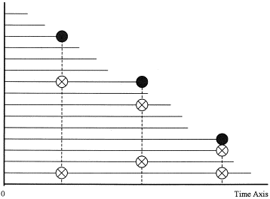
Nested matched case-control design
A nested case-control design can be used to match cases (i.e. NEC) at a given point in time (days from birth) to non-cases at that time point.
Cases and controls come from the same population
Cases can be matched to ‘similar controls’
Future cases can be included as controls
Controls can be used more than once
Allows time dependent exposure
Figure 1. Essebag (2003) – In this example, there are 2 controls (white circle with X) for every case (black circle).
We propose adopting this design to provide a novel framework for studying a potential causal relationship between feeds and NEC using the ADEPT trial data.
Notes:
The method we propose using is a nested matched case-control design.
Typically used as an efficient alternative to a full cohort study – a subset of controls can be selected from the risk set that best fit the case population

Slide 7
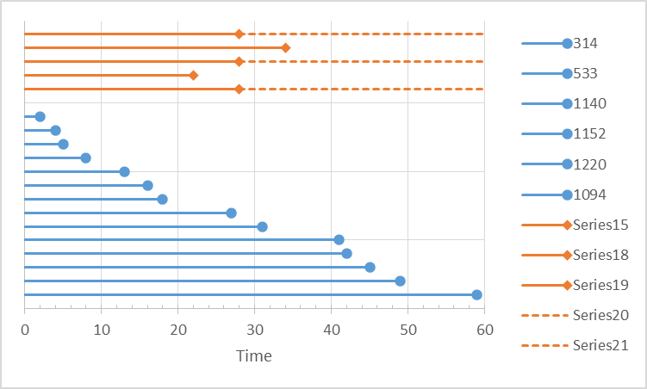
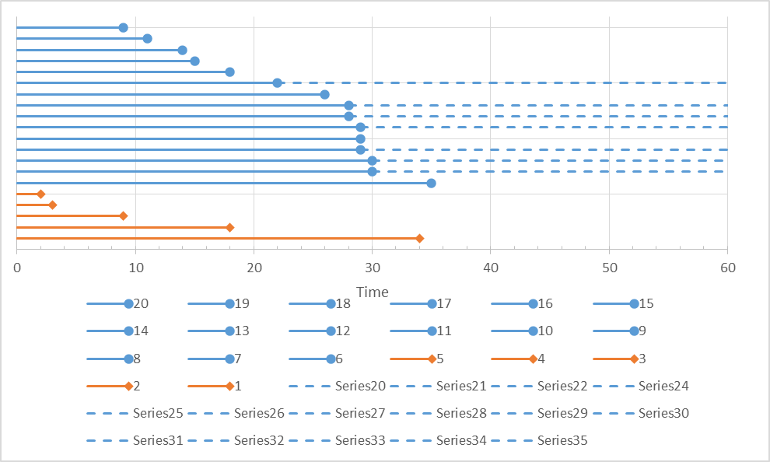
Nested matched case-control design
Control infants
(do not develop NEC)
Time to death or discharge
Time following discharge
Case infants
(develop NEC)
Time to NEC
Notes:
A nested case-control design can be used to match cases (i.e. NEC) at a given point in time (days from birth) to non-cases at that time point.
‘Non-cases’ are controls (i.e. Non NEC) or cases that have yet to ‘become a case’ at that time (i.e. at that moment in time they are yet to be diagnosed with a case of NEC).
This includes infants who later go on to become a case, as well as infants who never become a case before censoring (death, discharge or end of feed logs).
Each index case is matched to controls with similar characteristics (e.g. the same sex and similar gestational age and birthweight.)

Slide 8
Nested matched case-control design
Control infants
(do not develop NEC)
Time to death or discharge
Time following discharge
Potential match
Case infants
(develop NEC)
Time to NEC
2 days following birth, first infant develops NEC
This infant is compared against matched controls (same sex and similar gestational age and birthweight). This design also treats infants who are yet to become cases as controls too.
Notes:
A nested case-control design can be used to match cases (i.e. NEC) at a given point in time (days from birth) to non-cases at that time point.
‘Non-cases’ are controls (i.e. Non NEC) or cases that have yet to ‘become a case’ at that time (i.e. at that moment in time they are yet to be diagnosed with a case of NEC).
This includes infants who later go on to become a case, as well as infants who never become a case before censoring (death, discharge or end of feed logs).
Each index case is matched to controls with similar characteristics (e.g. the same sex and similar gestational age and birthweight.)

Slide 9
Nested matched case-control design
Control infants
(do not develop NEC)
Time to death or discharge
Time following discharge
Potential match
Case infants
(develop NEC)
Time to NEC
2 days following birth, first infant develops NEC
This infant is compared against matched controls (same sex and similar gestational age and birthweight). This design also treats infants who are yet to become cases as controls too.
Notes:
A nested case-control design can be used to match cases (i.e. NEC) at a given point in time (days from birth) to non-cases at that time point.
‘Non-cases’ are controls (i.e. Non NEC) or cases that have yet to ‘become a case’ at that time (i.e. at that moment in time they are yet to be diagnosed with a case of NEC).
This includes infants who later go on to become a case, as well as infants who never become a case before censoring (death, discharge or end of feed logs).
Each index case is matched to controls with similar characteristics (e.g. the same sex and similar gestational age and birthweight.)

Slide 10
Nested matched case-control design
Control infants
(do not develop NEC)
Time to death or discharge
Time following discharge
Potential match
Case infants
(develop NEC)
Time to NEC
2 days following birth, first infant develops NEC
This infant is compared against matched controls (same sex and similar gestational age and birthweight). This design also treats infants who are yet to become cases as controls too.
Notes:
A nested case-control design can be used to match cases (i.e. NEC) at a given point in time (days from birth) to non-cases at that time point.
‘Non-cases’ are controls (i.e. Non NEC) or cases that have yet to ‘become a case’ at that time (i.e. at that moment in time they are yet to be diagnosed with a case of NEC).
This includes infants who later go on to become a case, as well as infants who never become a case before censoring (death, discharge or end of feed logs).
Each index case is matched to controls with similar characteristics (e.g. the same sex and similar gestational age and birthweight.)

Slide 11
Nested matched case-control design
Control infants
(do not develop NEC)
Time to death or discharge
Time following discharge
Case infants
(develop NEC)
Time to NEC
3 days following birth, a second infant develops NEC
Notes:
A nested case-control design can be used to match cases (i.e. NEC) at a given point in time (days from birth) to non-cases at that time point.
‘Non-cases’ are controls (i.e. Non NEC) or cases that have yet to ‘become a case’ at that time (i.e. at that moment in time they are yet to be diagnosed with a case of NEC).
This includes infants who later go on to become a case, as well as infants who never become a case before censoring (death, discharge or end of feed logs).
Each index case is matched to controls with similar characteristics (e.g. the same sex and similar gestational age and birthweight.)

Slide 12
Nested matched case-control design
Control infants
(do not develop NEC)
Time to death or discharge
Time following discharge
Potential match
Case infants
(develop NEC)
Time to NEC
3 days following birth, a second infant develops NEC
Again, this infant is compared against matched controls (same sex and similar gestational age and birthweight).
Notes:
A nested case-control design can be used to match cases (i.e. NEC) at a given point in time (days from birth) to non-cases at that time point.
‘Non-cases’ are controls (i.e. Non NEC) or cases that have yet to ‘become a case’ at that time (i.e. at that moment in time they are yet to be diagnosed with a case of NEC).
This includes infants who later go on to become a case, as well as infants who never become a case before censoring (death, discharge or end of feed logs).
Each index case is matched to controls with similar characteristics (e.g. the same sex and similar gestational age and birthweight.)

Slide 13
Nested matched case-control design
Control infants
(do not develop NEC)
Time to death or discharge
Time following discharge
Potential match
Case infants
(develop NEC)
Time to NEC
3 days following birth, a second infant develops NEC
Again, this infant is compared against matched controls (same sex and similar gestational age and birthweight).
Notes:
A nested case-control design can be used to match cases (i.e. NEC) at a given point in time (days from birth) to non-cases at that time point.
‘Non-cases’ are controls (i.e. Non NEC) or cases that have yet to ‘become a case’ at that time (i.e. at that moment in time they are yet to be diagnosed with a case of NEC).
This includes infants who later go on to become a case, as well as infants who never become a case before censoring (death, discharge or end of feed logs).
Each index case is matched to controls with similar characteristics (e.g. the same sex and similar gestational age and birthweight.)

Slide 14
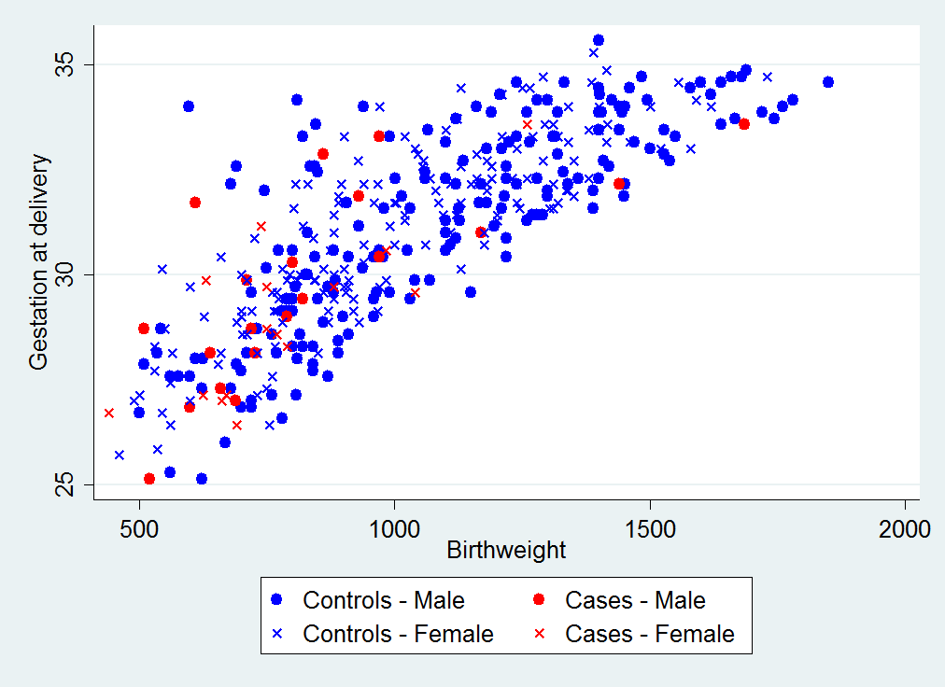
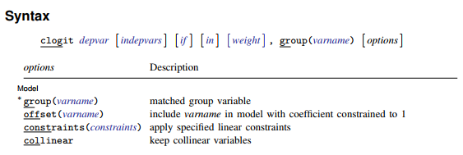
Analysis of a nested matched case-control study
Matched infants can be compared by their exposures up until that point in time.
Analysing involves estimating odds ratios in the underlying cohort that are controlled for time, as well as the matching factors.
Using conditional logistic regression one can adjust for further covariates.
We matched each case to four controls with the same sex and smallest Mahalanobis distance based on gestational age and birthweight.
We adjusted for trial arm in the analysis using conditional logistic regression.
Notes:
At each time point one can estimate an odds ratio between the exposure status (at that time) and the outcome status (at that time).
The simplest way to analyse the nested case-control design is through a conditional logistic regression model which estimates odds ratios which implicitly are adjusted for time and the matching factors. In addition, covariates can be added to the conditional logistic regression model to further adjust for other covariates.
We matched infants to four controls with the same sex and the minimum (Malhalonbis distance) based on gestational age and birthweight. The reason for this (as exemplified in the scatter plot of birthweight and gestational age below) is the strong correlation between the two. Also, note the tendency of NEC infants to be located in the bottom left corner of the graph – evidence of their strong association with the development of NEC.
Trial arm was adjusted for as a covariate in the conditional logistic regression.

Slide 15
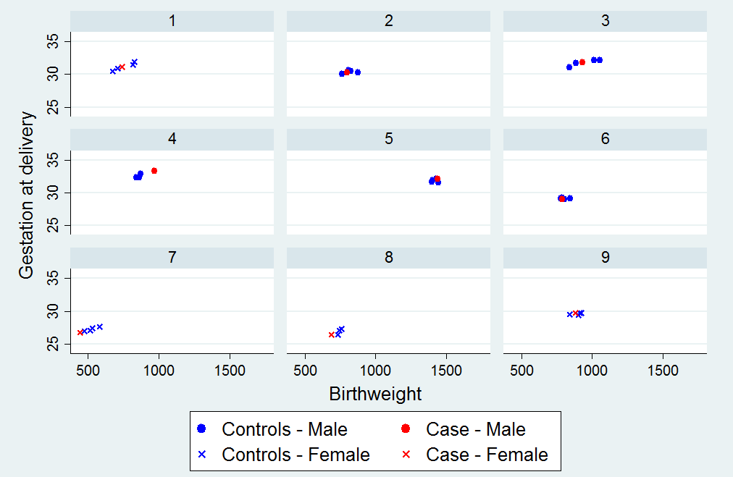
Notes:
These scatter plots show the same gestational age vs birthweight relationship as on the previous slide but this time each box represents an individual case of NEC (and the four matched controls).
It is clear, the matching algorithm has done its job – each infant is matched to one of the same sex with very similar sex and gestational age.

Slide 16
Baseline characteristics of matched controls
Matching factors are shaded
 | Controls (n = 363) | Matched controls (n = 140)¹ | Cases (Severe NEC) (n = 35)
Allocated to early arm, n (%) | 182 (50.1) | 74 (52.9) | 17 (48.6)
Male sex, n (%) | 193 (53.2) | 80 (57.1) | 20 (57.1)
Gestational age (weeks)
Median (IQR) | 32 (29 to 33) | 29 (28 to 31) | 29 (27 to 31)
<29 weeks | 69 (19.0) | 61 (43.6) | 16 (45.7)
Birthweight (grams)
Median (IQR) | 1030 (810 to 1280) | 780 (695 to 890) | 750 (660 to 931)
<750 g | 57 (15.7) | 53 (37.9) | 17 (48.6)
Multiple pregnancy, n (%)
Twins | 83 (22.9) | 26 (18.6) | 5 (14.3)
Triplets | 6 (1.7) | 3 (2.1) | 0
CPAP² at trial entry , n (%) | 122 (33.6) | 78 (55.7) | 22 (62.9)
¹109 unique controls. Each index case is matched to 4 controls with the same sex and the smallest distance in terms of the Malhalanobis distance based on gestational age and birthweight. For cases where the distance is the same, infants are selected at random.
²Continuous positive airway pressure
Notes:
Not quite so visually appealing, but this table is just as exciting! This shows the baseline characteristics of the matched controls compared to the case (columns 2 and 3), while the first column is the actual pure-control population (infants who never get NEC).
Note the much improved balance of not only the matching factors, but also other correlated characteristics.
Also, as a side note, notice that 140 controls are selected, but only 109 are unique controls (some infants have been sampled more than once).

Slide 17
Discussion points
Selecting the appropriate number of controls
Implication of including future cases as controls
The dilemma of matching/adjusting for allocation

Slide 18
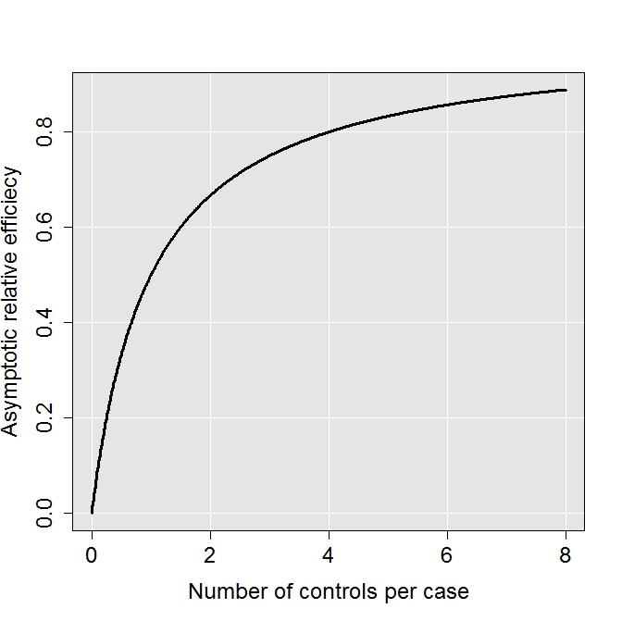
Discussion points
1. Selecting the appropriate number of controls
Convention is to select four controls per case
However we are not restricted by financial or time constraints so could match to every available control?
What about the potentially adverse impact of many duplicated observations?
In previous example, of 140 matched controls:
  84 infants were used once
  19 were used twice
  6 were used 3 times
Duplication likely to occur for infants with lower birthweight and gestational ages
Notes:
Convention is to select four controls for each case. This is based on the diminishing returns of the asymptotic relative efficiency (each additional control adds less value than the previous one).
However, one of the reasons for this convention is that in the typical use of a nested case-control study there is some cost (financial or time) associated with taking samples.
In this case, there is no burden in selecting more controls so why not select every control possible?
We were particular uneasy about the reuse of controls. The more controls we sample per case, the more duplicates we have in our matched control population. We were particularly worried that this duplication of infants was likely to occur mainly in the lower birthweight and gestation infants (which in turn would increase the chance of selecting more future cases) and the impact this would have on interpretation of the odds ratio.

Slide 19
Discussion points
2. Implication of including future cases as controls
 | Controls (n = 363) | Matched controls (n = 140)* | Cases (Severe NEC) (n = 35)
Allocated to early arm, n (%) | 182 (50.1) | 74 (52.9) | 17 (48.6)
Male sex, n (%) | 193 (53.2) | 80 (57.1) | 20 (57.1)
Gestational age (weeks)
Median (IQR) | 32 (29 to 33) | 29 (28 to 31) | 29 (27 to 31)
<29 weeks | 69 (19.0) | 61 (43.6) | 16 (45.7)
>=29 weeks | 294 (81.0) | 79 (56.4) | 19 (54.3)
Birthweight (grams)
Median (IQR) | 1030 (810 to 1280) | 780 (695 to 890) | 750 (660 to 931)
<750 g | 57 (15.7) | 53 (37.9) | 17 (48.6)
>=750 g | 306 (84.3) | 87 (62.1) | 18 (51.4)
A diagnosis of severe NEC, n (%) | 0 (0.0) | 8 (5.7) | 35 (100.0)
Missing | 0 | 0 | 0
*109 unique controls. Each index case is matched to 4 controls with the same sex and the smallest distance in terms of the Malhalanobis distance based on gestational age and birthweight. For cases where the distance is the same, infants are selected at random.
8 future cases were used as matched controls (these infants later went on to develop NEC)
Literature warns against the exclusion of future cases – leads to biased effect estimates.¹
¹Essebag, V., et al., The nested case-control study in cardiology. American Heart Journal, 2003. 146(4): p. 581-590.
Notes:
The table is the same as one presented earlier, but has a new row – any diagnosis of severe NEC. This shows that 8 future cases were incorporated into the matched controls (not too bad) but should be concerned about letting this get too high.
The literature warns against the exclusion of future cases on the grounds that this leads to a biased estimate of the odds ratio, however, it’s not clear to me (having read the paper) the reason for this and the implications on interpreting the results.

Slide 20
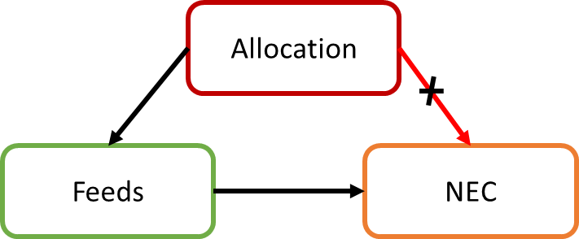
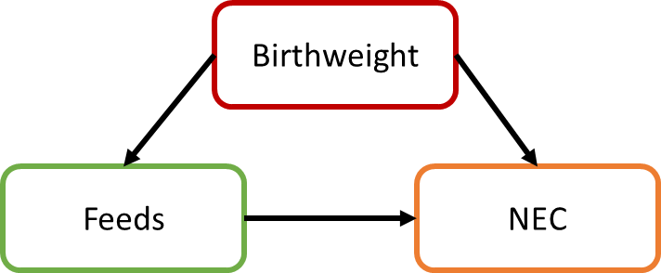
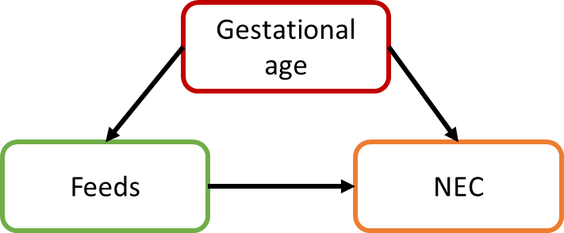
Discussion points
3. Matching/adjusting for allocation
Overmatching
A potentially critical fault in a matched case-control study caused by inappropriate selection of matching factors.
Consequences of overmatching
Loss of efficiency
Bias - because the controls become more similar to the cases in regard to exposure
Confounder
Exposure
Outcome
Notes:
One of the other worries we had was the possibility of over matching (caused by inappropriate selection of matching factors). Birthweight and gestational age were pretty uncontroversial, but adjustment by trial arm was an interesting one. Clearly has a major effect on the exposure, since it directly impacts the feeding regime (and thereby the infants chances of exposure) but the trial demonstrated no evidence of association with the outcome (NEC) so this would lead to overmatching.

Slide 21
References
Leaf, A., et al., Early or Delayed Enteral Feeding for Preterm Growth-Restricted Infants: A Randomized Trial. Pediatrics, 2012. 129(5): p. e1260-e1268.
Walsh, M.C. and R.M. Kliegman, Necrotizing enterocolitis: treatment based on staging criteria. Pediatr Clin North Am, 1986. 33.
Ernster, V.L., Nested Case-Control Studies. Preventive Medicine, 1994. 23(5): p. 587-590.
Essebag, V., et al., The nested case-control study in cardiology. American Heart Journal, 2003. 146(4): p. 581-590.
Essebag, V., et al., Comparison of nested case-control and survival analysis methodologies for analysis of time-dependent exposure. BMC Medical Research Methodology, 2005. 5(1): p. 5.
Graham, D.J., et al., Risk of acute myocardial infarction and sudden cardiac death in patients treated with cyclo-oxygenase 2 selective and non-selective non-steroidal anti-inflammatory drugs: nested case-control study. The Lancet, 2005. 365(9458): p. 475-481.

