Slide 1
Research funding opportunities for Statisticians & Methodologists
Medical
^
Dr Göher Ayman
Research Facilitator, NPEU
goher.ayman@npeu.ox.ac.uk
01895 (2) 89757

Slide 2

Principal Investigator (PI) | Independent research leader
Fellowship | Investment in you as an independent researcher, or to become one. Tenure positions, or the next step towards, are expected as a result.
Grant | Funding for a research project/programme. PI is the lead for the project, AKA Chief Investigator Or, can be small awards e.g. travel, small projects, partial funding e.g. equipment.

Slide 3

What career stage?
Trial design/ surrogate endpoints/ secondary data analysis/ systematic reviews/ meta-analyses/ risk factors/ interventions/ parameter estimation/ methodology development/ statistical processes/ applications/ inference/ big data/ medical/ healthcare/ population/ genetics/ physics/ technology…
Student
PhD
Postdoc ECR
Senior Professor

Slide 4








Grants (some)
CHECK REMIT & ELIGIBILITY
Methodology
Research Project
SWATs (HTA)
RfPB
Research on Research
Starting Grant
New Investigator Scheme
New investigator/Research
SDAI
New Investigator Award

Slide 5


Fellowships (some)
CHECK REMIT & ELIGIBILITY
Doctoral
Advanced
Skills Development
Career Development Award
Future leaders
ESRC-Alan Turing Institute Joint
Post-doc (via DTP)
Early Career
Sir Henry Wellcome Postdoctoral
Sir David Phillips
Discovery
David Sainsbury
Post-doc/ECR
University Research

Slide 6

Also consider…
CHECK REMIT & ELIGIBILITY
Training fellowships/opportunities:
MRC Skills Dev., NC3Rs Training, NIHR Career Dev., UKRI Doctoral Training Partnerships (DTPs) and Centres for Doctoral Training (CDTs)
International opportunities:
Marie S-Curie, Wellcome International Fellowships, NIH
University/divisional/departmental
ISSF
John Fell
CDFs (Dept) & JRFs (College)
NDPH Pump Priming, BHF CRE, etc…
Oxford BRC
Charities, Industry (incl. international) & Cross-funding
Other areas e.g. Public Engagement
Proof of concept
Pump priming
Small (& med) projects
Discipline hopping
Return to work/Carers
Skills/development
Travel & exchanges
Knowledge exchange
Public engagement
Conferences/courses
etc…

Slide 7
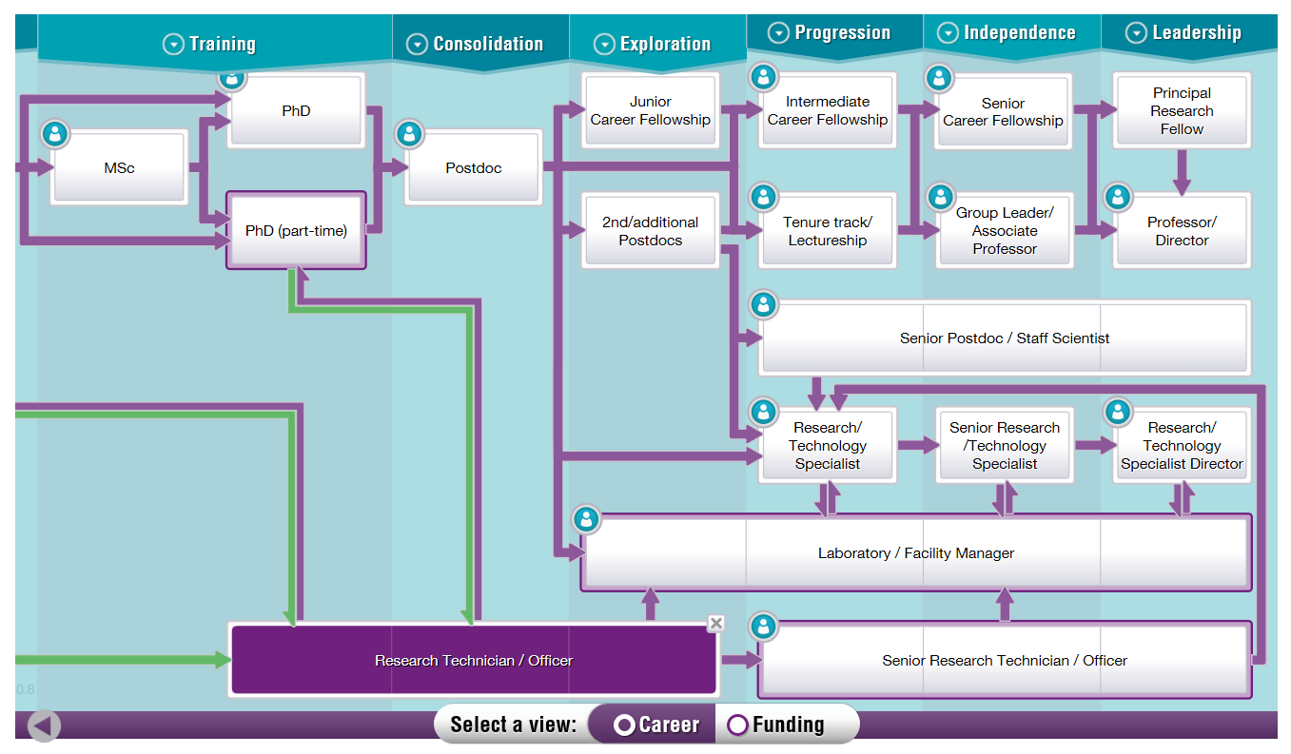
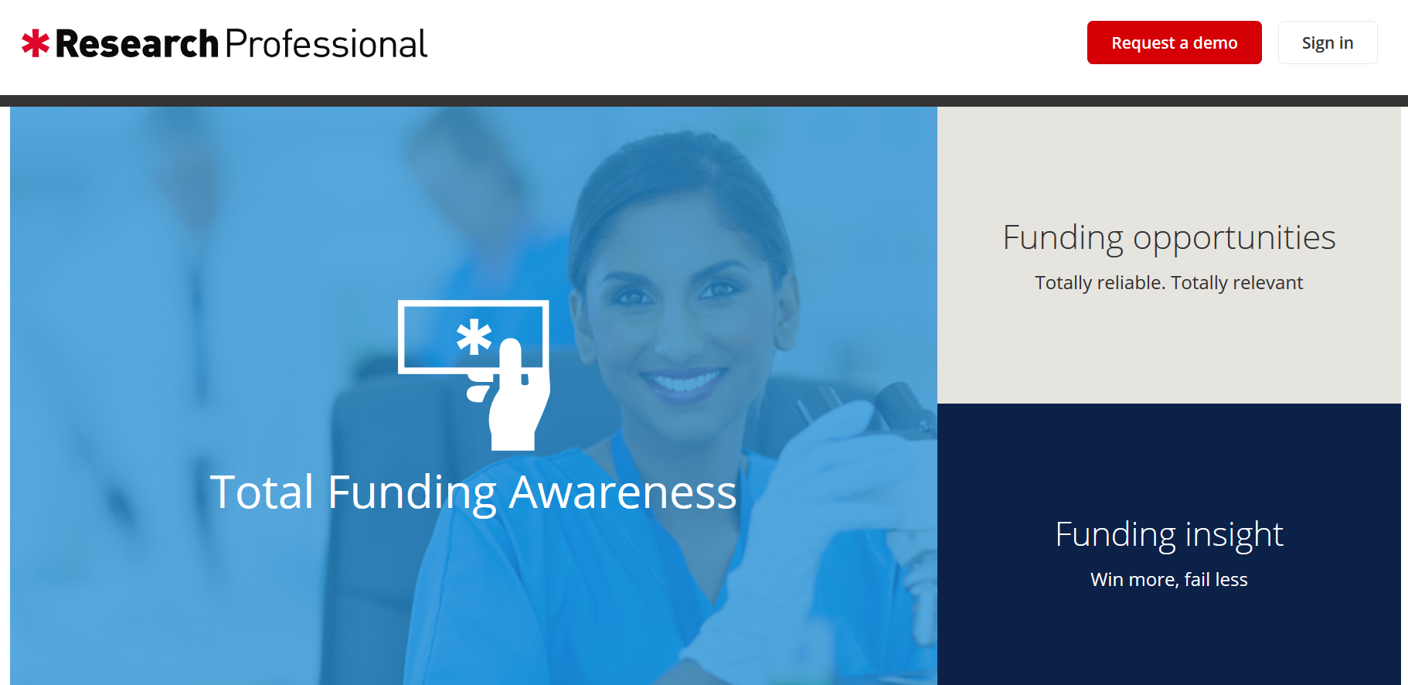

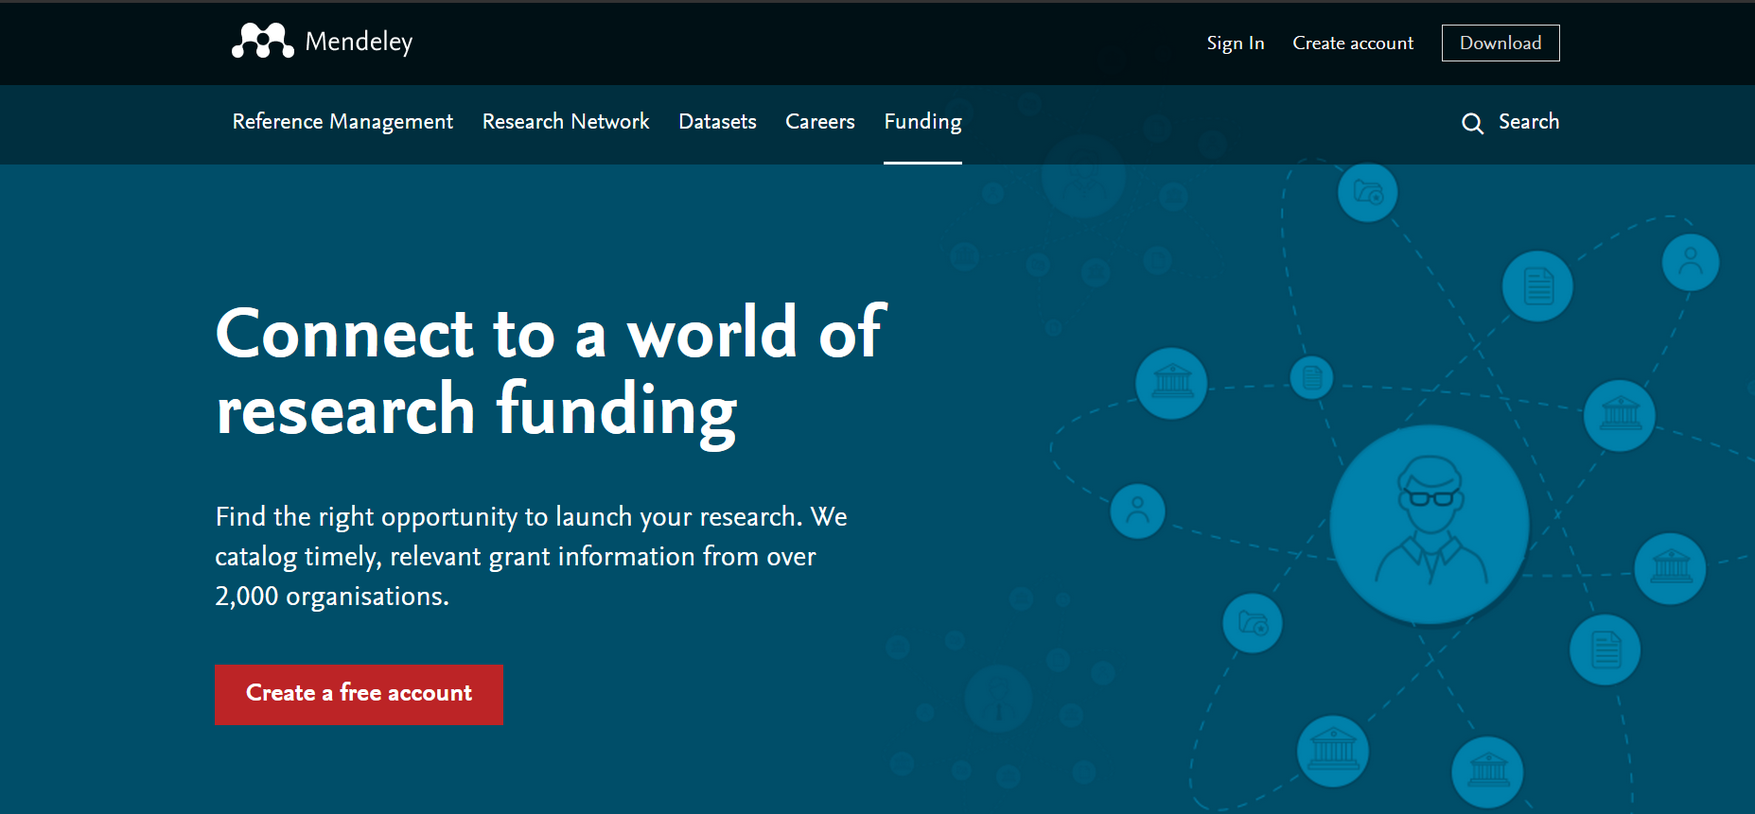
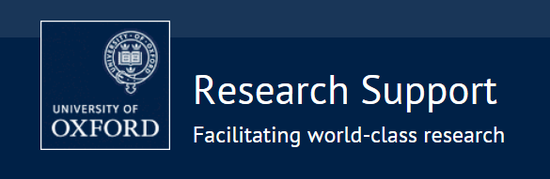
Ways to find funding
https://mrc.ukri.org/skills-careers/interactive-career-framework/
Choosing the right fellowship and relevant skills needed
http://info.researchprofessional.com/
https://www.medsci.ox.ac.uk/research/internal
https://researchsupport.admin.ox.ac.uk/funding/
List of popular science fellowships
https://www.mendeley.com/funding
EC and Global opportunities – get advice!

Slide 8

General pointers
Discuss any plans/applications as early as possible (>6 mo.) with:
Department/line manager
Finance
Collaborators/supervisors
Research Services
Suitability of:
You (career stage, readiness)
Institution/department/collaborators/supervisors
Costings (differences!)
Tenure and departmental commitment requirements
Flexibility/opportunities
Seek support!
CHECK REMIT & ELIGIBILITY

Slide 9

You are not alone…
Department/line manager/supervisor/mentor
Departmental Research Facilitators
RDS
Been there, done its
Research Services
Careers service
Vitae
Funder/programme managers
Training opportunities
Careers service: Fellowship Applications and Interview Skills Workshop
NIHR/RDS: FAD, EGGA, individual grant workshops/conferences, Research Methods Fellowships and Internships, webinars, Statistics Group
Royal Society of Statisticians and local RSS group
...and more!

Slide 10
