Slide 1
Teaching Opportunities in OXSTAT
Jennifer Carter
Jennifer.carter@ndph.ox.ac.uk

Slide 2
Teaching Opportunities in NDPH
Summer Lecture Series
Short Course in Statistics

Slide 3
MSc Global Health Science & Epidemiology
Intensive training in epidemiology (30 sessions) and statistics (30 sessions + 30 practicals)
14 week research placement over summer
Some more advanced techniques needed for summer placement are outside the scope of the main curriculum

Slide 4
Summer Lecture Series
Introductory lectures on more “advanced” methods that of interest to department
You choose topic or pick one from our list
~1 hour- although there is flexibility
Runs on Fridays in June and July
Great forum for 1st time lecturers
Notes:
Introductory so not statistician level – more epidemiological aimed

Slide 5
Summer Lecture Series
Aim:
Introduce audience to a new method
Example analysis
Discuss difficulties/ caveats
Provide references where can seek information/training to employ method properly
Generally not expected that attendees will receive enough information in the one hour to run a full analysis themselves

Slide 6
Summer Lecture Series
Recruiting now for Summer 2018
Looking for lectures on:
Propensity scores
Time series analysis
Network meta-analysis
Risk scores
Time updated Cox regression
Any other suggestions?
“Statistics for epidemiology”

Slide 7
Teaching Opportunities in NDPH
Summer Lecture Series
Short Course in Statistics

Slide 8
MSD Short Course: Introduction to the Principles of Statistics
One week course run twice a year
Introducing basic principles of statistics to scientists
Fully booked+ 60 people on wait list within 3 hours of opening up registration
10 lectures, 6 practicals and 1 self-directed project in R

Slide 10
Why Teach?
Opportunities are unpaid BUT…
Looks great on CV-here and elsewhere
Develop your presentation skills
Necessary on CV to apply for university promotions
It’s fun!
Inspire others on topics you are passionate about

Slide 11
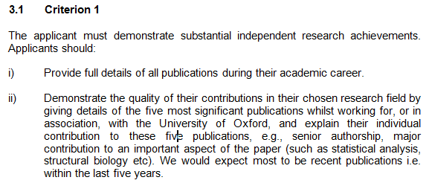
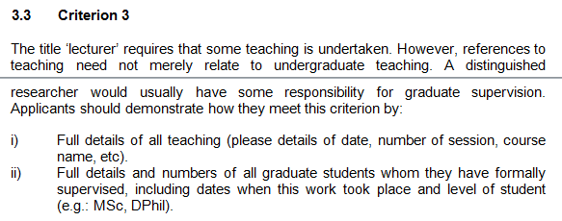
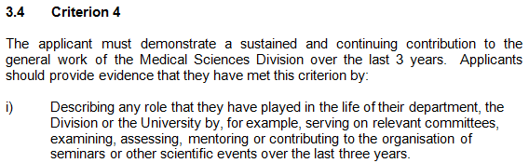
University Research Lecturership policy
(Same for Associate Professorship)
senior authorship
Why does teaching matter?
graduate supervision
contribute to… play in the life of the department

Slide 12
Contact
Jennifer Carter
Jennifer.carter@ndph.ox.ac.uk

