Slide 1
Automated Reports Using Stata
Chuck Huber, PhD
StataCorp
chuber@stata.com
Oxford University
Clinical Trials Research Unit
October 16, 2018

Slide 2
Outline
Options for Importing Data
Options for Creating Automated Reports
odbc
putdocx
Examples
  Local macros
  Conditional text
  Returned values
  Estimation results and tables of estimation results
  Tables of summary statistics
  Tables of frequencies
  Tables of raw data
  Add time, date, and other user information
  Describe and use partial datasets

Slide 3
Options for Importing Data
Copy and Paste
infile (free format without a data dictionary)
infile (fixed format with a data dictionary)
infix (fixed format without a data dictionary)
import delimited
import excel
import sasxport
import dbase
use partial datasets
odbc (Open Database Connectivity)

Slide 4
Options for Creating Automated Reports
markdown, dyndoc, dyntext
putexcel
putdocx
putpdf

Slide 5
Creating Automated Reports
We will focus on:
  odbc to import data
  putdocx to create reports.

Slide 6

Outline
Options for Importing Data
Options for Creating Automated Reports
odbc
putdocx
Examples
  Local macros
  Conditional text
  Returned values
  Estimation results and tables of estimation results
  Tables of summary statistics
  Tables of frequencies
  Tables of raw data
  Add time, date, and other user information
  Describe and use partial datasets

Slide 7
Open Database Connectivity (ODBC)
ODBC is a standardized set of function calls for accessing data stored in both relational and non-relational database-management systems.
Advantages
  Confidential data are stored in a secure database at all times
  Password can be submitted from the ODBC client (Stata)
  No need to export data from the database
  Can access data using SQL queries
  Data are always up-to-date

Slide 8
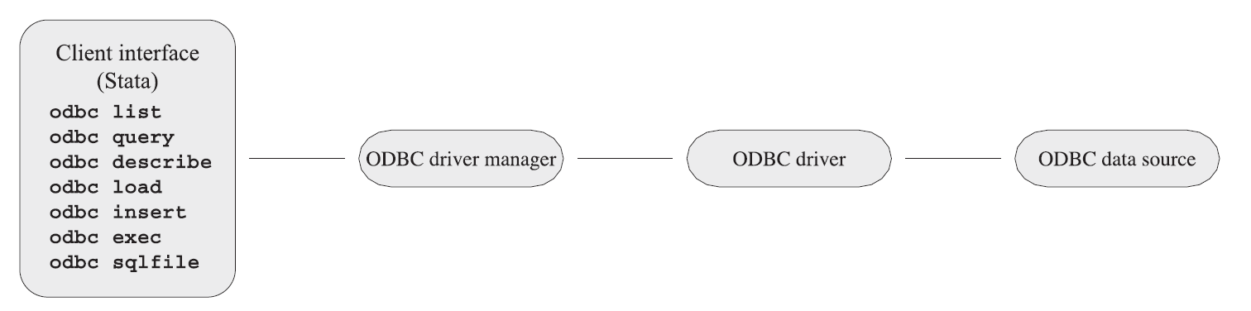
Open Database Connectivity (ODBC)
ODBC’s architecture consists of four major components :
  The client interface (such as Stata)
  The ODBC driver manager
  The ODBC drivers
  The data sources

Slide 9
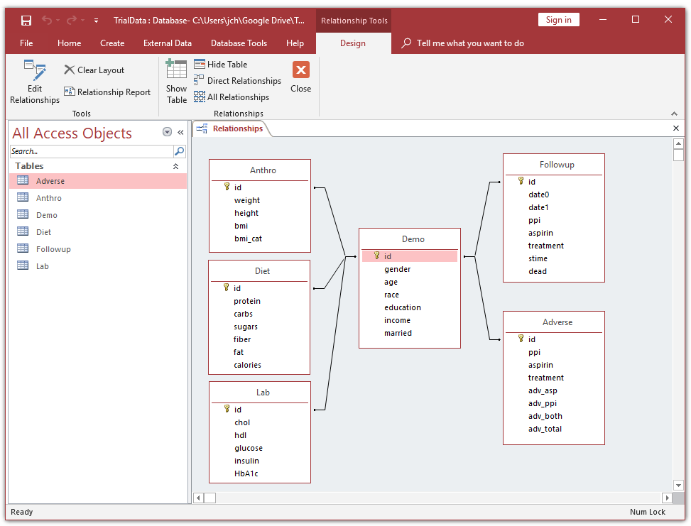
Microsoft Access Database

Slide 10
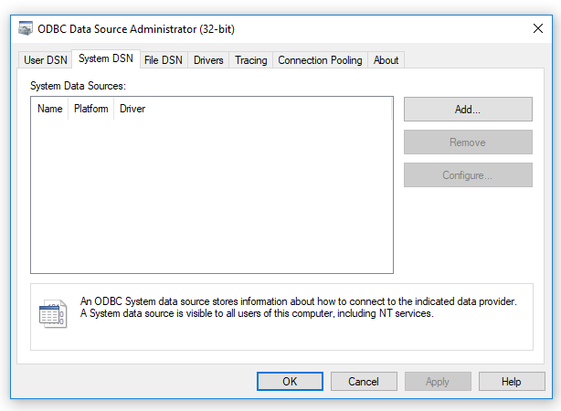
Windows 10 ODBC Driver Manager
Start > Windows Administrative Tools > ODBC Data Sources

Slide 11
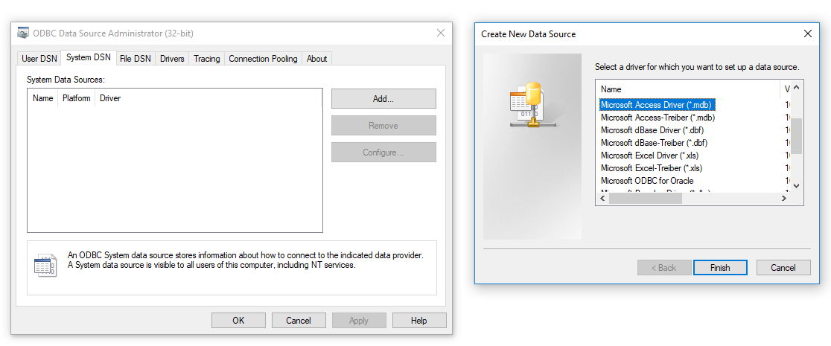
Windows 10 ODBC Drivers

Slide 12
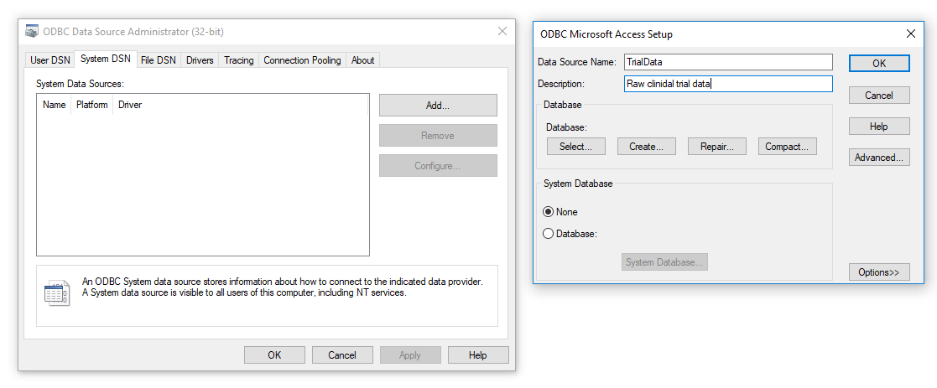
Setup ODBC in Windows 10

Slide 13
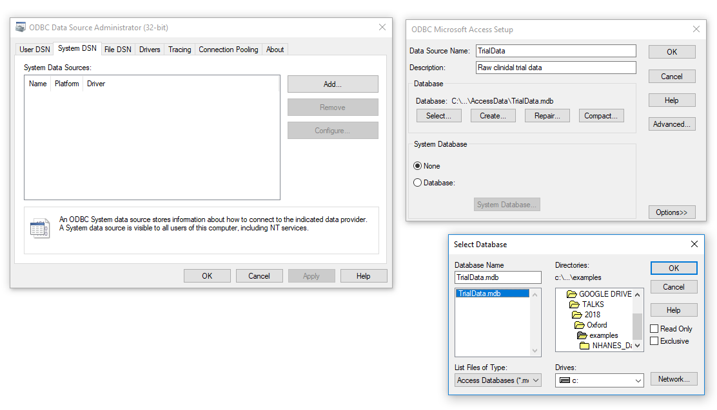
Setup ODBC in Windows 10

Slide 14
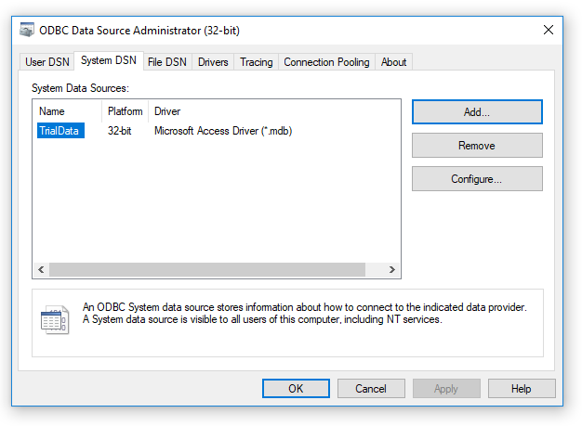
Setup ODBC in Windows 10

Slide 15
Some ODBC Commands in Stata
odbc list - List ODBC sources to which Stata can connect
odbc query - Retrieve available names from specified data source
odbc describe - List column names and types associated with specified table
odbc load - Import data from an ODBC data source
odbc insert - Export data to an ODBC data source
odbc exec("SqlStmt") – Issue SQL statements directly to ODBC data source
odbc sqlfile("filename") - Batch job alternative to odbc exec

Slide 16
Using ODBC in Stata

Slide 17
ODBC Data

Slide 18
ODBC Data

Slide 19
ODBC Data

Slide 20
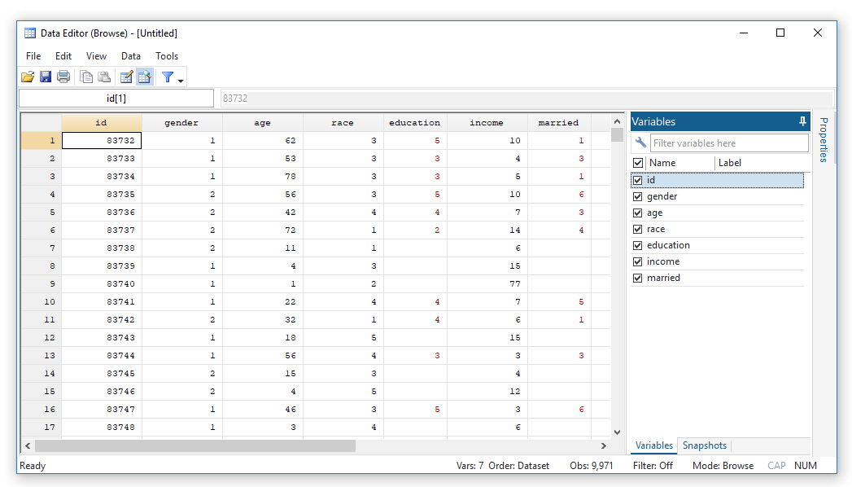
SQL Queries From Stata
odbc load, exec("SELECT Demo.* FROM Demo") dsn("TrialData")

Slide 21
SQL Queries From Stata
#delimit ;
local sqlcmd "SELECT Demo.id , Demo.gender, Demo.age, Demo.race,
Demo.education, Demo.income, Demo.married,
Anthro.weight, Anthro.height, Anthro.bmi,
Anthro.bmi_cat,
Diet.protein, Diet.carbs, Diet.sugars,
Diet.fiber, Diet.fat, Diet.calories,
Lab.chol, Lab.hdl, Lab.glucose, Lab.insulin, Lab.HbA1c,
Adverse.adv_asp, Adverse.adv_ppi, Adverse.adv_both,
Adverse.adv_total,
Followup.date0, Followup.date1, Followup.ppi,
Followup.aspirin, Followup.treatment , Followup.stime,
Followup.dead
FROM ((((Demo INNER JOIN Anthro ON Demo.[id] = Anthro.[id])
INNER JOIN Diet ON Demo.[id] = Diet.[id])
INNER JOIN Followup ON Demo.[id] = Followup.[id])
INNER JOIN Lab ON Demo.[id] = Lab.[id])
INNER JOIN Adverse ON Demo.[id] = Adverse.[id];"
;
#delimit cr
odbc load, exec(`"`sqlcmd'"' ) dsn("TrialData") clear

Slide 22
SQL Queries From Stata
odbc sqlfile(“query.sql"), dsn("TrialData“)
query.sql
SELECT Demo.id, Demo.gender, Demo.age, Demo.race,
Demo.education, Demo.income, Demo.married,
Anthro.weight, Anthro.height, Anthro.bmi, Anthro.bmi_cat,
Diet.protein, Diet.carbs, Diet.sugars,
Diet.fiber, Diet.fat, Diet.calories,
Lab.chol, Lab.hdl, Lab.glucose, Lab.insulin, Lab.HbA1c,
Adverse.adv_asp, Adverse.adv_ppi, Adverse.adv_both, Adverse.adv_total,
Followup.date0, Followup.date1, Followup.ppi,
Followup.aspirin, Followup.treatment , Followup.stime, Followup.dead
FROM ((((Demo INNER JOIN Anthro ON Demo.[id] = Anthro.[id])
INNER JOIN Diet ON Demo.[id] = Diet.[id])
INNER JOIN Followup ON Demo.[id] = Followup.[id])
INNER JOIN Lab ON Demo.[id] = Lab.[id])
INNER JOIN Adverse ON Demo.[id] = Adverse.[id];

Slide 23
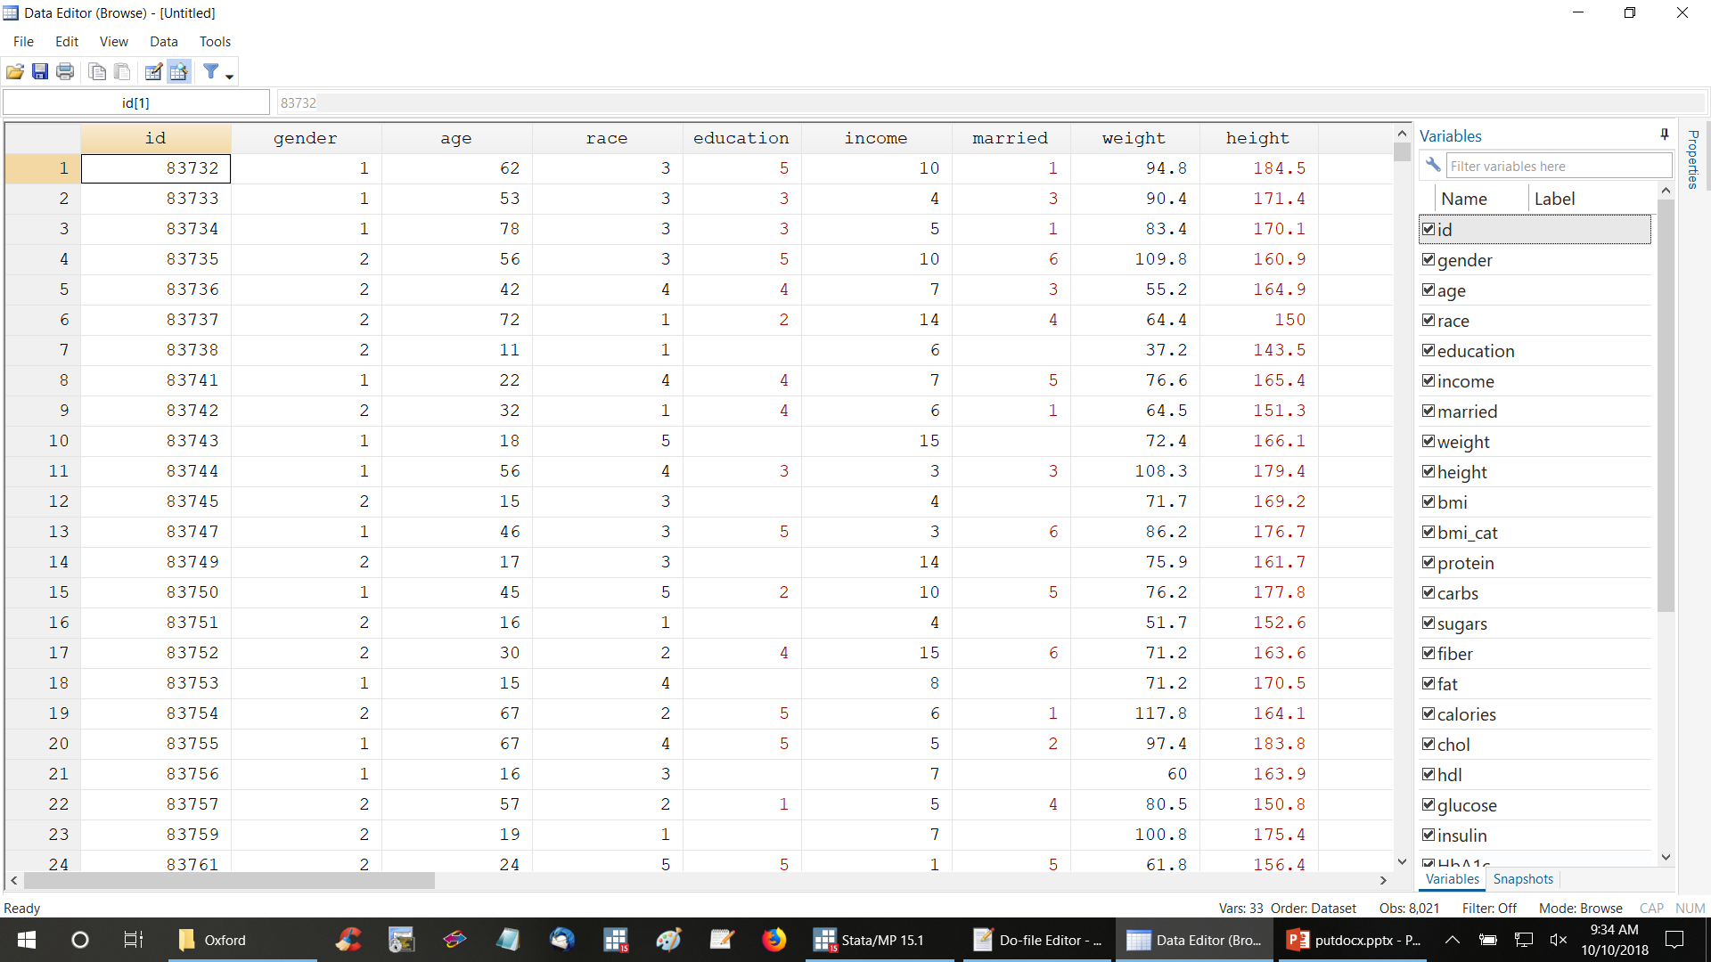
SQL Queries From Stata

Slide 24
Outline
Options for Importing Data
Options for Creating Automated Reports
odbc
putdocx
Examples
  Local macros
  Conditional text
  Returned values
  Estimation results and tables of estimation results
  Tables of summary statistics
  Tables of frequencies
  Tables of raw data
  Add time, date, and other user information
  Describe and use partial datasets

Slide 25
Some putdocx Commands
putdocx clear Close without saving
putdocx begin Create document for export
putdocx save Close and save document
putdocx paragraph Add paragraph to document
putdocx text Add text to paragraph
putdocx image Add image to paragraph
putdocx table Add table to document
putdocx pagebreak Add page break to document
putdocx sectionbreak Add section break to document
putdocx append Append content of documents

Slide 26
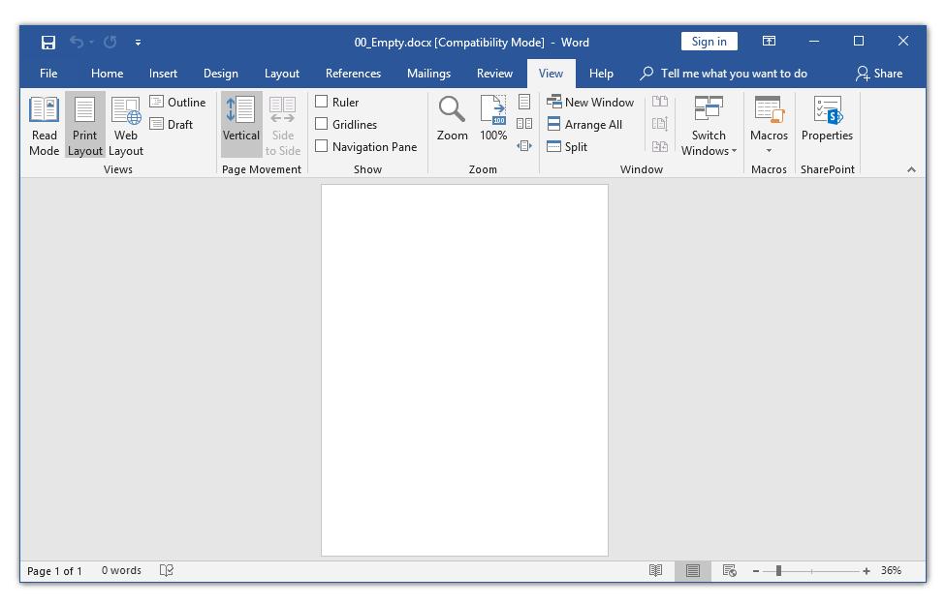
putdocx begin
putdocx clear
putdocx begin, pagesize(letter)
putdocx save "00_Empty.docx", replace

Slide 27
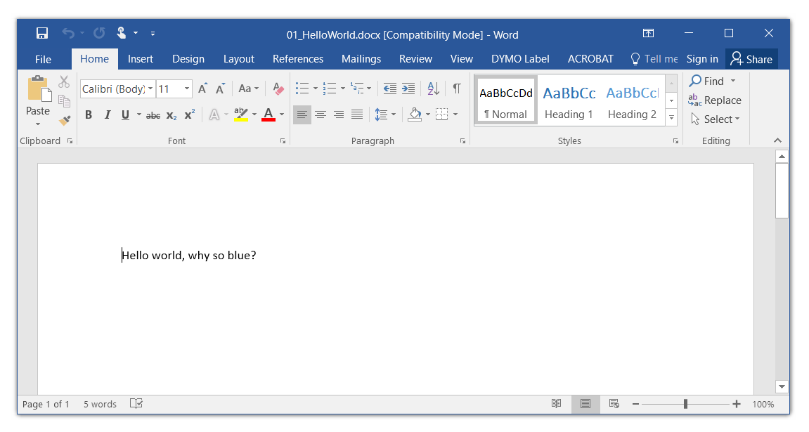
putdocx text
putdocx begin
putdocx paragraph
putdocx text ("Hello world, why so blue?")
putdocx save "01_HelloWorld.docx", replace

Slide 28
putdocx (paragraph and text options)

Slide 29
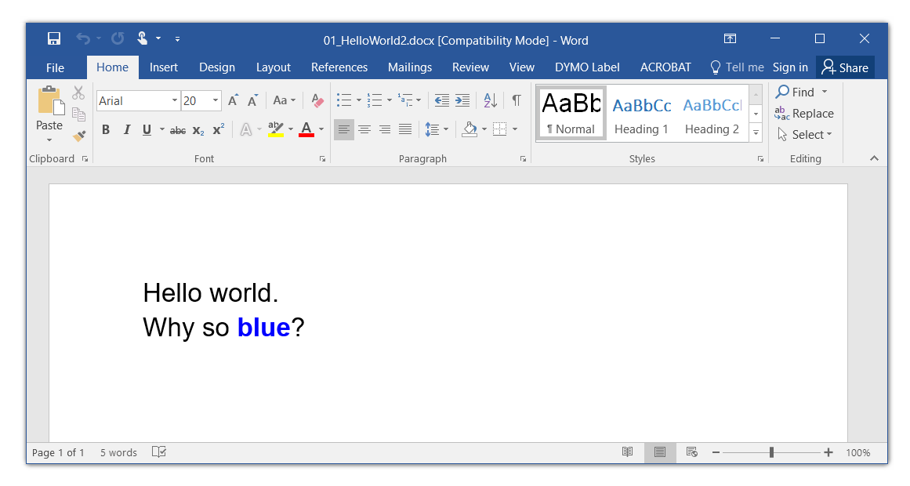
putdocx text
putdocx begin, pagesize(letter) font(Arial,20,black)
putdocx paragraph
putdocx text ("Hello world."), linebreak
putdocx text ("Why so ")
putdocx text ("blue"), font(Arial,20,blue) bold
putdocx text ("?")
putdocx save "01_HelloWorld2.docx", replace

Slide 30
putdocx image
putdocx clear
putdocx begin, pagesize(letter) font(Arial,20,black)
putdocx paragraph
regress weight c.age##i.gender i.race calories
margins gender, at(age=(20(10)80))
marginsplot, title("Expected Weight (kg) by Gender and Age") ///
subtitle("Adjusted for Race and Caloric Intake")
graph export ./graphs/02_Boxplot.png, as(png) replace
putdocx image ("./graphs/02_Boxplot.png"), width(6) height(4.5)
putdocx save "02_Marginsplot.docx", replace

Slide 31
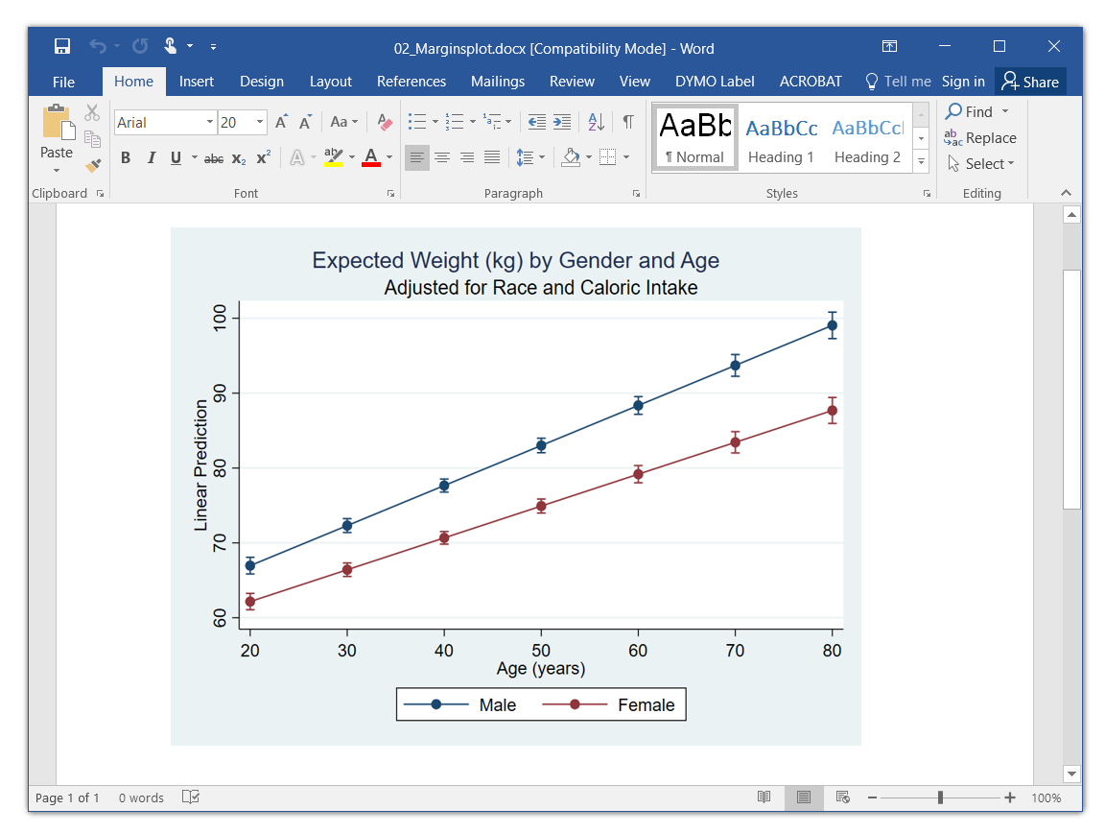
putdocx image

Slide 32
putdocx table
putdocx begin, pagesize(letter) font(Arial,16,black)
putdocx table Table1 = (3,2)
putdocx table Table1(1,1) = ("Cell 1,1")
putdocx table Table1(1,2) = ("Cell 1,2")
putdocx table Table1(2,1) = ("Cell 2,1")
putdocx table Table1(2,2) = ("Cell 2,2")
putdocx table Table1(3,1) = ("Cell 3,1")
putdocx table Table1(3,2) = ("Cell 3,2")
putdocx save "05_TableManual.docx", replace

Slide 33
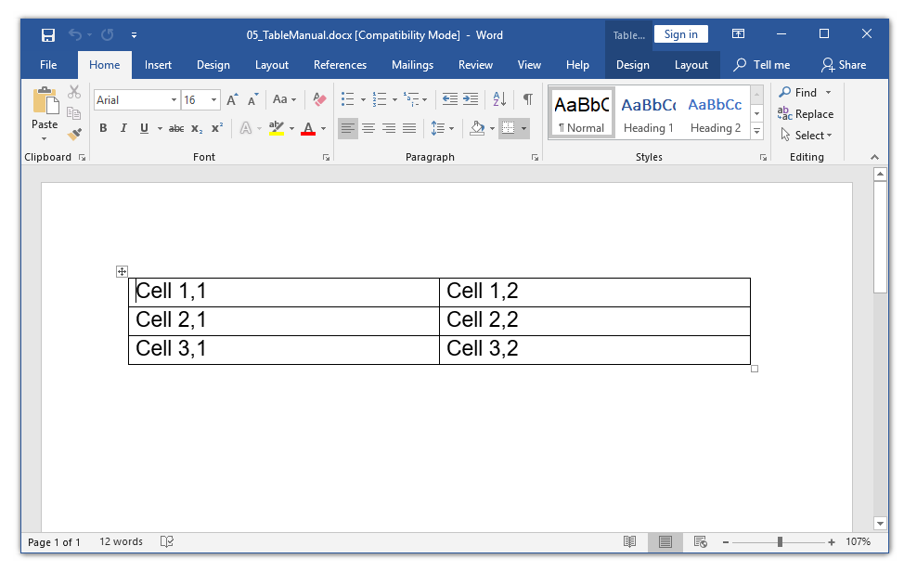
putdocx table

Slide 34
putdocx table (options)

Slide 35
putdocx table (options)

Slide 36
putdocx table (options)
putdocx begin, pagesize(letter) font(Arial,16,black)
putdocx table Table1 = (3,2)
putdocx table Table1(1,1) = ("Cell 1,1"), halign(left) font(Arial,16,red)
putdocx table Table1(1,2) = ("Cell 1,2"), halign(right) font(Arial,16,green)
putdocx table Table1(2,1) = ("Cell 2,1"), halign(center) bold
putdocx table Table1(2,2) = ("Cell 2,2"), italic shading(yellow)
putdocx table Table1(3,1) = (3.1415927), halign(right) nformat("%5.2f")
putdocx table Table1(3,2) = ("Cell 3,2"), border(bottom, double, green, 3pt)
putdocx save "06_TableManual.docx", replace

Slide 37
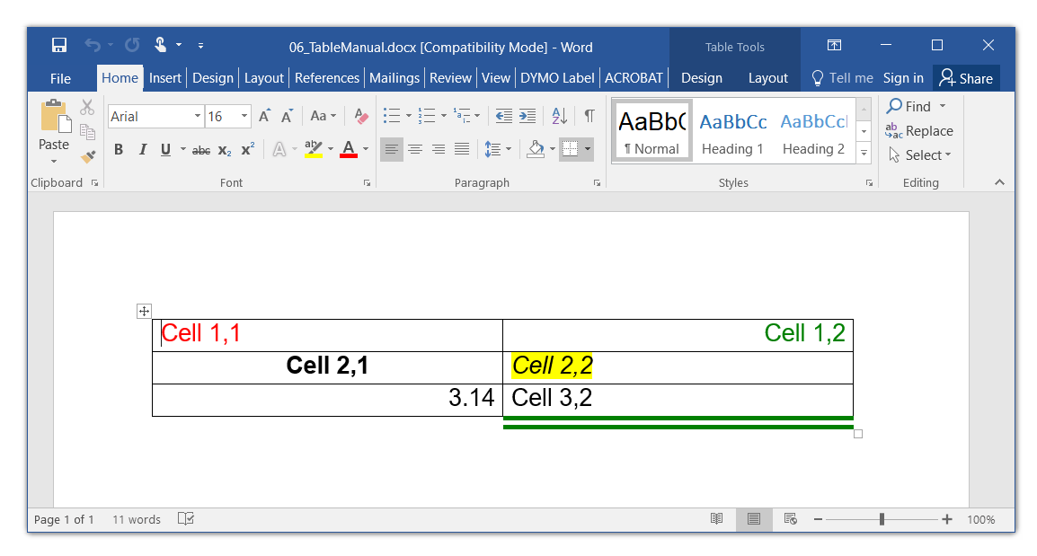
putdocx table (options)

Slide 38
putdocx table (options)
putdocx clear
putdocx begin, pagesize(letter) font(Arial,16,black)
putdocx table Table1 = (5,3)
putdocx table Table1(1,2) = ("Span Columns"), colspan(2) halign(center) bold
putdocx table Table1(2,.) , border(bottom, double, green, 3pt)
putdocx table Table1(.,1) , border(right, single, red, 3pt)
putdocx table Table1(1,2/3) , border(bottom, single, blue, 3pt)
putdocx save "07_TableManual.docx", replace

Slide 39
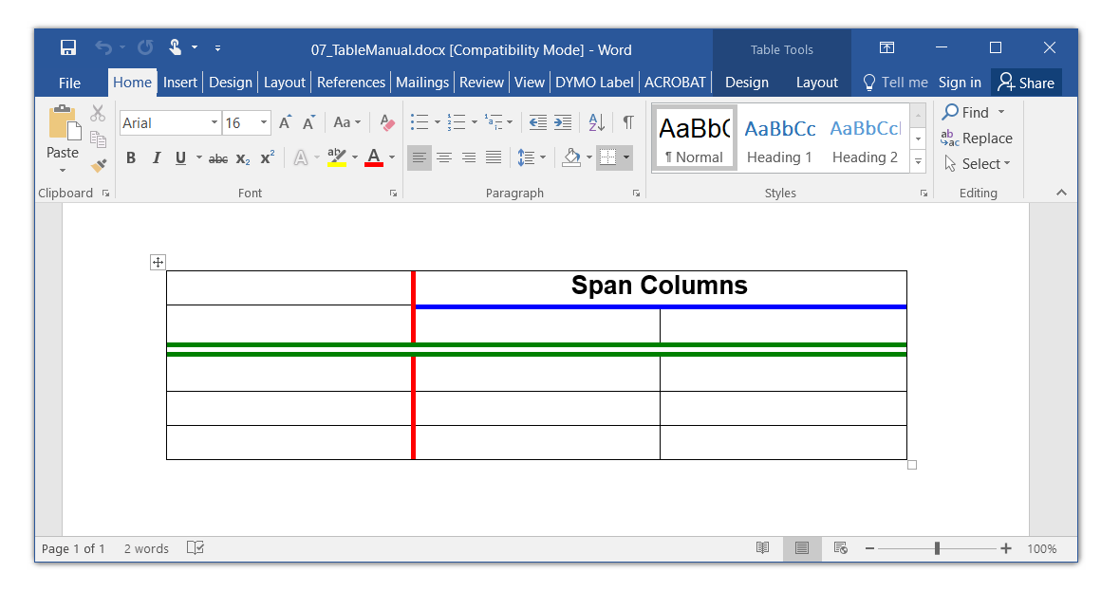
putdocx table (options)

Slide 40
Outline
Options for Importing Data
Options for Creating Automated Reports
odbc
putdocx
Examples
  Local macros
  Conditional text
  Returned values
  Estimation results and tables of estimation results
  Tables of summary statistics
  Tables of frequencies
  Tables of raw data
  Add time, date, and other user information
  Describe and use partial datasets

Slide 41
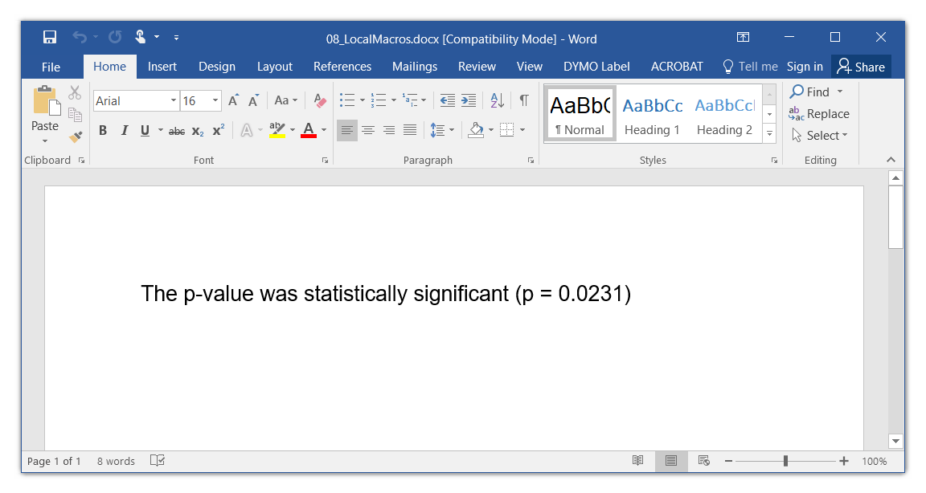
Local Macros
putdocx begin, pagesize(letter) font(Arial,16,black)
putdocx paragraph
local pvalue = 0.0231
putdocx text ("The p-value was statistically significant (p = 0`pvalue')")
putdocx save "08_LocalMacros.docx", replace

Slide 42
Outline
Options for Importing Data
Options for Creating Automated Reports
odbc
putdocx
Examples
  Local macros
  Conditional text
  Returned values
  Estimation results and tables of estimation results
  Tables of summary statistics
  Tables of frequencies
  Tables of raw data
  Add time, date, and other user information
  Describe and use partial datasets

Slide 43
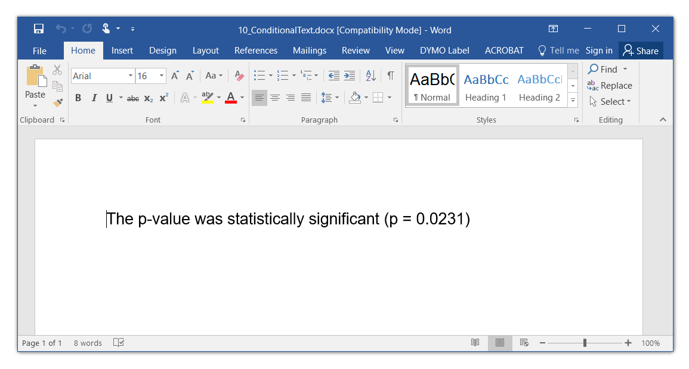
Conditional Text
putdocx begin, pagesize(letter) font(Arial,16,black)
putdocx paragraph
local pvalue = 0.0231
local significant = cond(`pvalue'<0.05, "was", "was not")
putdocx text ("The p-value `significant' statistically significant (p = 0`pvalue')")
putdocx save "10_ConditionalText.docx", replace

Slide 44
Conditional Text
putdocx begin, pagesize(letter) font(Arial,16,black)
putdocx paragraph
local pvalue = 0.0231
if `pvalue'<0.05 {
putdocx text ("The p-value was statistically significant (p = 0`pvalue'))")
}
else {
putdocx text ("The p-value was not statistically significant (p = 0`pvalue')")
}
putdocx save "08_ConditionalText.docx", replace

Slide 45
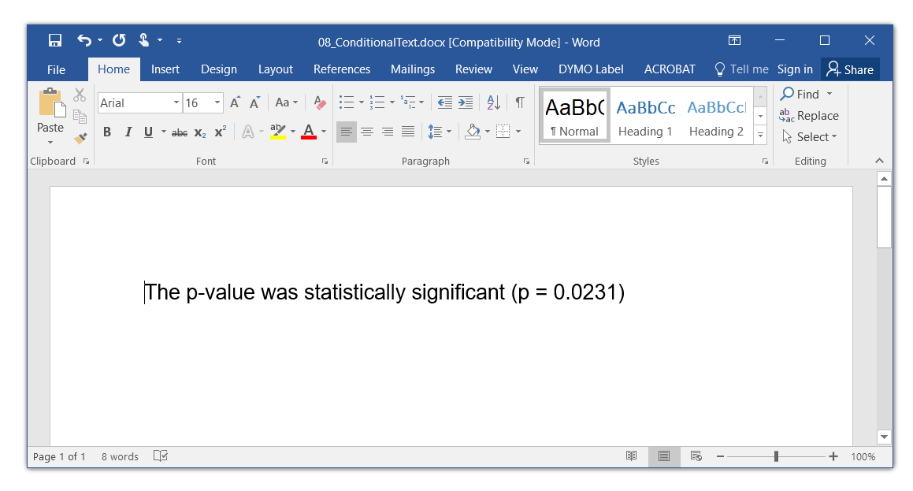
Conditional Text

Slide 46
Conditional Text
putdocx begin, pagesize(letter) font(Arial,16,black)
putdocx paragraph
local pvalue = 0.1231
if `pvalue'<0.05 {
putdocx text ("The p-value was statistically significant (p = 0`pvalue')")
}
else {
putdocx text ("The p-value was not statistically significant (p = 0`pvalue')")
}
putdocx save "09_ConditionalText.docx", replace

Slide 47
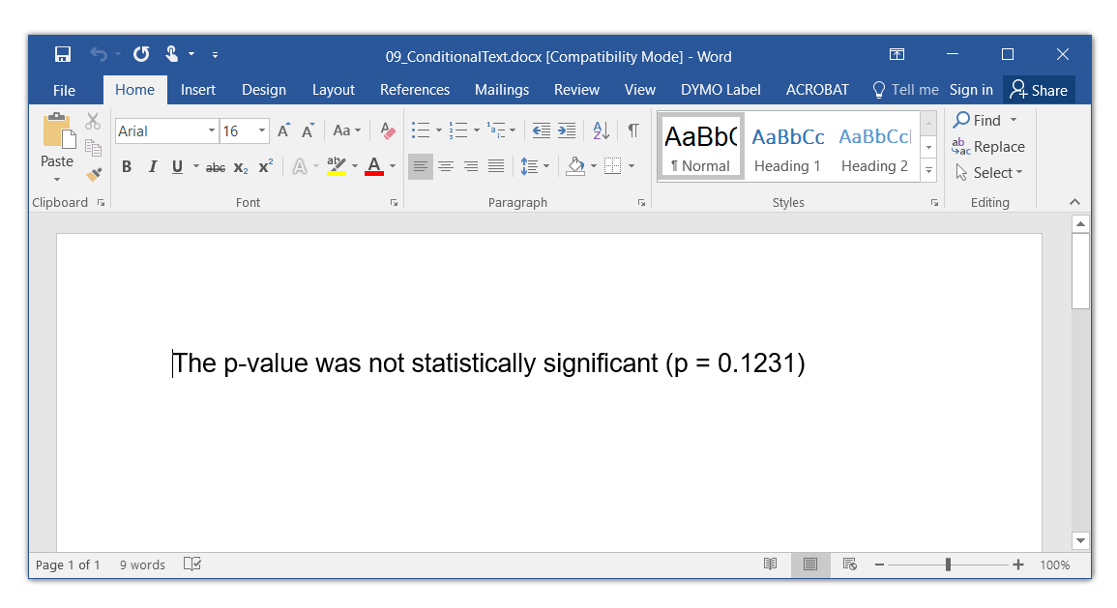
Conditional Text

Slide 48
Outline
Options for Importing Data
Options for Creating Automated Reports
odbc
putdocx
Examples
  Local macros
  Conditional text
  Returned values
  Estimation results and tables of estimation results
  Tables of summary statistics
  Tables of frequencies
  Tables of raw data
  Add time, date, and other user information
  Describe and use partial datasets

Slide 49
Returned Values

Slide 50
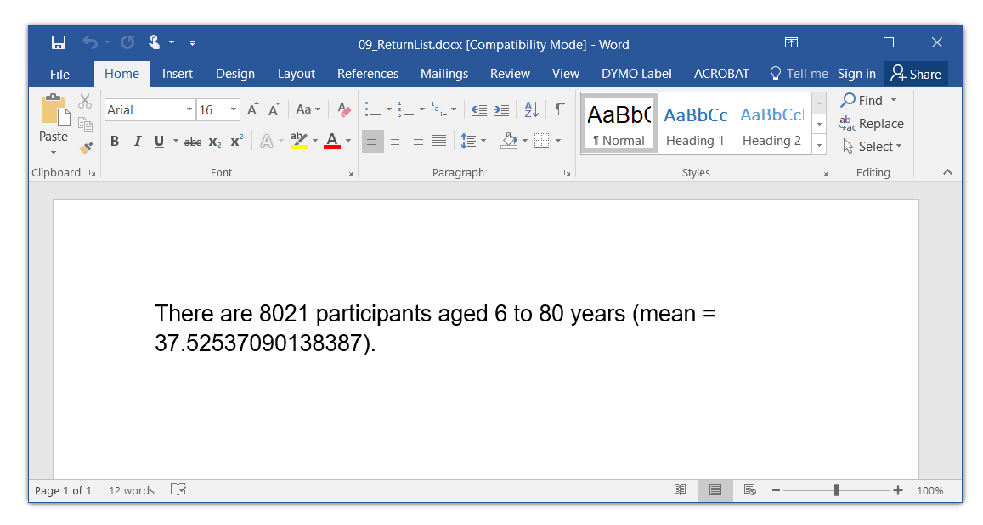
Returned Values
putdocx begin, pagesize(letter) font(Arial,16,black)
putdocx paragraph
summarize age
return list
putdocx text ("There are `r(N)' participants aged `r(min)' to ")
putdocx text ("`r(max)' years (mean = `r(mean)').")
putdocx save "09_ReturnList.docx", replace
Yuck!

Slide 51
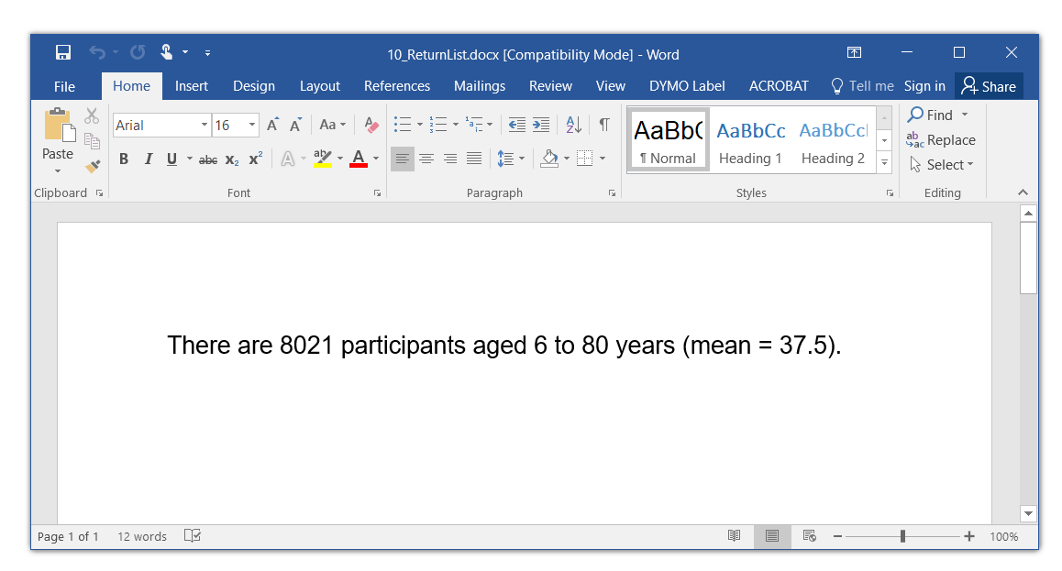
Returned Values
putdocx begin, pagesize(letter) font(Arial,16,black)
putdocx paragraph
summarize age
local mean = string(r(mean), "%5.1f")
putdocx text ("There are `r(N)' participants aged `r(min)' to ")
putdocx text ("`r(max)' years (mean = `mean').")
putdocx save "10_ReturnList.docx", replace
Better!

Slide 52
Outline
Options for Importing Data
Options for Creating Automated Reports
odbc
putdocx
Examples
  Local macros
  Conditional text
  Returned values
  Estimation results and tables of estimation results
  Tables of summary statistics
  Tables of frequencies
  Tables of raw data
  Add time, date, and other user information
  Describe and use partial datasets

Slide 53
Estimation Results

Slide 54
Estimation Results

Slide 55
Estimation Results

Slide 56
Estimation Results
putdocx begin, pagesize(letter) font(Arial,16,black)
putdocx paragraph
regress weight age
matrix RegressOutput = r(table)
local AgeBeta = string(RegressOutput[1,1], "%5.2f")
local Aget = string(RegressOutput[3,1], "%5.1f")
local Agetdf = string(RegressOutput[7,1], "%5.0f")
local AgePvalue = string(RegressOutput[4,1], "%6.4f")
local AgeDirection = cond(`AgeBeta'>0, "increase", "decrease")
local AgeSignificance = cond(`AgePvalue'<0.05, "significant", "not significant")
putdocx text ("Each additional year of age is associated ")
putdocx text ("with a `AgeBeta' kilogram `AgeDirection' in weight.")
putdocx text (" This effect was `AgeSignificance' at the 0.05 level ")
putdocx text ("(t = `Aget', df = `Agetdf', p = `AgePvalue').")
putdocx save "11_EstimationResults.docx", replace

Slide 57
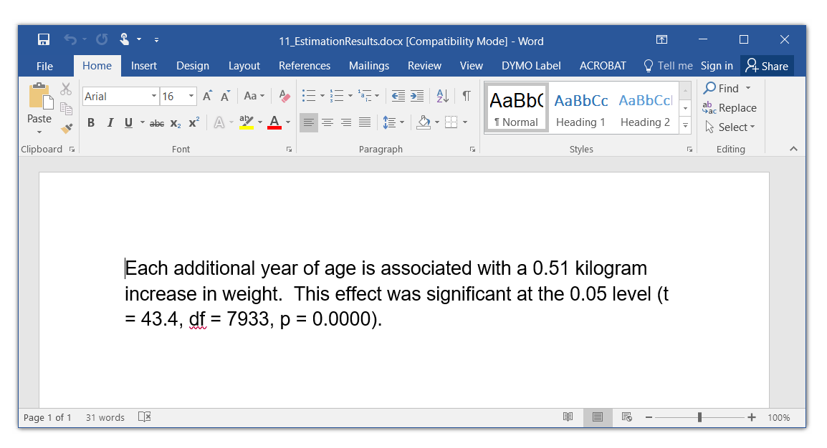
Estimation Results

Slide 58
Add a Marginsplot
putdocx begin, pagesize(letter) font(Arial,16,black)
putdocx paragraph
regress weight age
matrix RegressOutput = r(table)
margins, at(age=(20(10)80))
marginsplot, title("Regression of Weight on Age")
graph export ./graphs/03_Marginsplot.png, as(png) replace
local AgeBeta = string(RegressOutput[1,1], "%5.2f")
display "`AgeBeta'"
local Aget = string(RegressOutput[3,1], "%5.1f")
local Agetdf = string(RegressOutput[7,1], "%5.0f")
local AgePvalue = string(RegressOutput[4,1], "%6.4f")
local AgeDirection = cond(`AgeBeta'>0, "increase", "decrease")
local AgeSignificance = cond(`AgePvalue'<0.05, "significant", "not significant")
disp "`AgeSignificance'"
putdocx text ("Each additional year of age is associated ")
putdocx text ("with a `AgeBeta' kilogram `AgeDirection' in weight.")
putdocx text (" This effect was `AgeSignificance' at the 0.05 level ")
putdocx text ("(t = `Aget', df = `Agetdf', p = `AgePvalue').")
putdocx image ("./graphs/03_Marginsplot.png"), width(4) height(3)
putdocx save "11_EstimationResults2.docx", replace

Slide 59
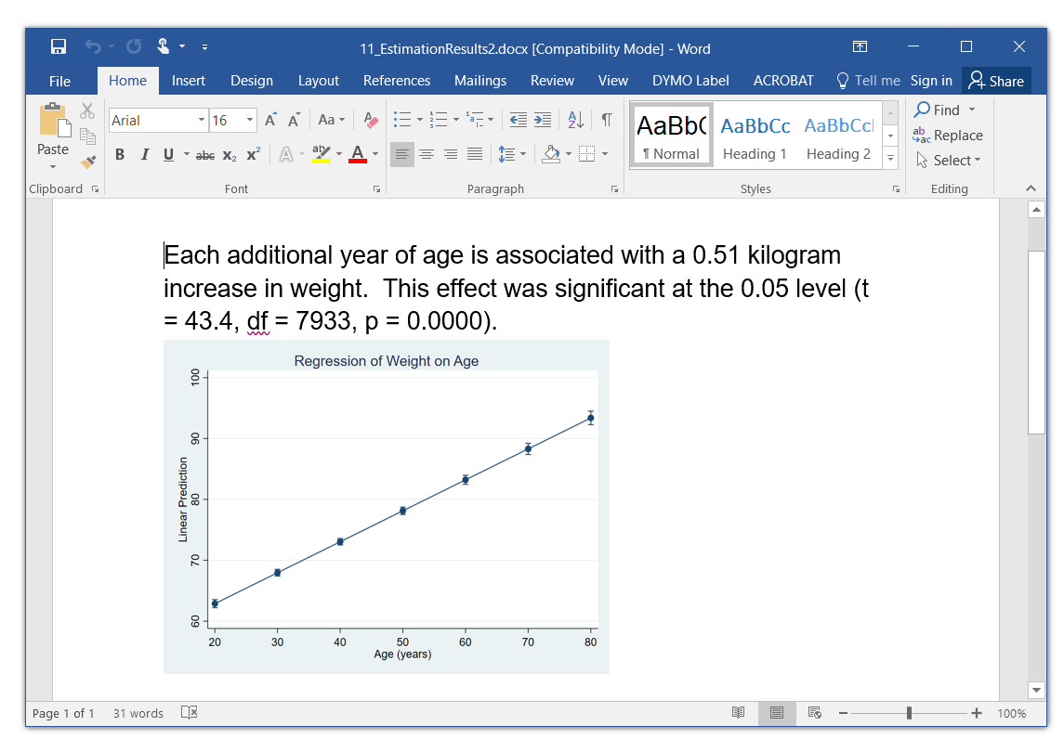
Add a Marginsplot

Slide 60
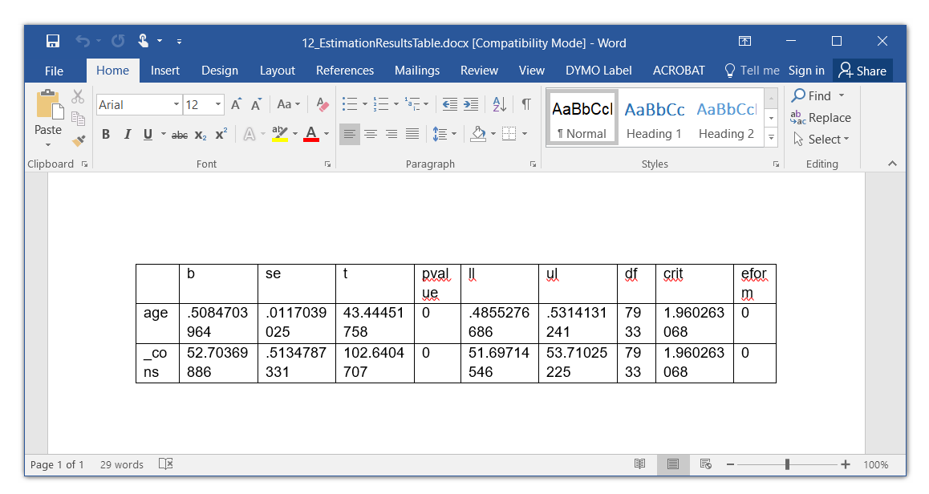
Table of Estimation Results
putdocx begin, pagesize(letter) font(Arial,12,black)
putdocx paragraph
regress weight age
matrix RegressOutput = r(table)‘
putdocx table Table1 = matrix(RegressOutput), rownames colnames
putdocx save "12_EstimationResultsTable.docx", replace

Slide 61
Table of Estimation Results
putdocx begin, pagesize(letter) font(Arial,12,black)
putdocx paragraph
regress weight age
matrix RegressOutput = r(table)'
matlist RegressOutput
putdocx table Table1 = matrix(RegressOutput), rownames colnames
putdocx table Table1(.,10), drop
putdocx table Table1(., 9), drop
putdocx table Table1(., 8), drop
putdocx save "13_EstimationResultsTable.docx", replace

Slide 62
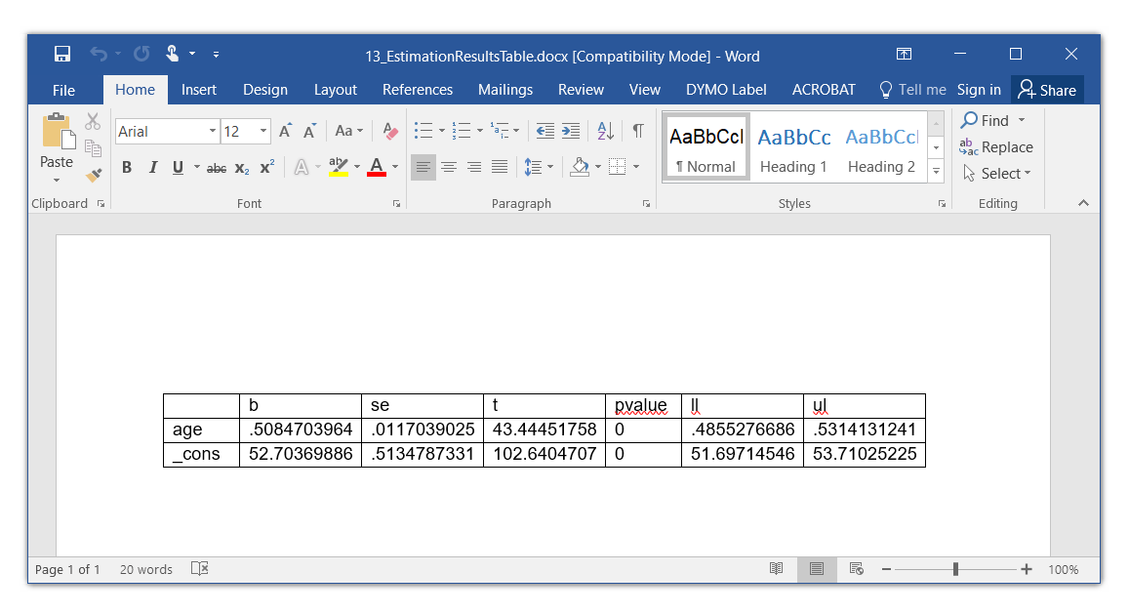
Table of Estimation Results

Slide 63
Table of Estimation Results
putdocx begin, pagesize(letter) font(Arial,12,black)
putdocx paragraph
regress weight age
matrix RegressOutput = r(table)'
matlist RegressOutput
putdocx table Table1 = matrix(RegressOutput), rownames colnames
putdocx table Table1(.,10), drop
putdocx table Table1(., 9), drop
putdocx table Table1(., 8), drop
putdocx table Table1(.,2) , nformat(%9.2f) halign(right)
putdocx table Table1(.,3) , nformat(%9.3f) halign(right)
putdocx table Table1(.,4) , nformat(%9.2f) halign(right)
putdocx table Table1(.,5/7), nformat(%9.4f) halign(right)
putdocx save "14_EstimationResultsTable.docx", replace

Slide 64
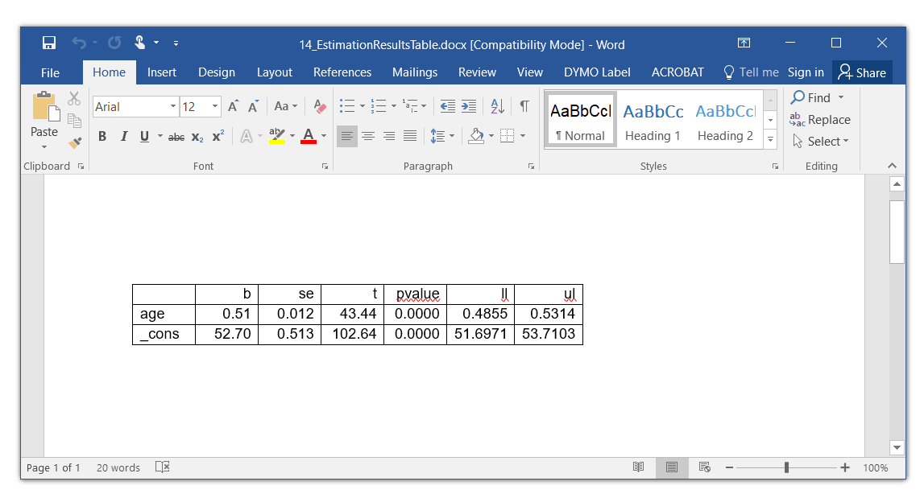
Table of Estimation Results

Slide 65
Table of Estimation Results
putdocx begin, pagesize(letter) font(Arial,12,black)
putdocx paragraph
regress weight age
matrix RegressOutput = r(table)'
matlist RegressOutput
putdocx table Table1 = matrix(RegressOutput), rownames colnames
putdocx table Table1(.,10), drop
putdocx table Table1(., 9), drop
putdocx table Table1(., 8), drop
putdocx table Table1(.,2) , nformat(%9.2f) halign(right)
putdocx table Table1(.,3) , nformat(%9.3f) halign(right)
putdocx table Table1(.,4) , nformat(%9.2f) halign(right)
putdocx table Table1(.,5/7), nformat(%9.4f) halign(right)
putdocx table Table1(.,.) , border(all, nil)
putdocx table Table1(1,.) , halign(center) bold border(bottom, single, black, 3pt)
putdocx table Table1(.,1) , halign(right) bold border( right, single, black, 2pt)
putdocx save "15_EstimationResultsTable.docx", replace

Slide 66
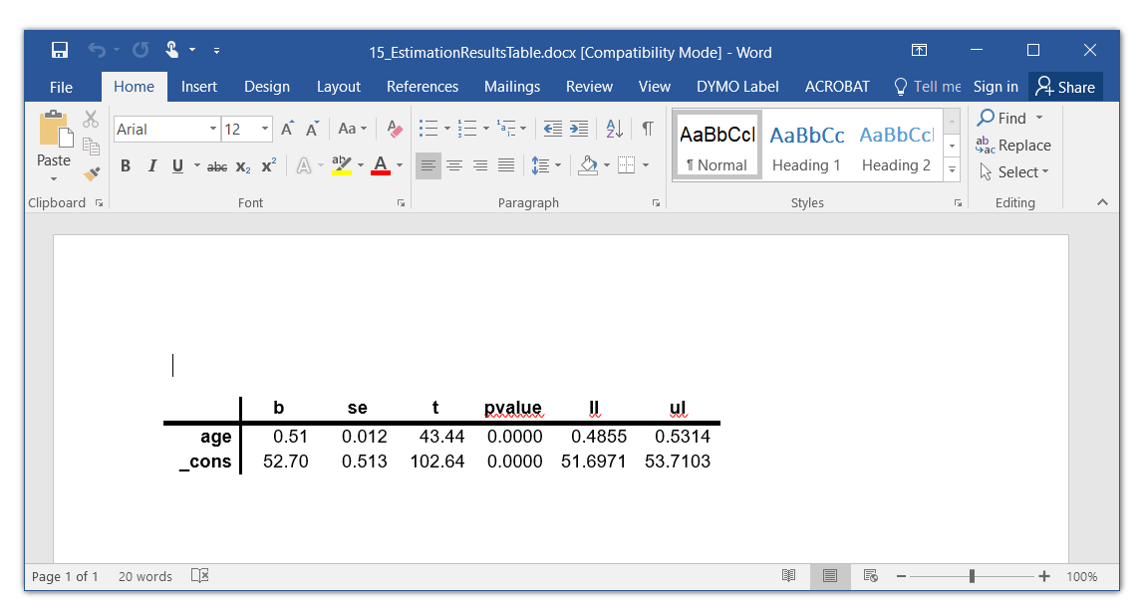
Table of Estimation Results

Slide 67
Outline
Options for Importing Data
Options for Creating Automated Reports
odbc
putdocx
Examples
  Local macros
  Conditional text
  Returned values
  Estimation results and tables of estimation results
  Tables of summary statistics
  Tables of frequencies
  Tables of raw data
  Add time, date, and other user information
  Describe and use partial datasets

Slide 68
Table of Summary Statistics

Slide 69
Table of Summary Statistics

Slide 70
Table of Summary Statistics
putdocx begin, pagesize(letter) font(Arial,12,black)
tabstat chol hdl glucose insulin HbA1c, ///
stat(count mean sd skewness kurtosis) ///
columns(statistics) save
matrix LabResults = r(StatTotal)'
putdocx table Table1 = matrix(LabResults), rownames colnames
putdocx save "04_TableMatrix.docx", replace

Slide 71
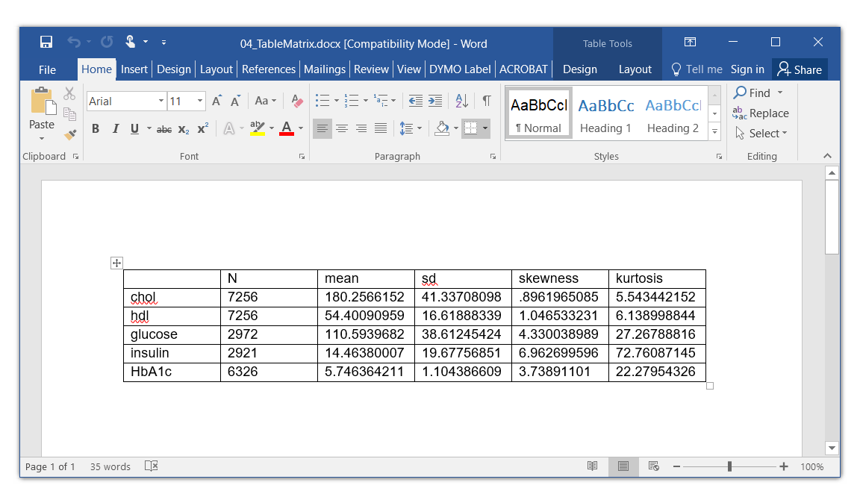
Table of Summary Statistics

Slide 72
Table of Summary Statistics
putdocx begin, pagesize(letter) font(Arial,12,black)
tabstat chol hdl glucose insulin HbA1c, ///
stat(count mean sd skewness kurtosis) ///
columns(statistics) save
matrix LabResults = r(StatTotal)'
putdocx table Table1 = matrix(LabResults), rownames colnames layout(autofitcontents)
putdocx table Table1(.,2) , nformat(%9.0f) halign(right)
putdocx table Table1(.,3/6), nformat(%9.2f) halign(right)
putdocx table Table1(.,.) , border(all, nil)
putdocx table Table1(1,.) , halign(center) bold border(bottom, single, black, 3pt)
putdocx table Table1(.,1) , halign(right) bold border( right, single, black, 2pt)
putdocx save "04_TableMatrix2.docx", replace

Slide 73
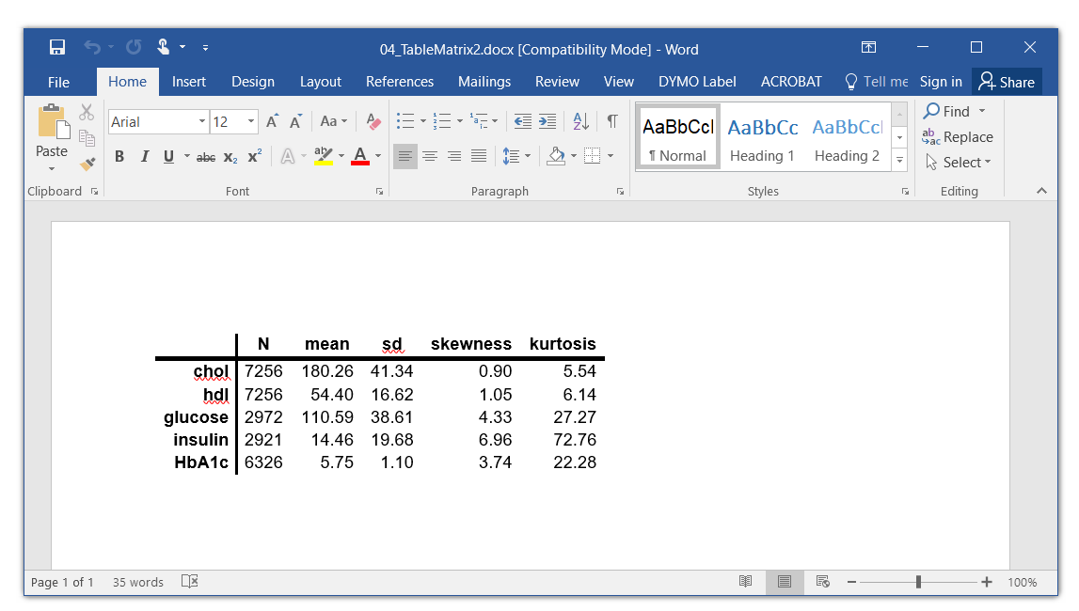
Table of Summary Statistics

Slide 74
Outline
Options for Importing Data
Options for Creating Automated Reports
odbc
putdocx
Examples
  Local macros
  Conditional text
  Returned values
  Estimation results and tables of estimation results
  Tables of summary statistics
  Tables of frequencies
  Tables of raw data
  Add time, date, and other user information
  Describe and use partial datasets

Slide 75
Table of Frequencies

Slide 76
Table of Frequencies
putdocx begin, pagesize(letter) font(Arial,12,black)
tabulate race gender, matcell(CellCounts)
putdocx table Table1 = matrix(CellCounts), , rownames colnames
putdocx save "16_Crosstabs1", replace

Slide 77
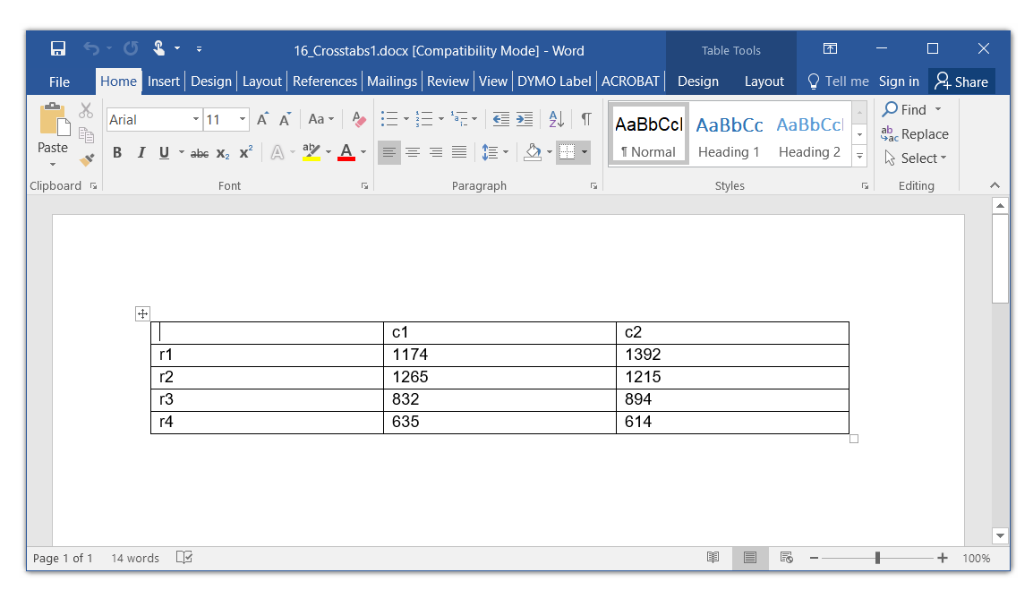
Table of Frequencies

Slide 78
Table of Frequencies

Slide 79
Table of Frequencies
putdocx begin, pagesize(letter) font(Arial,12,black)
tabulate race gender, matcell(CellCounts)
tabulate race if !missing(gender), matcell(RowTotals)
matrix CellCounts = CellCounts,RowTotals
putdocx table Table1 = matrix(CellCounts), rownames colnames
putdocx save "17_Crosstabs2", replace

Slide 80
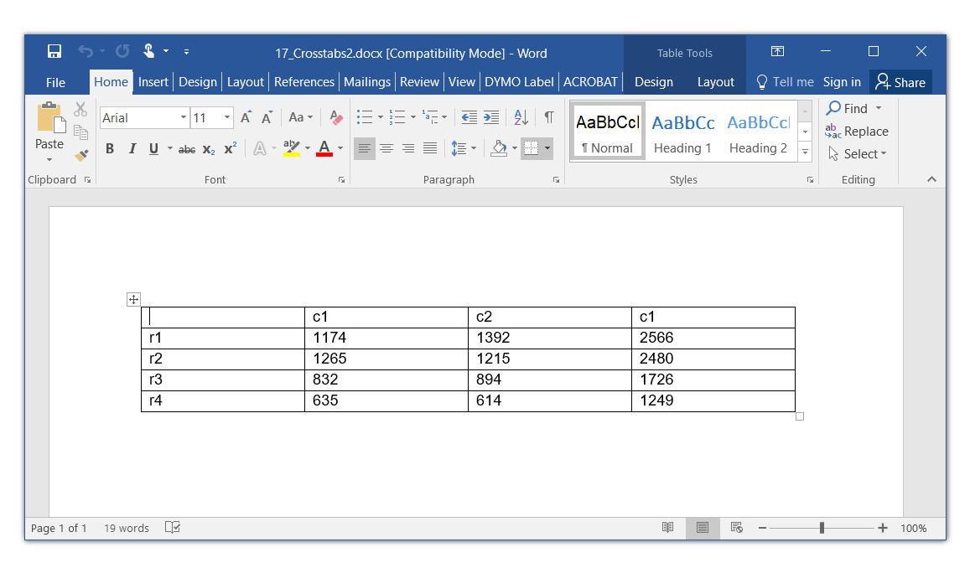
Table of Frequencies

Slide 81
Table of Frequencies

Slide 82
Table of Frequencies
putdocx begin, pagesize(letter) font(Arial,12,black)
tabulate race gender, matcell(CellCounts)
tabulate race if !missing(gender), matcell(RowTotals)
matrix rownames CellCounts = Hispanic White Black Other
matrix colnames CellCounts = Male Female Total
matlist CellCounts
putdocx table Table1 = matrix(CellCounts), rownames colnames
putdocx save "18_Crosstabs3", replace

Slide 83
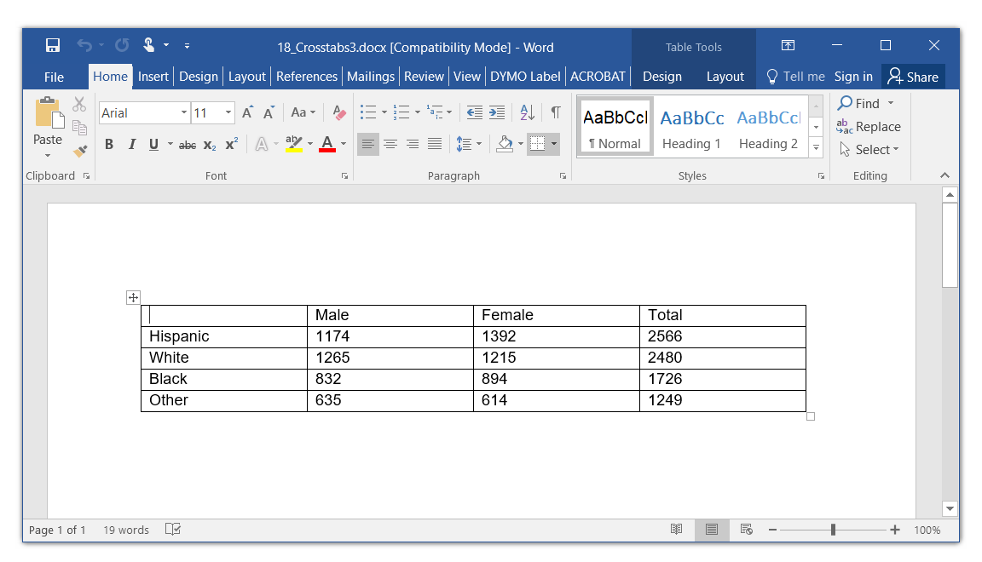
Table of Frequencies

Slide 84
Table of Frequencies
putdocx begin, pagesize(letter) font(Arial,12,black)
tabulate race gender, matcell(CellCounts)
tabulate race if !missing(gender), matcell(RowTotals)
matrix CellCounts = CellCounts,RowTotals
matrix rownames CellCounts = Hispanic White Black Other
matrix colnames CellCounts = Male Female Total
matlist CellCounts
putdocx table Table1 = matrix(CellCounts), rownames colnames layout(autofitcontents)
putdocx table Table1(.,.) , halign(right) border(all, nil)
putdocx table Table1(1,.) , halign(center) bold border(bottom, single, black, 3pt)
putdocx table Table1(5,.) , border(bottom, single, black, 3pt)
putdocx table Table1(.,1) , halign(right) bold border( right, single, black, 2pt)
putdocx table Table1(.,4) , halign(left) border( left, single, black, 2pt)
putdocx save "19_Crosstabs4", replace

Slide 85
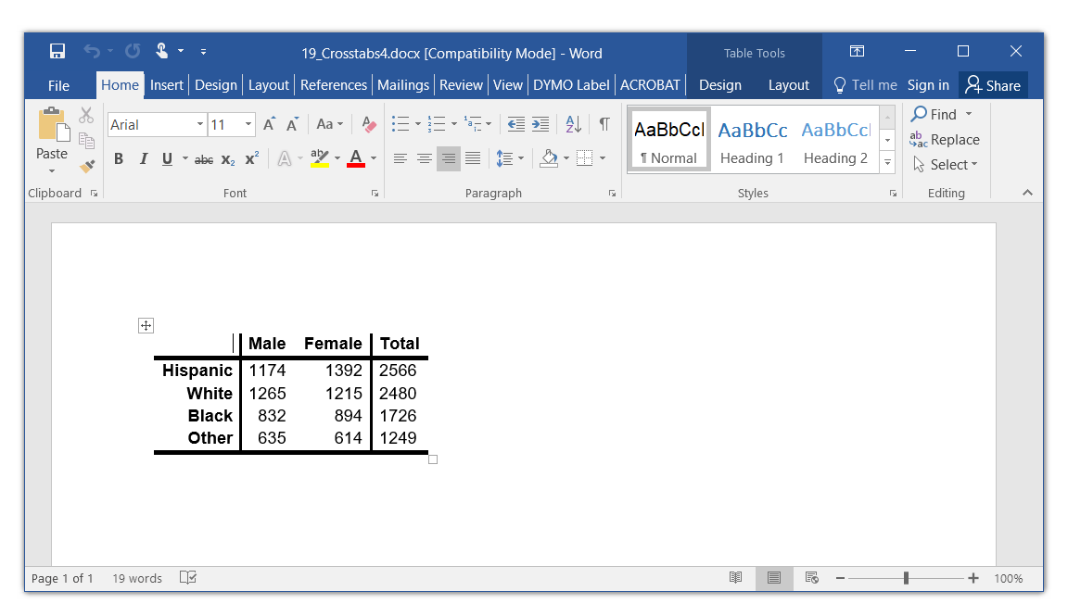
Table of Frequencies

Slide 86
Outline
Options for Importing Data
Options for Creating Automated Reports
odbc
putdocx
Examples
  Local macros
  Conditional text
  Returned values
  Estimation results and tables of estimation results
  Tables of summary statistics
  Tables of frequencies
  Tables of raw data
  Add time, date, and other user information
  Describe and use partial datasets

Slide 87
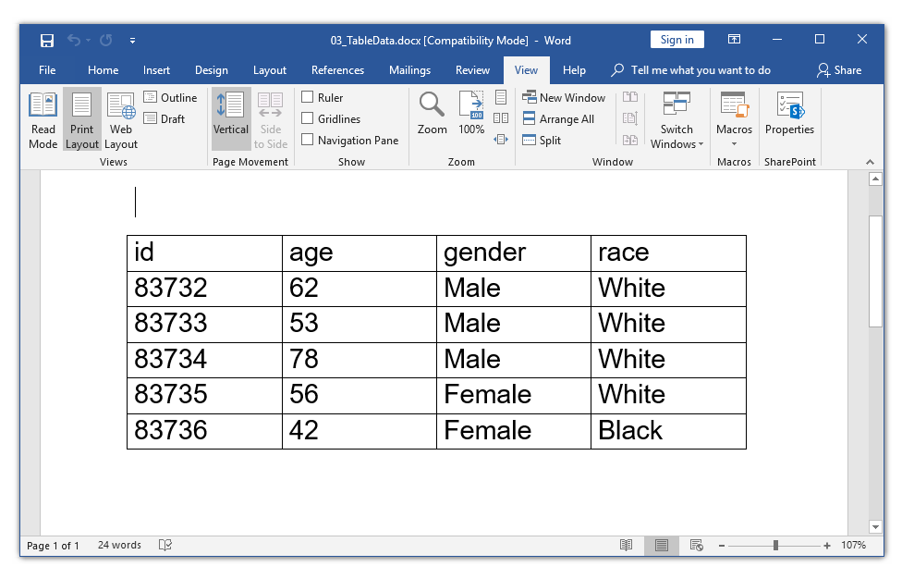
Table of Raw Data
putdocx begin, pagesize(letter) font(Arial,20,black)
putdocx table Table1 = data(id age gender race) in 1/5, varnames
putdocx save "03_TableData.docx", replace

Slide 88
Outline
Options for Importing Data
Options for Creating Automated Reports
odbc
putdocx
Examples
  Local macros
  Conditional text
  Returned values
  Estimation results and tables of estimation results
  Tables of summary statistics
  Tables of frequencies
  Tables of raw data
  Add time, date, and other user information
  Describe and use partial datasets

Slide 89
creturn list

Slide 90
creturn list

Slide 91
creturn list
putdocx begin, pagesize(letter) font(Arial,14,black)
putdocx paragraph
putdocx text ("Report Date: `c(current_date)'"), linebreak
putdocx text ("Report Time: `c(current_time)'"), linebreak
putdocx text ("Report created by user: `c(username)'"), linebreak
putdocx text ("Report created using: `c(hostname)'"), linebreak
putdocx text ("Report HTTP proxy: `c(httpproxy)'"), linebreak
putdocx save "20_creturn.docx", replace

Slide 92
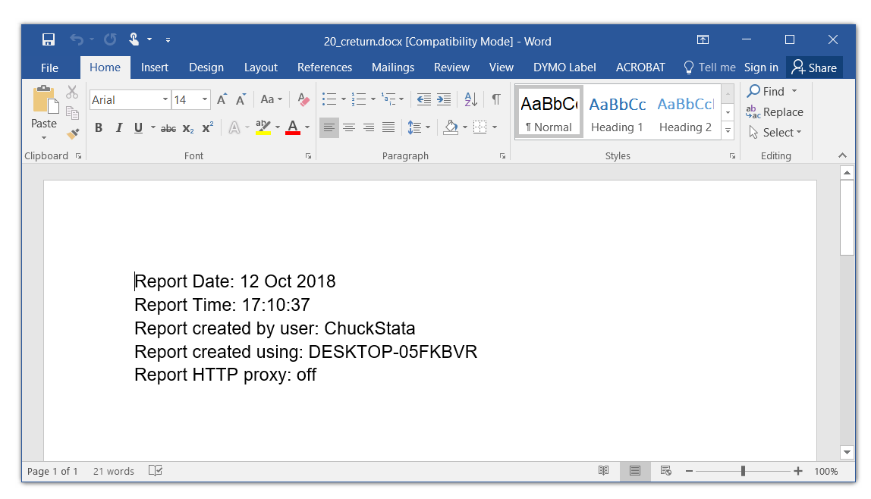
creturn list

Slide 93
Outline
Options for Importing Data
Options for Creating Automated Reports
odbc
putdocx
Examples
  Local macros
  Conditional text
  Returned values
  Estimation results and tables of estimation results
  Tables of summary statistics
  Tables of frequencies
  Tables of raw data
  Add time, date, and other user information
  Describe and use partial datasets

Slide 94
use Partial Datasets
You have a 30 gigabyte data file and you only have 16 gigabytes of RAM on your computer. How do you work with this file in Stata?

Slide 95
use Partial Datasets
You can describe a data file on a disk without opening the file
  describe using mydata.dta
You can use a subset of variables and/or observations
  use id age sex if race==2 using mydata.dta

Slide 96
putexcel
Creating Excel tables with putexcel, part 1: Introduction and formatting
https://blog.stata.com/2017/01/10/creating-excel-tables-with-putexcel-part-1-introduction-and-formatting/
Creating Excel tables with putexcel, part 2: Macro, picture, matrix, and formula expressions
https://blog.stata.com/2017/01/24/creating-excel-tables-with-putexcel-part-2-macro-picture-matrix-and-formula-expressions/
Creating Excel tables with putexcel part 3: Writing custom reports for arbitrary variables
https://blog.stata.com/2017/04/06/creating-excel-tables-with-putexcel-part-3-writing-custom-reports-for-arbitrary-variables/
Export tables to Excel
https://blog.stata.com/2013/09/25/export-tables-to-excel/

Slide 97
Outline
Options for Importing Data
Options for Creating Automated Reports
odbc
putdocx
Examples
  Local macros
  Conditional text
  Returned values
  Estimation results and tables of estimation results
  Tables of summary statistics
  Tables of frequencies
  Tables of raw data
  Add time, date, and other user information
  Describe and use partial datasets

Slide 98
Thank you!
Questions?
You can download the slides, dataset, and do-file here:
https://tinyurl.com/2019putdocx
You can contact me here:
chuber@stata.com

