Slide 1

How to be a PI as a statistician
ECRN
Dr Louise Linsell, Senior Medical Statistician
National Perinatal Epidemiology Unit

Slide 2

How to be PI as a statistician
PI on a methodological grant/programme
Fellowship grants
Study Within a Trial (SWAT)
Secondary analyses of primary trial/cohort data
ECRN

Slide 3
How to be PI as a statistician
PI on a methodological grant/programme
Fellowship grants
Study Within a Trial (SWAT)
Secondary analyses of primary trial/cohort data
ECRN

Slide 4
My experience of a Fellowship
NIHR Doctoral Fellowship 2012
Prior to that - CTU Statistician
Read up – project ideas
Use contacts
Supervisors and host institution
ECRN

Slide 5
My experience of a Fellowship
Allow plenty of time
Written application Jan 2011 (20% chance)
Panel interview June 2011 (50% chance)
Decision in August 2011
Start Oct 2011/Jan 2012
60%/80%/100%FTE options
ECRN

Slide 6
My experience of a Fellowship
Building up collaborators
Coming up with a research idea
Leading on the application
Delivery within deadlines
Planning & managing a research budget
Reporting to the funder
First author of papers
Conference experience
ECRN

Slide 7
How to be PI as a statistician
PI on a methodological grant/programme
Fellowship grants
Study Within a Trial (SWAT)
Secondary analyses of primary trial/cohort data
ECRN

Slide 8
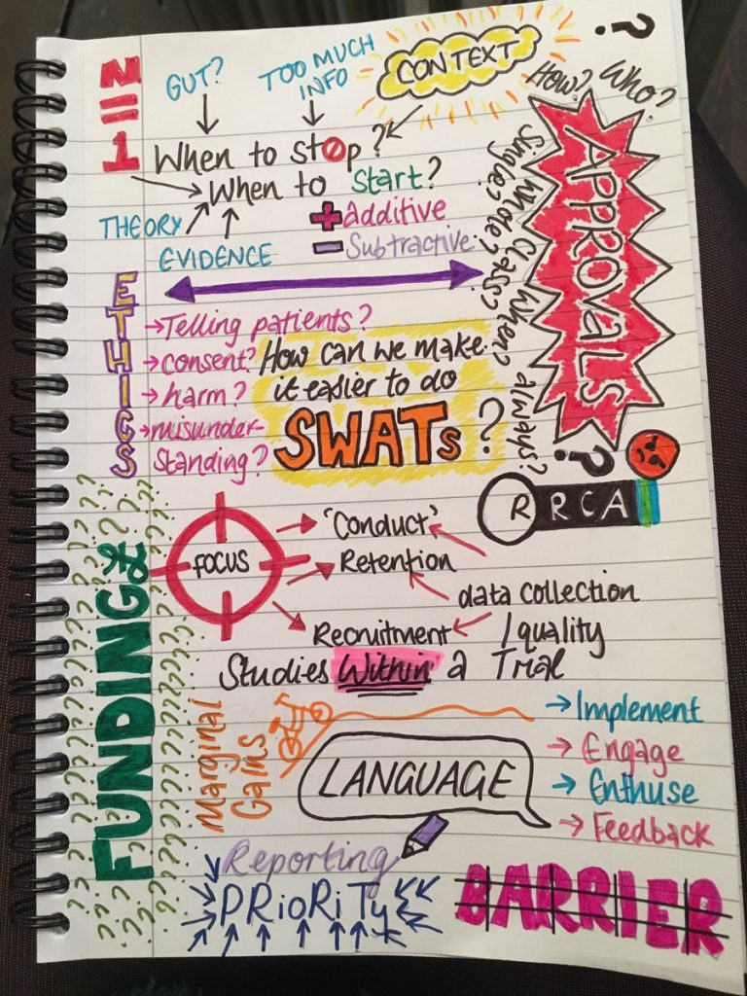
Will 6-monthly newsletters help keep patients in the trial?
Will a financial incentive increase the response rate to a follow-up questionnaire?
How much more accurate is it to use data specifically collected for a trial rather than routine data?’
More details about SWATs here:
http://www.evidentlycochrane.net/studies-within-a-trial/
Examples of studies in SWAT repository: http://www.qub.ac.uk/sites/TheNorthernIrelandNetworkforTrialsMethodologyResearch/SWATSWARInformation/Repositories/SWATStore/

Slide 9
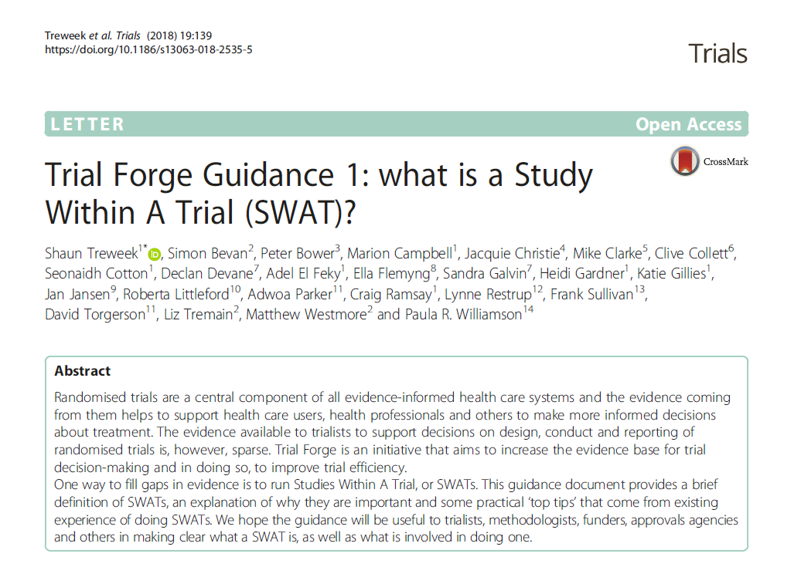

Slide 10
How to be PI as a statistician
PI on a methodological grant/programme
Fellowship grants
Study Within a Trial (SWAT)
Secondary analyses of primary trial/cohort data
ECRN

Slide 11
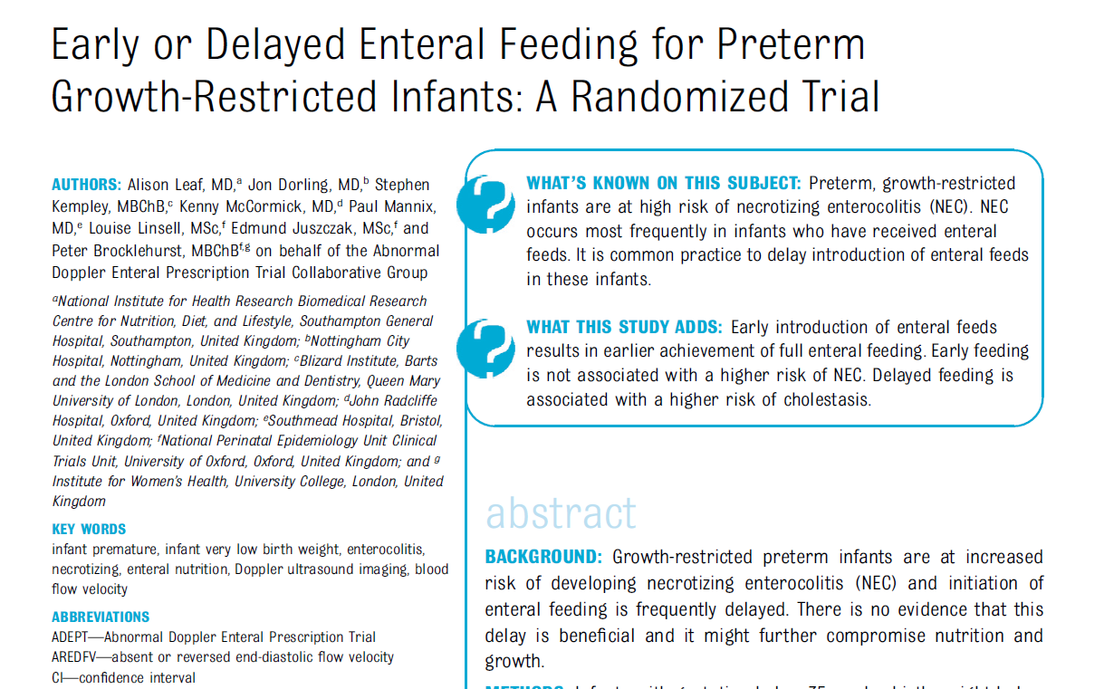
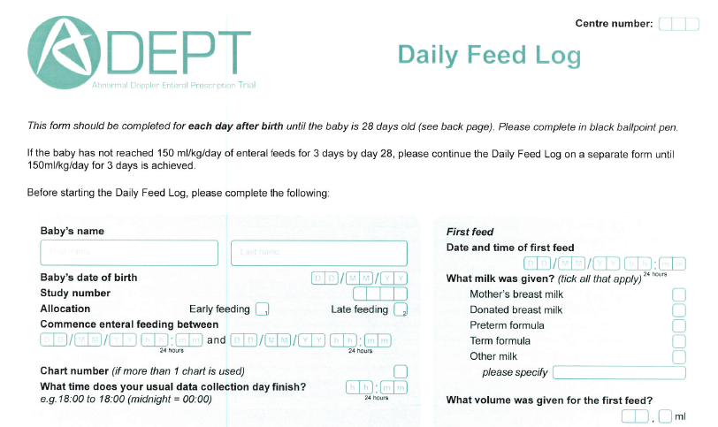
Funding: £22,226 Action Medical Research
6 month data analysis project in a trial of 400 babies

Slide 12
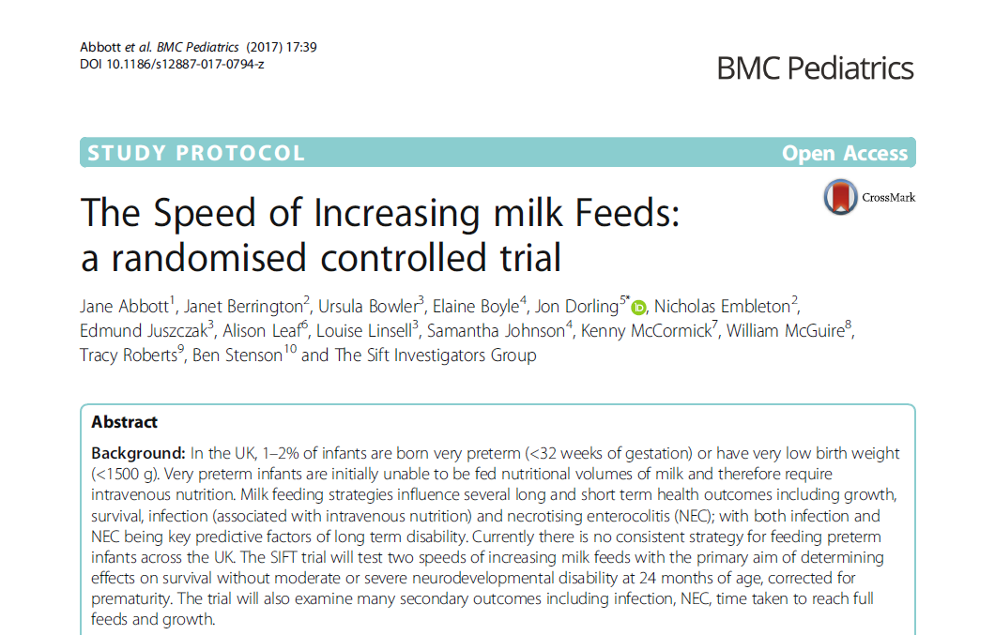
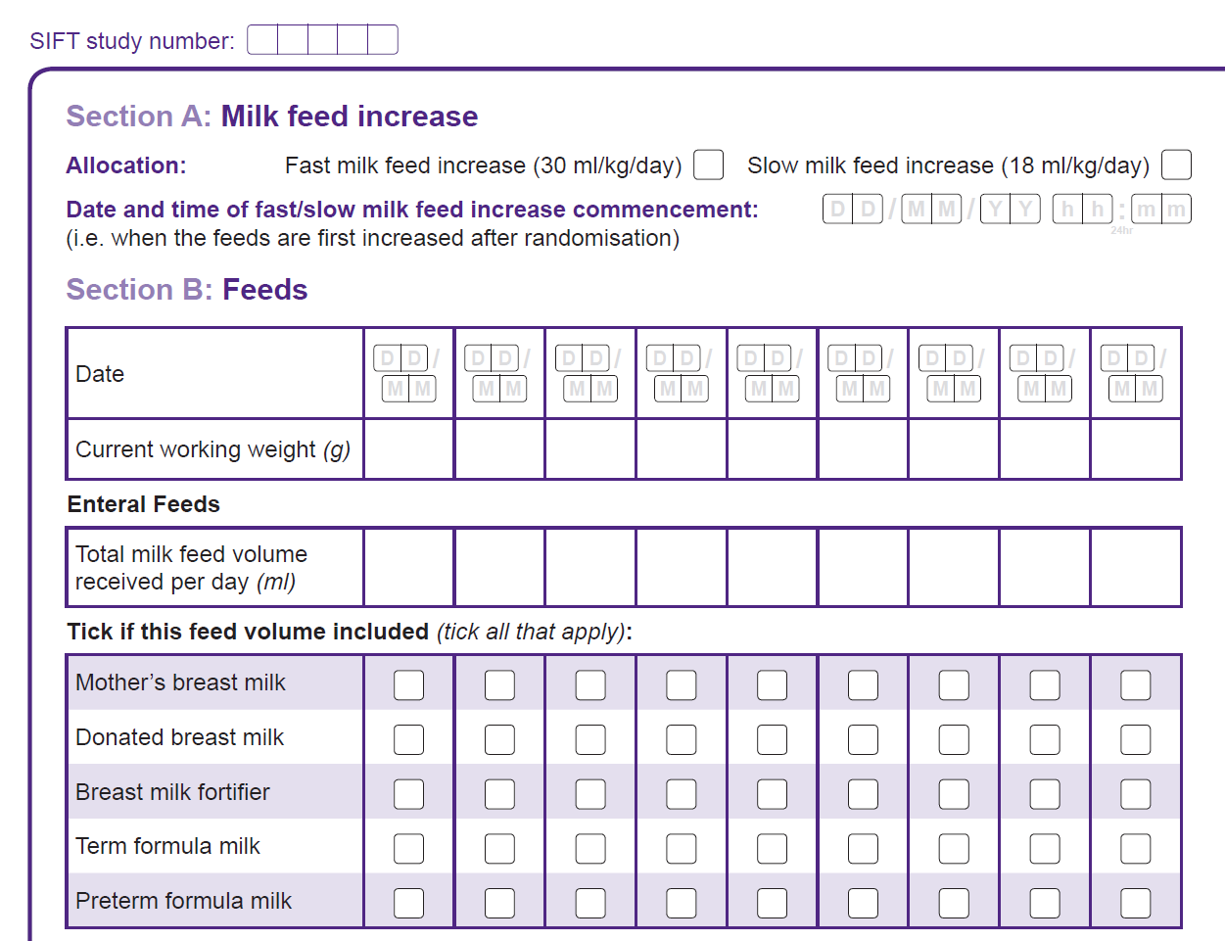
Funding: £75-100k? NIHR Research for Patient Benefit
1 year data analysis project in a trial of 2800 babies

Slide 13
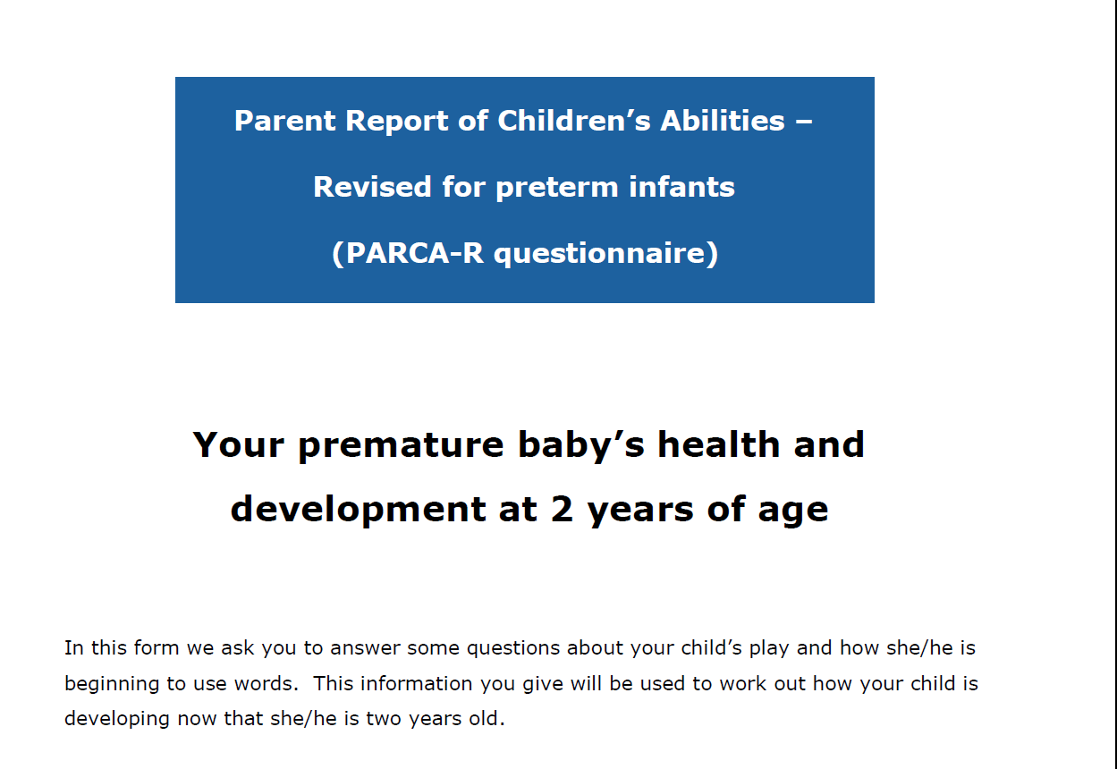
Funding: £66,500 Action Medical Research
1 year project – Standardisation of the PARCA-R Questionnaire using the trial data of 6000 babies

