Slide 1
Statistical Advising OXSTAT meeting, University of Oxford 20 November 2019
Jamie Sergeant
Lecturer in Biostatistics
Centre for Biostatistics, University of Manchester

Slide 3
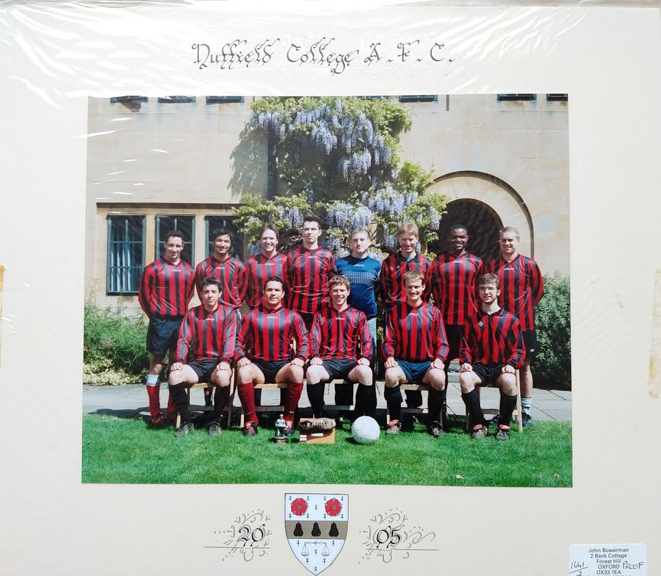

Slide 4
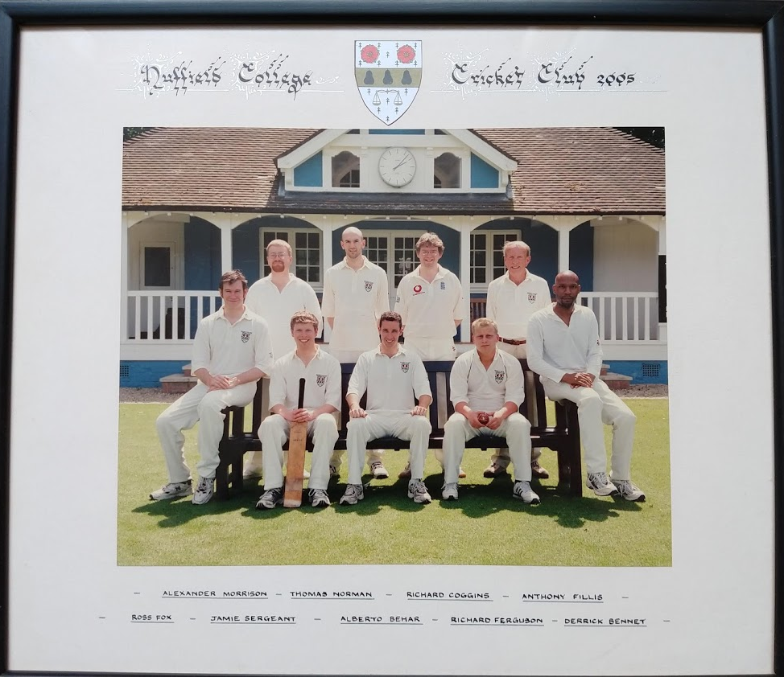

Slide 5
NIHR Statistics Group
Session first delivered at the NIHR Statistics Group annual conference in Sheffield, June 2019
NIHR Statistics Group Improving Statistical Literacy working group
Broad aim: Improve statistical literacy throughout the NIHR

Slide 6
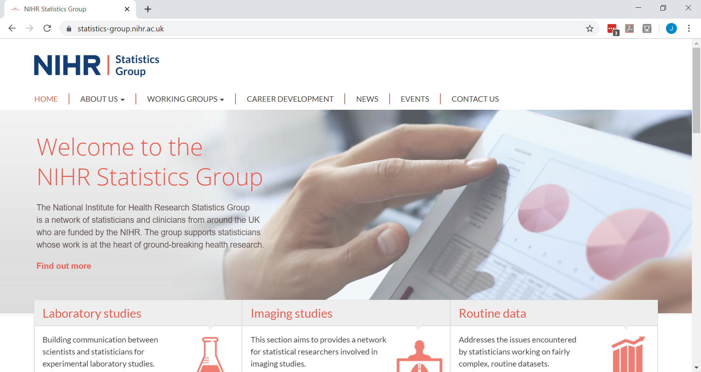

Slide 7
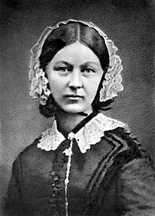
The importance of statistics
“Statistics ... is the most important science in the whole world, for upon it depends the practical application of every other [science] and of every art”
Florence Nightingale
(1820-1910)
[First female member of the RSS, 1858]
https://www.stat.wisc.edu/quotes

Slide 8
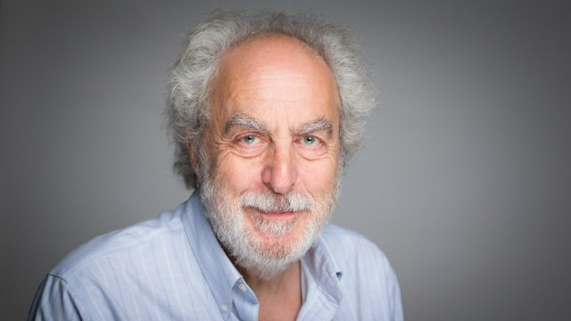
Doug Altman (1948-2018)

Slide 9
“The majority of statistical analyses are performed by people with an inadequate understanding of statistical methods. They are then peer reviewed by people who are generally no more knowledgeable. Sadly, much research may benefit researchers rather more than patients, especially when it is carried out primarily as a ridiculous career necessity”
Doug Altman (1998)
https://www.telegraph.co.uk/obituaries/2018/06/11/douglas-altmanstatistician-obituary/

Slide 10
“The good news is that statistical analysis is becoming easier and cheaper. The bad news is that statistical analysis is becoming easier and cheaper.”
Hofacker (1983)
Quoted in: Altman (1999). Practical Statistics for Medical Research

Slide 11
Peng, R. (2015), “The Reproducibility Crisis in Science: A Statistical Counterattack,” Significance, 12, 30–32.

Slide 12
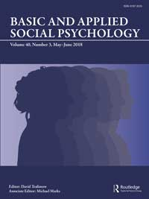
Trafimow, D., and Marks, M. (2015), “Editorial,” Basic and Applied Social Psychology 37, 1–2.

Slide 13
Ioannidis, PLoS Medicine, 2005
Notes:
Move to before Peng

Slide 14
ASA Statement on Statistical Significance and P-Values (2016)
“While the p-value can be a useful statistical measure, it is commonly misused and misinterpreted.”

Slide 15
Biostatistical advice
There is a role for (bio)statistical advice
There is a necessity for (bio)statistical advice

Slide 16
Statistical Advising
Broad aim: put advising on the agenda
Aims:
Gain a better picture of practice
Is there a “best” practice?
Consider the role and value of advising
Discuss issues and challenges

Slide 17
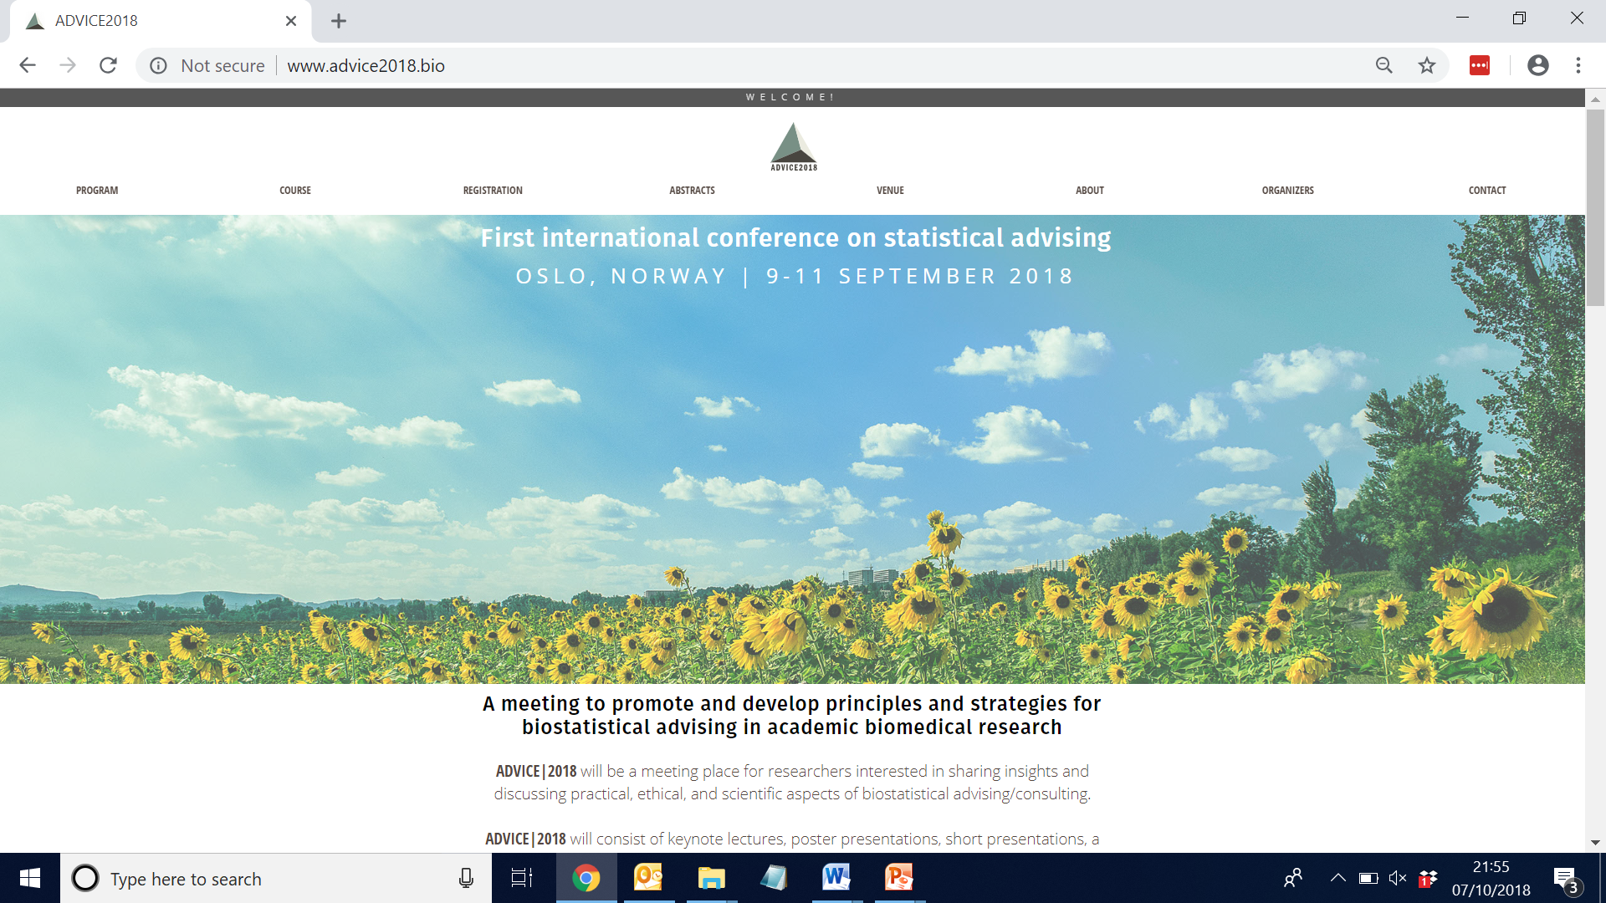

Slide 18
Terminology
Advising
Consulting
PROCESS
Statistician
Consultant
ADVISOR
Support
Help
Technician
Supervision
Researcher
Service provider
Domain expert
ADVISEE
Researcher
Clinician
Client
Student

Slide 19
The golden triangle
Advising
Research
Teaching

Slide 20
Who approaches you and your group for advice?
Students
Clinicians
Research groups
…

Slide 21
How is the handling of requests for advice organised?
Structure
Funding
Administration
Record keeping
…

Slide 22
What role do the statisticians play in the scientific process?
Service providers
Data workers
Supervisors
Collaborators
Embedded in a research group
…

Slide 23
An advising session
Initial contact
Expectations
Structure
Communication
…

Slide 24
(Ethical) issues
Authorship
Sensitive data
Advisees not following advice
Fundamentally flawed research
…

Slide 25
Teaching and recruiting new advisers
Experiential learning
Formal training
Eric Vance & Heather Smith
A framework for advising
5 steps: Preparation, Practice, Doing, Reflection, and Mentoring others

Slide 36
Example: Jamie
Centre for Biostatistics, University of Manchester
Agreements to provide statistical advice for:
Medical student 3rd Year projects
NHS Scientist Training Programme (STP) projects
No formal agreements on other unfunded work
But we often help where we can (is this our contribution to social responsibility?)
Biostatistics Collaboration Unit provides statistical collaboration costed in grant applications

Slide 37
Example: Iftekhar Khan

Slide 38
Next steps?
Seeking greater recognition for
Advising as a tool for improving statistical literacy
Advising as an activity beneficial for statisticians
Implications for team science
An unmet training need
A UK meeting on advising?

