Slide 1
OXSTAT Meeting
Dr Louise Linsell, Senior Medical Statistician
National Perinatal Epidemiology Unit
Primary Care CTU and Medical Statistics Group
12 February 2018

Slide 2
Today’s talks
4.00 OXSTAT update (Louise Linsell)
4.10 Teaching opportunities in OXSTAT (Jennifer Carter)
4.20 Overview of Primary Care Clinical Trials Unit (Ly-mee Yu)
4.30 Evidence Based Health Care programme – statistics courses (Annette Pluddemann)
4.40 Setting up safety stopping boundaries for a phase II trial: the POPPI trial (Jennifer Bell)
4.55 Exploratory data analysis in big data using R (Catia Nicodemo)
Drinks at Royal Oak afterwards

Slide 3
Departments with CTUs in Oxford

Slide 4
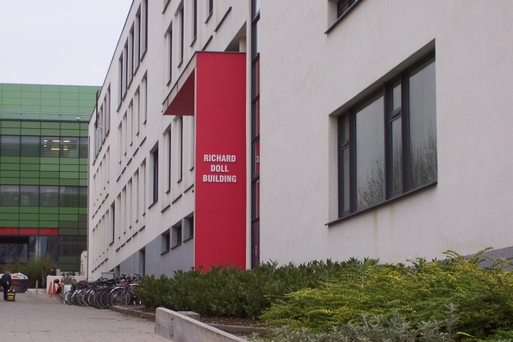
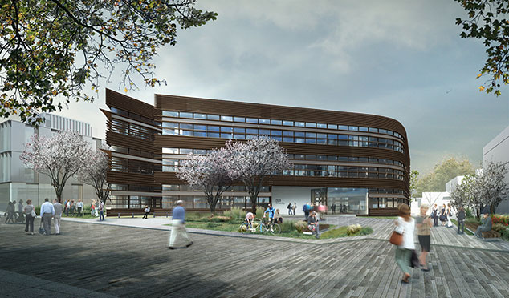
CTUs/Med Stats Hubs in Oxford
Richard
Doll
Building
Big Data Institute

Slide 5
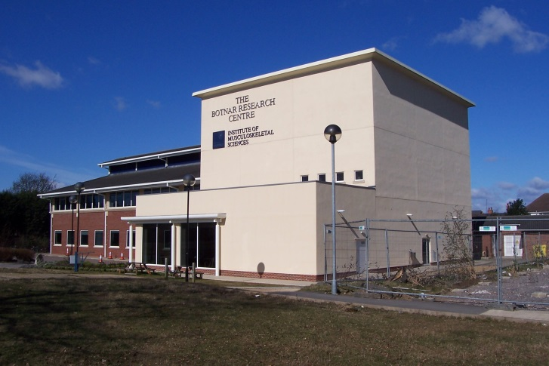
CTUs/Med Stats Hubs in Oxford
Botnar Research Centre

Slide 6
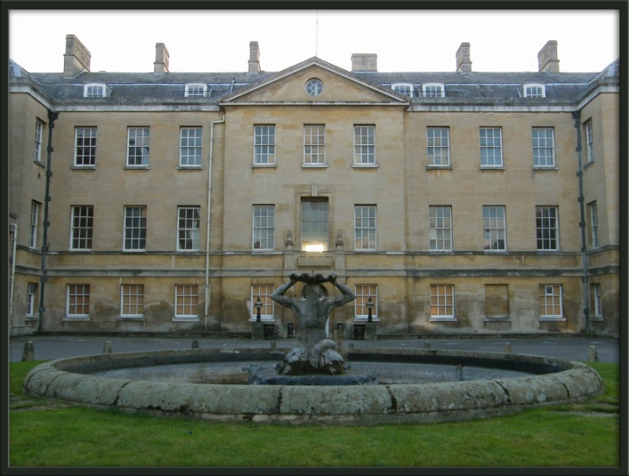
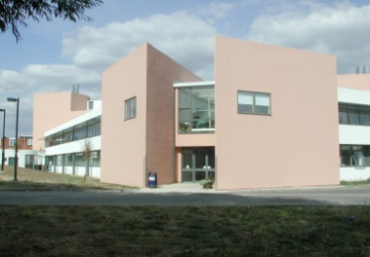
CTUs/Med Stats Hubs in Oxford
Medical Statistics Group
Radcliffe Infirmary
OCDEM, Churchill Campus

Slide 7
CTUs/Med Stats Hubs in Oxford
Medical Sciences Division
Nuffield Department of Population Health
Nuffield Department of Primary Care Health Sciences
Radcliffe Department of Medicine
NPEU
CTSU
CEU
Nuffield Department of Orthopaedics, Rheumatology and Musculoskeletal Sciences
OCTRU
CSM
SITU
Medical Statistics Group
DTU
PHC CTU

Slide 8
What is the remit of OXSTAT?
Communication
Networking
Collaboration

Slide 9
What is the remit of OXSTAT?
Aimed at early/mid-career medical statisticians working in clinical trials/epidemiology in Oxford
Meet once per term for @1-1.5 hours
Each unit takes a turn in hosting
Volunteers from each unit to be on OXSTAT organising group

Slide 10
OXSTAT Organising Group
oxstat@npeu.ox.ac.uk
Usama Ali
Jenny Bell
Derrick Bennett
Virginia Chiocchia
Lucy Davies
Charlie Harper
Chris Partlett
+ rep from PHC??
oxstat@npeu.ox.ac.uk

Slide 11
Talks for future meetings
Show ‘n’ Tell
Hotspots
Teaching
Career Corner
Methodology

Slide 12
Talks for future meetings
Show ‘n’ Tell
Have you got a piece of statistical work that you would like to share, or do you need some constructive criticism within a friendly environment? This could be anything from a pragmatic data analysis, a piece of methodological work, the solution to a statistical problem, the application of a novel technique or adaption of a standard technique, discussion of an interesting journal article or anything else you think might be of interest to others.

Slide 13
Talks for future meetings
Hotspots
Are you feeling a bit stuck or can’t fully get your head around something? Come and share it in a hotspot and let others see if they can help. It doesn’t have to be a formal presentation with slides, it could even be just a short question, it’s up to you.

Slide 14
Talks for future meetings
Teaching
Are you involved in teaching or running a course/ workshop that you would like to talk about? Perhaps you looking for volunteers to help out on your course and would like to talk about teaching opportunities available for statisticians and epidemiologists on your course or within the wider Medical Sciences Division? Or thinking of launching a new course or workshop and looking for ideas and input?

Slide 15
Talks for future meetings
Career Corner
This section is for people who want to talk about opportunities such as NIHR/MRC/Wellcome fellowships, pump-priming bids, how to be a PI as a statistician, getting methodology grants. Come and talk about your experiences, share your successes and failures, guidance to others on where to get help and advice.

Slide 16
Talks for future meetings
Methodology
Have you got some ideas for a piece of methodological work, but require some collaboration or expertise that you don’t have in your own unit? Come along and present your ideas and see if anyone is interested in collaborating with you.

Slide 17
OXSTAT Newsletter
Events
Courses/workshops
Training
Talks/seminars
Conferences
Announcements
oxstat@npeu.ox.ac.uk

