Slide 1
Overview of the Clinical Trial Service Unit and Epidemiological Studies Unit (CTSU)
Derrick Bennett

Slide 2
The Clinical Trial Service Unit and Epidemiological Studies Unit (‘CTSU’)
“To generate and disseminate reliable evidence from observational epidemiology and from randomised trials that leads to practicable methods of avoiding premature death and disability”.
https://www.ctsu.ox.ac.uk/research/

Slide 3


Two Co-directors
Professor Sir Richard Peto
Professor Sir Rory Collins

Slide 4
Large-scale observational studies in diverse populations
Prospective: Primarily major risk factors for premature death and disability
  Different effects in different populations
  Smoking
  Alcohol
  Adiposity
  Blood pressure
  Diabetes
5 CTSU-initiated studies in 1.4 million adults
  Fieldwork
  Data collection and cleaning
  Statistical analysis
  Interpretation and reporting of results
  Future blood-based analyses
Notes:
Increasingly blood-based analyses

Slide 5

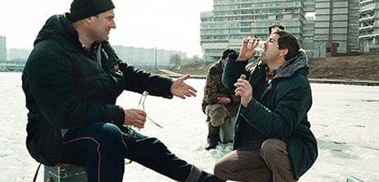
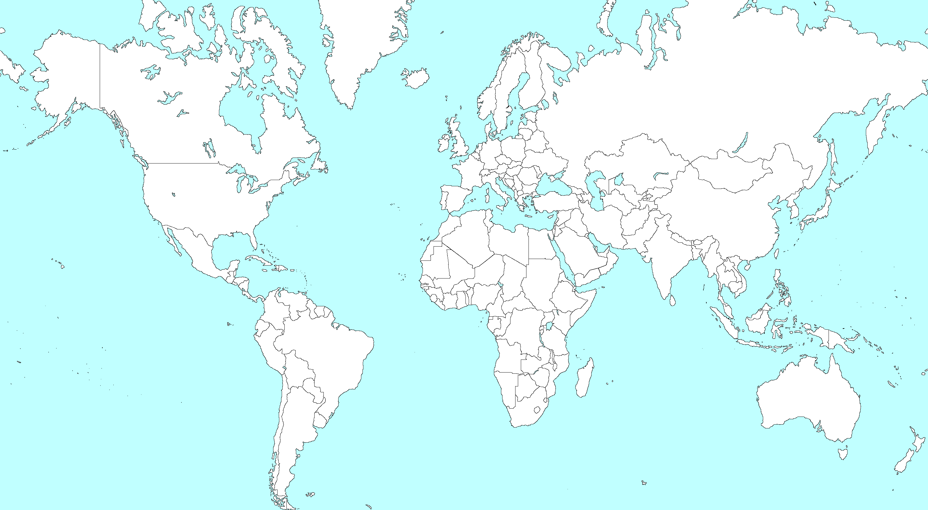
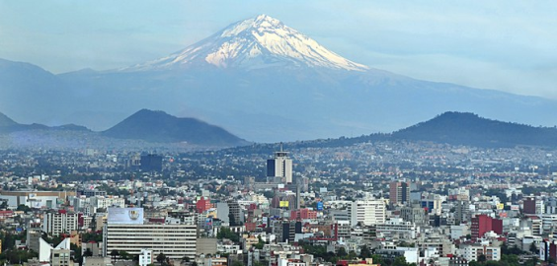
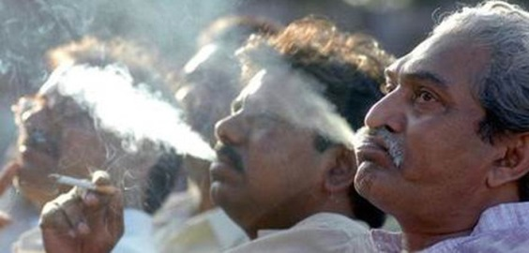

1.4 million participants
in 5 large studies
150,000 Cuba
200,000 Siberia, Russia
150,000 Mexico City
400,000 Kerala, India
500,000 Chennai, India

Slide 6
China Kadoorie Biobank (CKB)
An open-ended study with broad research aims
0.5M participants from 10 survey sites in China (with different risk exposure and disease patterns)
A collaborative project between:
  The Clinical Trial Service Unit & Epidemiological Studies Unit (CTSU), University of Oxford
    Principle investigator: Prof. Zhengming Chen
  The Chinese Academy of Medical Sciences (CAMS).
    Principle investigator: Prof. Liming Li

Slide 7
Clinical Trials
CTSU’s trials have largely focussed on cancer (particularly breast cancer) and cardiovascular disease.
CTSU is distinctive in that it coordinates some of the world’s largest trials (having pioneered the streamlined “mega-trial” approach)
  uniquely positioned to inform doctors and patients about the efficacy and safety of a wide range of interventions.

Slide 8
Recent Major Clinical Trials
Study | Sample size
HPS: Heart Protection Study | 20,536
HPS2 -THRIVE: Treatment of HDL to Reduce the Incidence of Vascular Events | 25, 673
HPS3 / TIMI 55 - REVEAL : Randomised EValuation of the Effects of Anacetrapib through Lipid-modification | 30,000
SEARCH: Study of the Effectiveness of Additional Reductions in Cholesterol and Homocysteine | 12,064
SHARP: Study of Heart and Renal Protection | 9,400

Slide 9
CTSU: recent and current trials
DIABETES
LENS
ASCEND
ASCEND
long-term FU
EMPA-KIDNEY
UK HARP-III
RENAL DISEASE
3C
UK
SHARP
SHARP post-trial FU
HARP-I
UK HARP-II
AMALFI
STICS
ORION-4
REVEAL
REVEAL post-
trial FU
CARDIOVASCULAR DISEASE
THRIVE
SEARCH
SEARCH long-term follow-up
Heart Protection Study
Heart Protection Study long-term follow-up
OCS
1
9
9
0
1
9
9
5
2
0
0
0
2
0
0
5
2
0
1
0
2
0
1
5
2
0
2
0
2
0
2
5

Slide 10
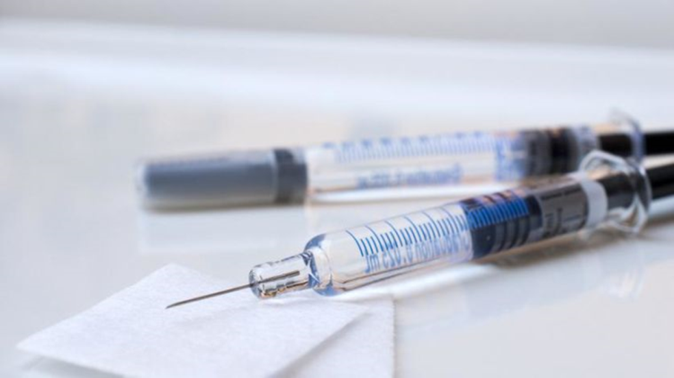
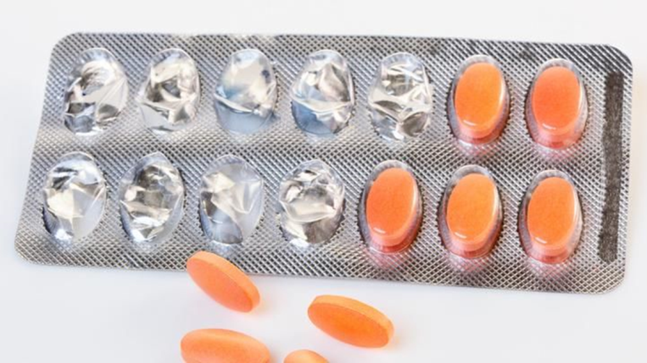
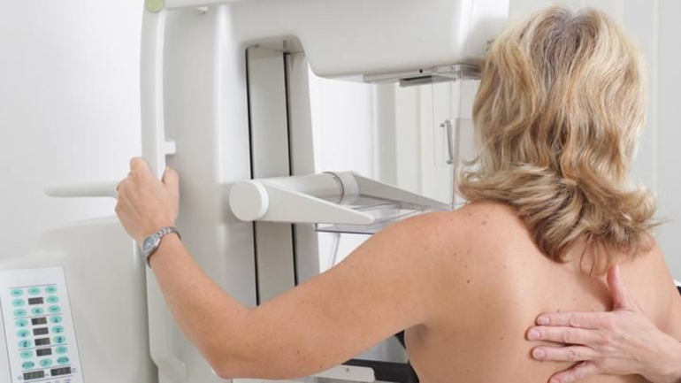
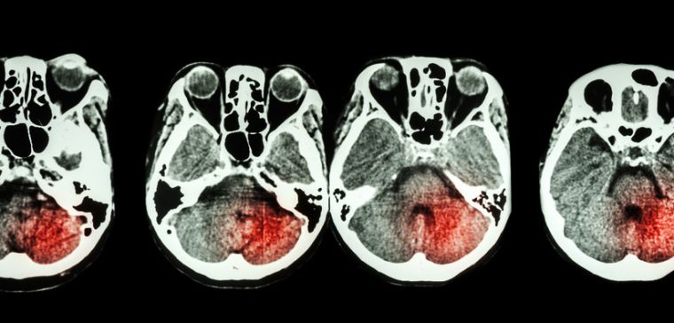
Individual participant data meta-analyses
Anti-thrombotic treatment trialist collaboration
Cholesterol Treatment Trialists’ Collaboration
Early Breast Cancer Treatment Trialists’ Collaboration
Stroke Thrombolysis Trialists’ Collaboration

Slide 11
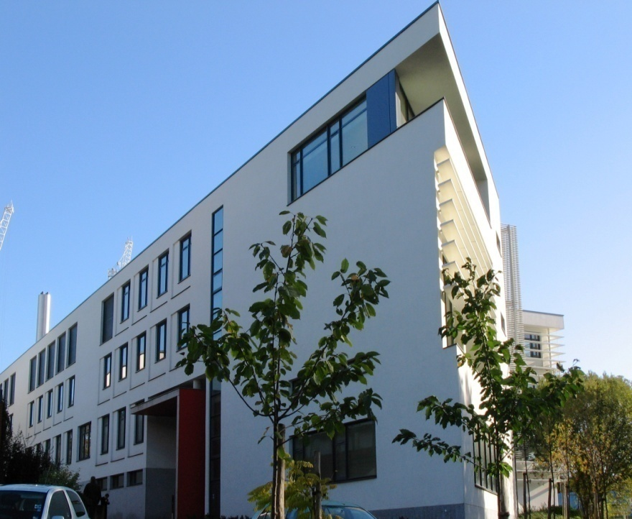
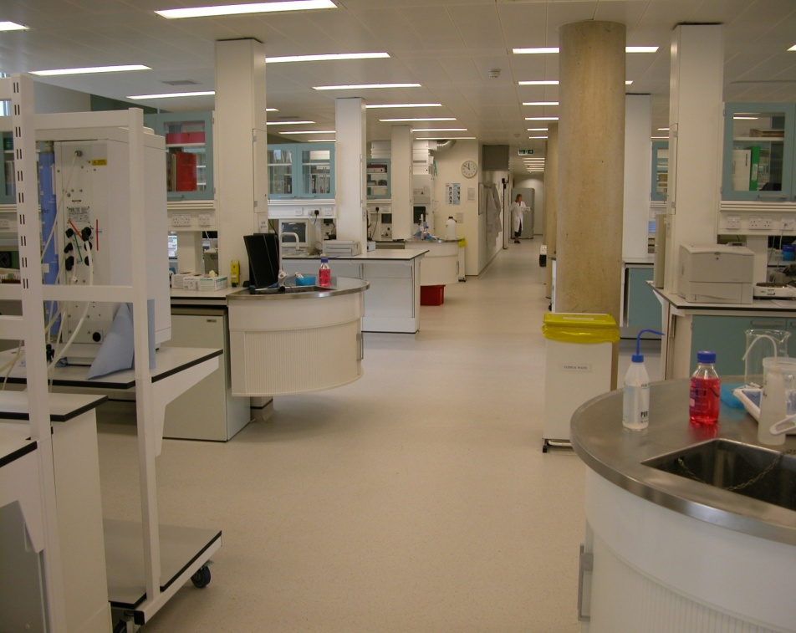
CTSU Wolfson Laboratories
June 2005 – New laboratories
June 2007 – HTA licence
July 2008 – ISO 17025:2005
Sample collection
Processing
Analysis
Long-term Storage

Slide 12
CTSU Research Staff
Statistical
  4 Professors of Medical Statistics
  3 Associate Professors of Statistics/Epidemiology/Clinical Trials
  10 Senior Statisticians
  ~30 Statisticians/Statistical Programmers
Clinical
  3 Professors; 3 Associate Professors
  Trial managers, study co-ordinators, research nurses, research fellows

