Slide 1

BayesCamp
Data Visualisation
Design and statistical considerations
Robert Grant
robert@bayescamp.com

Slide 2
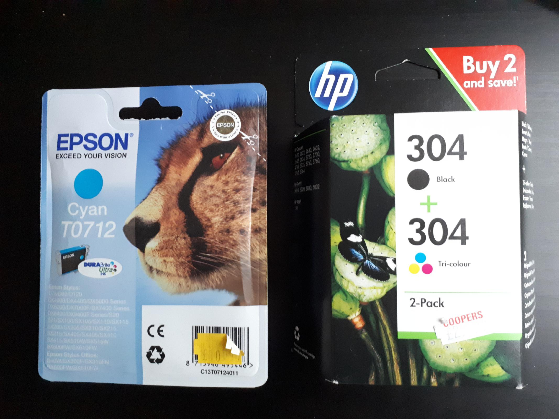

Slide 3

Calculate ...

Slide 4

•••
^{0o go}
^{33u}
n.
0Ite

Slide 5

Impact

Slide 6
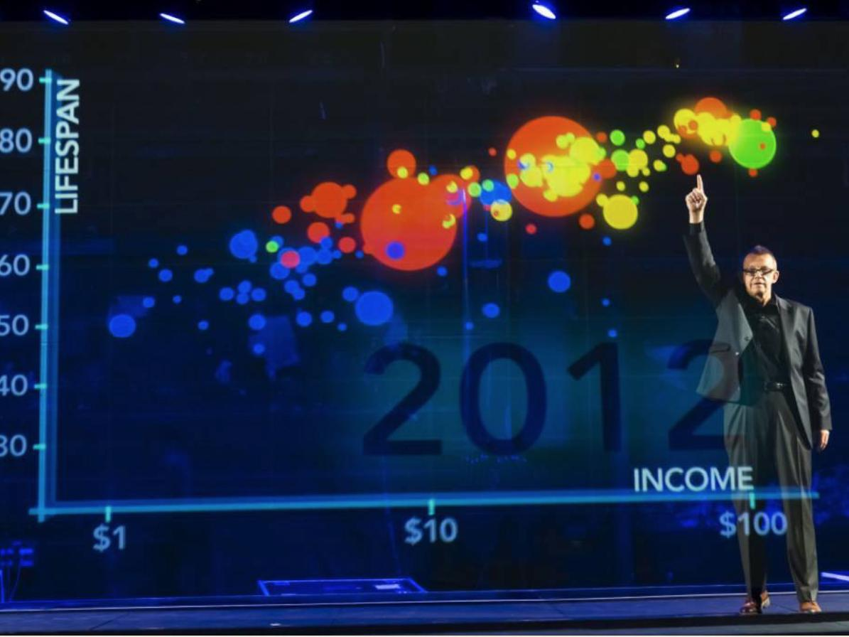
,_{ftw}i_{t}ow •

Slide 7
Six questions
1.Data provenance; audience & goals
2.Data or stats?
3.Encoding variables / stats as an image
4.Design, perception
5.Annotation, prolegomena, storytelling
6.How can you do user-testing?
stat.columbia.edu/~gelman/research/published/vis14.pdf

Slide 8
Data quality & provenance
TORONTO TRANSIT COMMISSION ANALYSIS OF RIDERSHIP 1615 TO 2017 ACTtau_S1050.3)1 |  |  |  |  |  |  | preamble
limo. | I FARE UEDA - |  |  |  |  |  |  |  | 2016 |  |  |  | 2016 • |  |  |  |  |  | 2014 |  |  |  |  | 2013 |  |  | 2012 |  |  |  | 2011 |  | 2010 |  | 2009 | 2X4 | 20.77 | :005
46610:3 | ADULT
 |  |  | roxEms⁻ TICKETS TriO-FARE |  |  | ., Ice NA MA |  |  | 102 071 NA WA |  |  |  | 1.0145 WA WA |  |  |  |  |  | III 157 NA NA |  |  |  |  | 112,980 NA NA |  |  | 117 982 MA MA |  |  |  | 121,748 NM MA |  | 120,218 1298 WA |  | 114888 9.807 WA | 04,210 34.445 NA | 88 794 16.398 NA | 75,340 10.648 MA
 |  |  | PRESTO - SINGLE RIDE |  |  | -" "" |  |  | ' ''''' |  |  |  | ' "" |  |  |  |  |  | " "'2 |  |  |  |  | 8.191 |  |  | 4.399 |  |  |  | 1.139 |  | 0 |  | 0 | NA | MA
 |  |  | PRESTO SR'/M TOKEN R CE |  |  |  |  | "Who" |  |  |  |  | and |  |  |  |  |  | "hole ⁴ |  |  |  |  | N A |  |  | NA |  |  |  | NVA |  | WA |  | WA | NA | MA | MA
 |  |  | PRLS T Q - Z;14V1.4 CAt4-410+11); PRESTO - MCHTHLY PASS Rf al,i AR 640N110 Y PAS!; POST-SECONDARY PASS TY6N.130 PASS YeEEK-Y PASS |  |  | .,....... NA 13.853 |  | same ....,...... N'A 7.517 |  |  |  |  |  |  |  | column -......... 9.813 |  | NA | a 2 -........5 NA 9,981 |  |  |  |  | q1.. A P. A :1 • 'I', . -, 4 ..: I..,. 0.557 |  |  | **A MA ;(K 011f; 35010 NAA 10,185 |  |  |  | _ NVP1 MA 1114 420 32091 NM 0.893 |  | _.N'A WA 203,101 9.200 14% 9237 |  | WA N'A 2011.172 WA NA 8.731t | ttlk_ NIA 212k313 NA NA 7.517 | I'6A MIA 196.001 NtA NIA 7./243 | 141111 rsvA 171,314 na* res• 5.113
 |  |  | CASH |  |  | 36.045 |  |  | 41.536 |  |  |  | 46.873 |  |  |  |  |  | 49.120 |  |  |  |  | 16.623 |  |  | 46.467 |  |  |  | 43.796 |  | 43.140 |  | 41.145 | 39.406 | 36.317 | 38.684
 | 9U-TOTAL |  |  |  |  | 417.6011 |  |  | 426.973 |  |  |  | 434.9111 |  |  |  |  |  | 137.287 |  |  |  |  | 411,142 |  |  | 410,118 |  |  |  | 401.684 |  | 306.341 |  | 341.1411 | 370,803 | - 372,676 | 366,287
 | three reports MANDOUSTUOCNT lar,)10.4.y PASS in one! |  |  |  |  | 2/.324 1011 31,196 |  |  | 2/.57' 950 32.997 |  |  |  | 25 092 672 32 515. |  |  |  |  |  | 23.064 515 33.108 |  |  |  |  | 20.50% 54: 35.472 |  |  | 19.769 824 97.039 |  |  |  | 18.540 702 96.299 |  | ¹7.160 814 34.474 |  | 15.33¹ 871 38.815 | 11,1164 7117 39.007 | 14,006 808 40.•01 | 12.221 372 10,808
 | - .- 1 PRESTO T :SINGLE RIDE |  |  |  |  | WA 5„703 |  |  | NA 1.4⁷' |  |  |  | WA 11* |  |  |  |  |  | N'A .1 |  |  |  |  | KA N.0 |  |  | Nist4 MA |  |  |  | rsm NA |  | WA N'A |  | WA N'A | NA NA | MA NIA | resi NA
 | PRESTO SRVM CASH R1DE |  |  |  |  | 263 |  |  | 2 |  |  |  |  |  |  |  |  |  |  |  |  |  |  |  |  |  | 1 |  |  |  | NM |  | WA |  | NA | NA | MA | MA
 | P14ES TO - MONTHLY PASS CASH |  |  |  |  | as 12 S22 |  |  | 10 1 |  |  |  |  |  | 40tals |  |  |  |  |  |  |  | within |  |  |  | data, I |  |  |  | MA 800 ⁸1(oft |  | WA S 8 167 |  | N'A 5 528 | NA | 5 2531211 NA | Si_{n}
 | 51.11/PTIITTAL |  |  |  |  | 71Ia |  |  | 72. |  |  |  | 717. |  |  |  |  |  | 4'1 0 |  |  |  |  | ¹'¹ ad |  |  |  |  |  |  |  |  | 10,543 |  | 50745 | a,_{z} | 10,114
 | FREE ROES |  |  |  |  | 24.856 |  |  | 21.875 |  |  |  | 0.030 |  |  |  |  |  | NA |  |  |  |  | NA |  |  | MA |  |  |  | MA |  | WA |  | WA | NA | NIA | NIA
 | TICIKETS |  |  |  |  | C |  |  | 0 |  |  |  | 1.066 |  |  |  |  |  | ⁷.097 |  |  |  |  | 7.563 |  |  | LIM |  |  |  | 5.3.04 |  | 9.287 |  | 8.562 | 6.732 | 4.951 | Me
 | PRESTO - FREE CHILD RIDE |  |  |  |  | 163 |  |  | 36 |  |  |  | 10 |  |  |  |  |  | NA |  |  |  |  | P1A |  |  | MA |  |  |  | MA |  | WA |  | WA | NA | NA | PeA
 | EA 9-1 |  |  |  |  | C |  |  | 0 |  |  |  | 526 |  |  |  |  |  | 3.¹'05 |  |  |  |  | 2.71¹ |  |  | 2.689 |  |  |  | 2 133 |  | 2.5.30 |  | 2.110 | 2.253 | 1.933 | 2168
 | SUS-TOTAL |  |  |  |  | 33.019 |  |  | 71 911 |  |  |  | 12.441 |  |  |  |  |  | 10,882 |  |  |  |  | 10,271 |  |  | 10,218 |  |  |  | 10,737 |  | MAIM |  | 10,072 | 11,036 | 111,8113 | 11,60
 | DANA( STAMMER EILIND/AAR AMPS PREMIUM EXPRESS POSTAL CARR rERS _{P}P ^{F}e²-''; |  |  |  |  | mu 1 MS 146 N A 4.214,1 |  |  | 9 130 i 0101 174 N'A .1 WZ₄ |  |  |  | 8 560 1088 490 WA ", 4" |  |  |  |  |  | 10.033 1 119 *51 NA ^{C}S^{K}L |  |  |  |  | 11.4123 1 tO... 431 N .). |  |  | 11 92D 1006 372 ty A 144 |  |  |  | 10 642 1 0430 341 MA ^{.5}.⁴) |  | 3,605 1 079 322 WA ,.. tgl. |  | 10 080 I , 071 913 WA .", | 9,061 1, 022 310 NA fi 415 | 9 816 1 041 295 ILA -,_2412 | 9,191 1025 259 5B' I 172.
 | tAltstartalrote ; • • • |  |  |  |  | :.513.1114 |  |  | ' MOO |  |  |  | WAS |  |  |  |  |  | :$14,141 |  |  |  |  | $06.104. |  |  | . . $1.407.::, |  |  |  | $00410 |  | 41'/41/ |  | 444.303 | 400,104 | IS | : .. 444:444:
 | sus |  |  |  |  |  |  |  |  |  |  |  |  |  |  |  |  |  | ' |  |  |  |  | :¹4.061 |  |  | 234.3112 |  |  |  | 121;60, |  | 2' 0 655 |  | 2111.515 | .115 4'.⁻ | 214 341 | 206 426
 | 9UII.TOTAL |  |  |  |  | setts s |  |  | 25.2.190 |  |  |  | 238,943 |  |  |  |  |  | 245.262 |  |  |  |  | 251,083 |  |  | 224.522 |  |  |  | 221.209 |  | 216,890 |  | 216.591 | 115.617 | 216.241 | 204.628
 | RAIL
 | E U 9WAY |  |  |  |  | 213.012 |  |  | 221.622 |  |  |  | 229.129 |  |  |  |  |  | 219.849 |  |  |  |  | 211.210 |  |  | 216.101 |  |  |  | 213.290 |  | 199.131 |  | 199.321 | 116.001 | titian | 101.775
 | 014 1 |  |  |  |  | 3.177 |  |  | 2,011 |  |  |  | 3 342 |  |  |  |  |  | 4.204 |  |  |  |  | 4.001 |  |  | 4.14? |  |  |  | 4.714_ |  | 4232 |  | 4400 | 4.62⁴ | 4.700 | 4.100
 | TROLLEY COACH STREETCAR |  |  |  |  | 0 SS 911 |  |  | 0 80 107 |  |  |  | 0 83.581 |  |  |  |  |  | 0 65,120 |  |  |  |  | 0 13.31S |  |  | 0 51.857 |  |  |  | 0 580e. |  | 0 54,110 |  | 0 49,067 | 0 50.060 | 0 47 390 | 0 52.118
 | 9UII-TOTAL |  |  |  |  | 272.143 |  |  | 286110 |  |  |  | 295.082 |  |  |  |  |  | 2211.925 |  |  |  |  | 224.220 |  |  | 212.425 |  |  |  | 276940 |  | MAU |  | 222,818 | 250.113 | 342.428 | name
 | 'TilirstlaTO/Pr.:::::_:::i.:;⁻'ill: |  |  |  |  | 211 |  |  |  |  |  |  |  |  |  |  |  |  | : ;10$101tVASIuturriStAittliigt:1114.stri; z Omar |  |  |  |  |  |  |  |  |  |  |  |  |  | .:••!Artlist |  | '.'..9citta | i':.;',01.716⁻• ::•;41021ditaimistt
WHEN | WEEKDAY WI 1 KI 10:1140koDAY |  |  |  |  | 424 I '-.- 100W.⁻. |  |  | 414-117 123.1104 113,502 11011)7 |  |  |  |  |  |  |  |  |  | 123.240 116297 406.913 396.579 379.610 111648 1421,801 107_04a 1046 il ay . 54 T |  |  |  |  |  |  |  |  |  |  |  |  |  |  |  | 371.908 371.765 366.917 367.814 96,325 *1 036 101152 68.730
_{S}. | 51^{,4}Starteliikt. :7:7. : 7: :. : 7:glif. k la |  |  |  |  |  |  |  | .... kl Irbifinnigiiit |  |  |  |  |  |  |  |  |  | ' :Isi,e14-⁷.':liCililk7:01,4)Ne:. •: iha_{y}tai.:7:4V1;$/f |  |  |  |  |  |  |  |  |  |  |  |  |  |  |  | ::Intidr.y.7440.6.:'::as6W::*:saktrai
:.41,01¹⁻ 4: ¹+1 I.:WW1* |  | a WV C41 OECT⁴Yi |  |  |  |  |  |  |  |  |  |  |  |  |  |  |  |  |  |  |  | )..AkKE _ |  |  |  |  |  |  |  |  |  |  |  | •

Slide 9
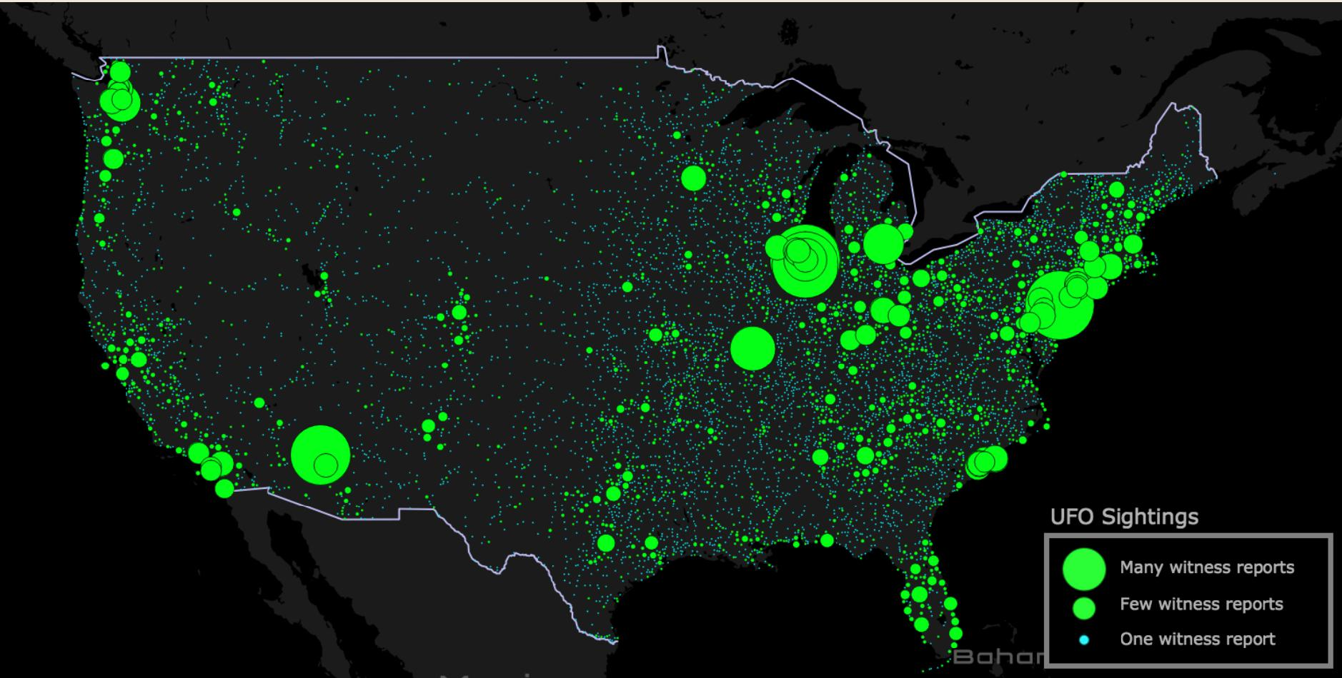
Data quality & provenance

Slide 10
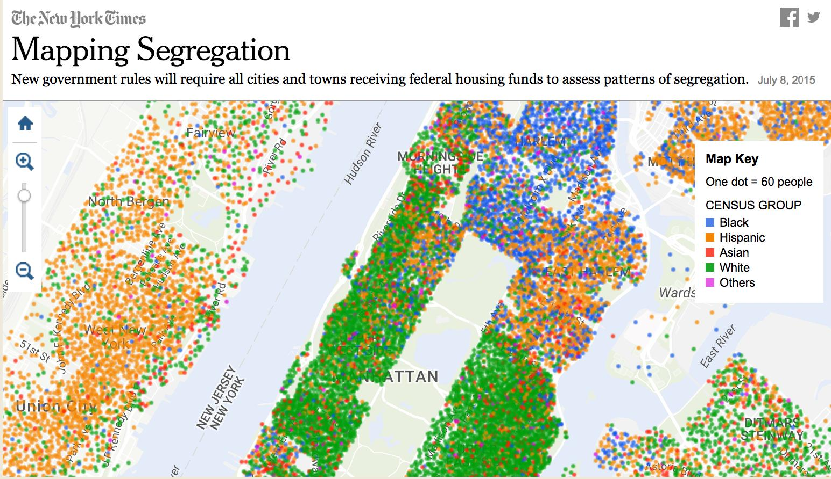
Data or stats?
c ;Mu pork ee!iincr)
Mapping Segregation
Ely
New government rules will require all cities and towns receiving federal housing funds to assess patterns of segregation.
July 8, 2015
01 • • 0011, ^{e}ill^{i}_{p}* _{g}ib ^{Se}
7
••tb•• %%U^{s}* _{t•}^{ldr}te• • ..
^{S}' • • ₁,
CI _{I}:W_{e}t_{s}.
\I's • :•1
-.1 •
Q
pis lªkset^{s}:^{e.10}₂. •
o^{c}
Map Key
One dot = 60 people
a_{t}• _{t}•lq-- •• •
..• S.
A_{lo}s • • ••• • • • •
plei_{ce} • • •"
••
••
es _{t}•
4r⁴
:
•
CENSUS GROUP
Black
Hispanic
Asian
White
III Others
•
* ••
S^{S}. •
•
• Ward:
•
•
•
• • •
Sp •
is,
se'
• • •
•
C^{be) :rne}
•
TTAN
•
•
a
^{S}_{i}r_{e}•
• 4
,^{e}
A
'S^{S} s

Slide 11




Party support: 30 November 2019
Party
 | CON | LAB | LD | BRX | SNP | GRNJ |  | UKIP | TIGfC
Average (%) | 42 31 |  | 14 | 4 4 |  | 3 | 0 0 0
Likely range | (38-46) (27-35) |  | (10-18) | (0-8) (0-7)
:,^{fr}e„" Trend line showing average voting intention, based on : individual polls
50-
12 Dec
Election
• • • | • | . s • • • ma •• see • •
40
. . • • •
• s
• • •• • •
• • • • •
• ••• • • I
• • • • • • esI
e • • • • •
• • • • • • ••• • • • • • •
30
S. • • •• • • • 0 •
de • • 00 • 0 • 00 OD
•
• GO • • • • • • • • • • • •
• • 00 • • • • • •
0 • • • ••
•• • a •
• • • • ••• • • •
• •• •• • • • •• •is •• •• • ••
• • • • • • • • • •
20
• • • • • • • ••
• • •
• ow • • • es-
• •• • • • • • • 0 - •
• • • • • • • • •
• • • de • ••
0 • 0
• • • • •
10
• • • •• • • • • • • • • OW
• • • 0 • • • • • • • • •
• •
• • •
• • • • • • • ••
• • v • • • • •
•
• • OD • ••• •• •• •• • • •
• ea • • • • • • • • • •
•
• Ile• ±. • * • • 0 • • • NV 0001.
 | ell 00 0*
_•
• •
• • • • • • ••• • • • • • • • •
• • • • • *Ow •
sr
Feb Mar Apr May Jun Jul Aug Sep Oct Nov Dec

Slide 12

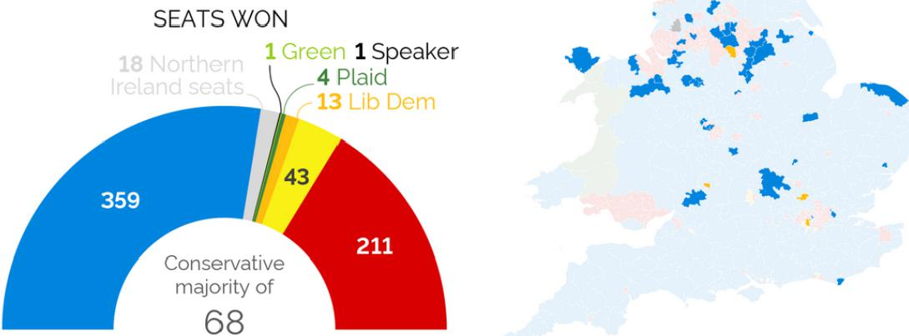
YouGov 2019 election M RP model results
See more in-depth results at yougov.co.uk/uk-general-election-2019
VOTE SHARE (GB ONLY)
Con Lab LD
43%
32%
BXP 3%
Green I 3%
SNP
PC 141%
Other 1 1%
 |  | SEATS CHANGING HANDS
A
SEATS WON
¹
^{v 4}.1f^{r}NA ^{"I}
1 Green 1 Speaker
•
4 Plaid
11 I it-, 1⁻1(
P_{r}
4
a
•
Conservative majority of
68
YouGoV

Slide 13
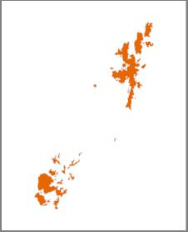
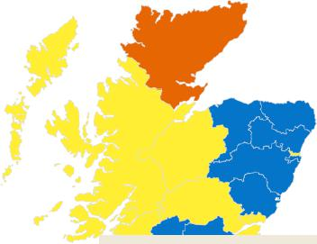
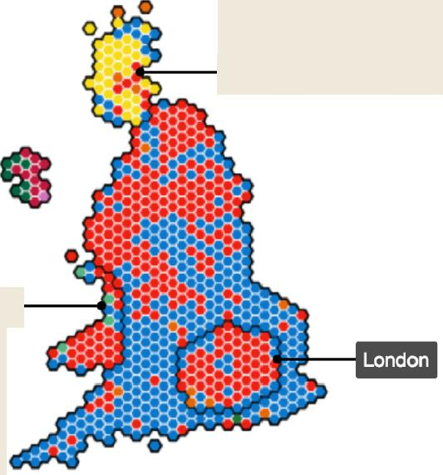

All UK constituencies shown at same size
Tap or click for more details
ti
-I, I,
SCOTLAND
.114
_{i}tii` ^{44'}
_{v}iv_{t}
..,
.
,,.........„
: 1-4⁻04¹⁴¹604 roN
.......„.„,
WALES
ogoutfripidimi
Nar*⁴4⁴4,„ flikte —...
^{ww}Wlightliv-, i
l& .a.1.10. 4_}...ott, 1₄-7, IlltiA 740C-141* AVOW
- .1 potu. Now
4....alk_{i.}.....₇₀,_{40,}
'..4‘ ar426Tell
41 g kW I kor; k At^{r}ks^{ri}tikib^{i}gg,, T.,
, i rAi Ktnlj I liprfo -404 , 431**If
111.0.4.71110₁₁,2.;,, *NA"
.API'
al. -4P
zfe..**
⁰4"⁻
Con • Lab SNP LD • DUP • SF
PC • Green Ind
Con • Lab SNP LD PC Ind • DUP
SF • Green Map built with Carto using hexagons by Esri UK.

Slide 14
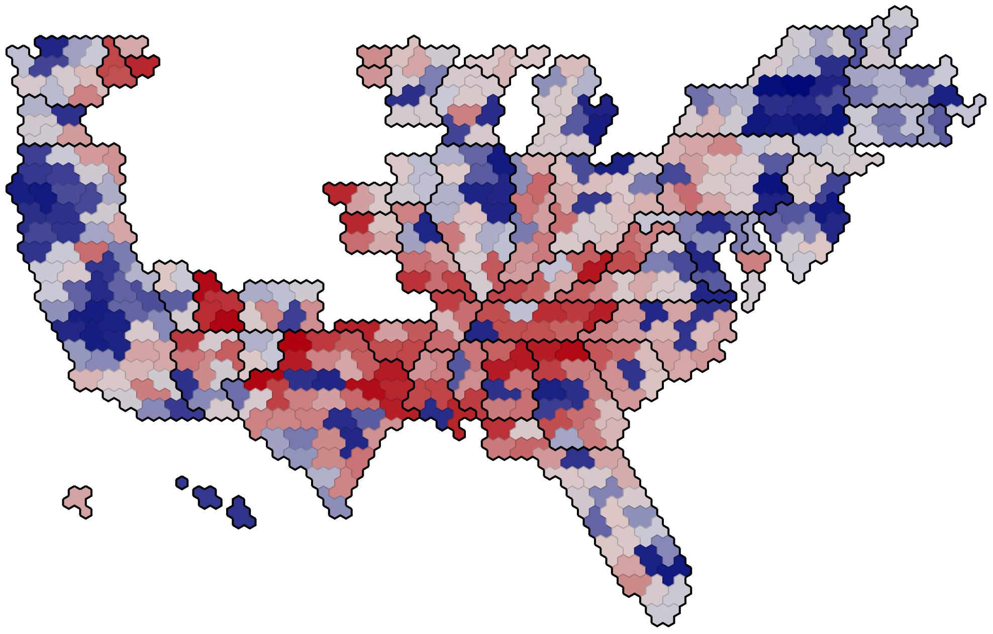

Slide 15


Slide 16
TABLE 2.1 Visual parameters
Parameter Ideal data type Position Quantitative Length Quantitative Angle Quantitative* Area Quantitative* Volume Quantitative* Color hue Nominal or ordinal* Color saturation Ordinal
 |  |  |  |  | 0
 |  |  |  |  |  |  |  |  |  |  | 0
 |  |  |  |  |  |  |  | 0
 |  | =I
 |  | =a1
 | 0.•
Marker shape Nominal* Features Quantitative* |  |  |  |  |  |  |  | 0 A
 |  |  |  |  | A
Line width Ordinal*

Slide 17
A
_{11_}
1
2
4
3
B C
5 1
4 2
3
"_{i}ii
1
4
2
3
3 3
3
2)
2)
2)
1
1
1
1
1
1
1
i
i
i
15 -
15 -
15 -
10 -
10 -
10 -
5
...
5
5
...
0
0
0
1 2 3 4 5 | 1 2 3 4 5 1 2 3 4 5

Slide 18
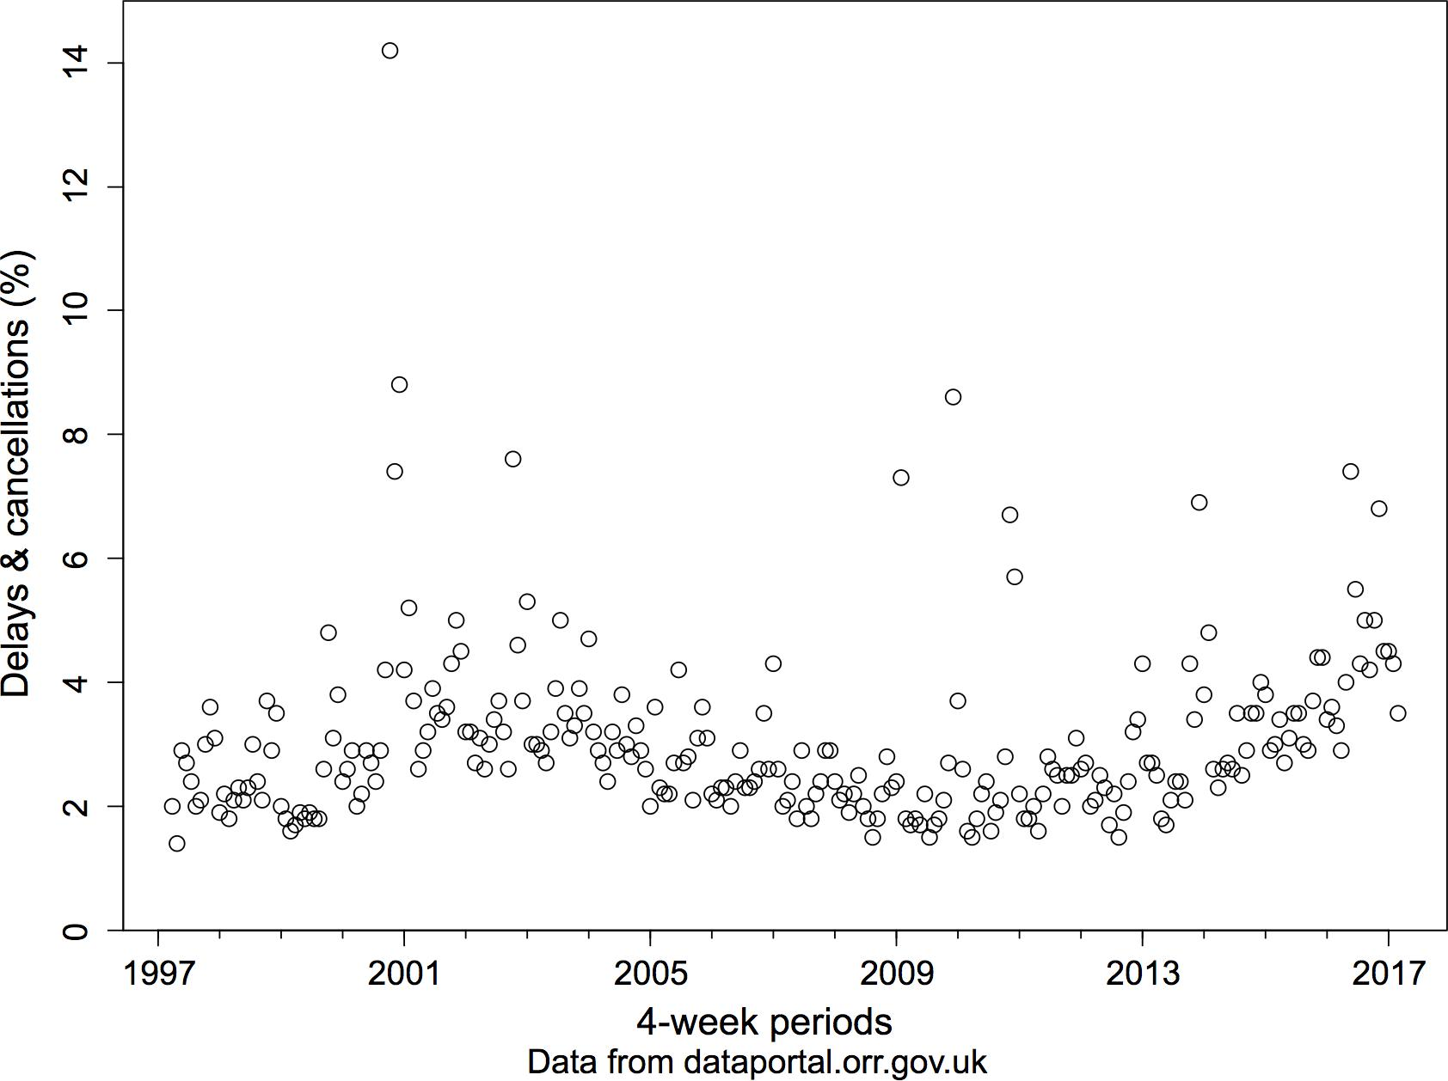
,:t
r
0
N r
0
r
0
0
CO -
0
O
O
O
O
O
O
O
0
CD
0
0 0 CI coc3
O 0 0
O _{o} º ₀
00 e⁹
O
O
9₎
(2_{),}(9 00
o_{0 do 00} 00 ° o o 0
0, cr % o oo 0 _{co}
op vg o eb o • (2) ₀ 63;8_{4..G9} ⁰
O
0 B 0
0 C© CP⁹i
O
8
O
0® 0
_{c0} o
0e0
o
o&
0 0
₀ 8n o •••_{a}
N
9 d*
tity
6 fo •
re RD
; (0)
O
O 1
1997
[
' I 1
2001
1
I I I
! ,
' I 1
2013
' I
2005 2009
4-week periods
Data from dataportal.orr.gov.uk
2017

Slide 19
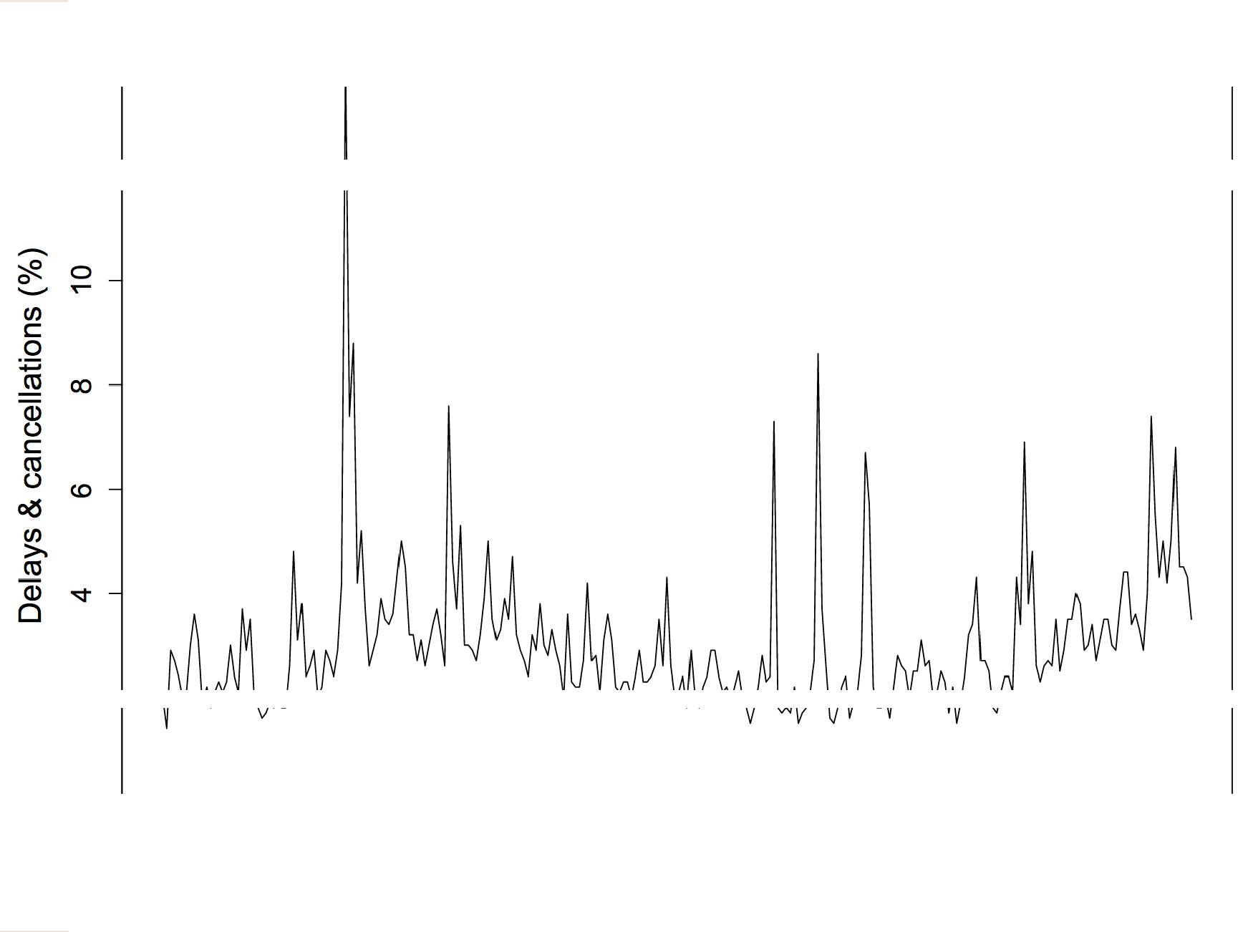
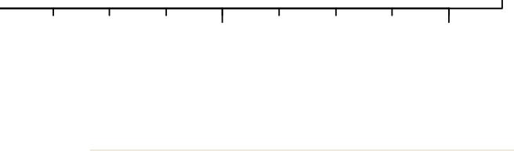

.cr
r
CV
r
CV
cp ₁ I I _{I} I I I ₁ I I I 1
1997 2001 2005 2009
4-week periods
Data from dataportal.orr.gov.uk
2013 |  | 2017

Slide 20
Perception

Slide 21
Perception
Customers' social media use, 2017 Customers' social media use, 2017
2010
CheepCheep 2015
2010
Linkchat
2015
2010
My Face 2015
CheepCheep 2010 Linkchat
MyFace
CheepCheep 2015 Linkchat
MyFace
0 10 20 30 40 50 60 70 80 90 100 % of respondents who use:
0 10 20 30 40 50 60 70 80 90 100 °/0 of respondents who use:

Slide 22
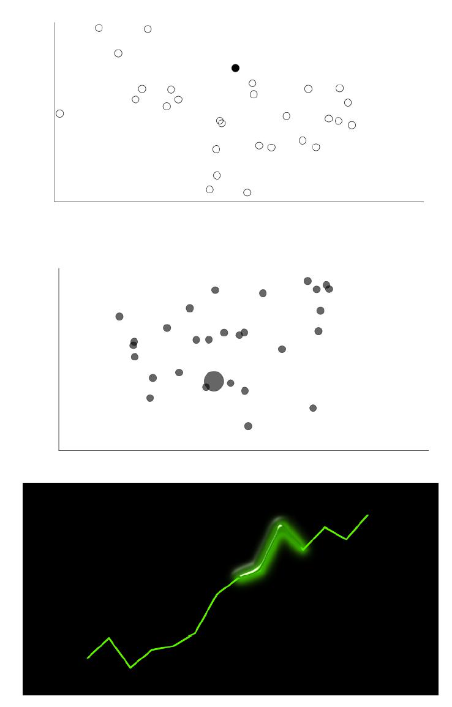
Pre-attentive features

Slide 23
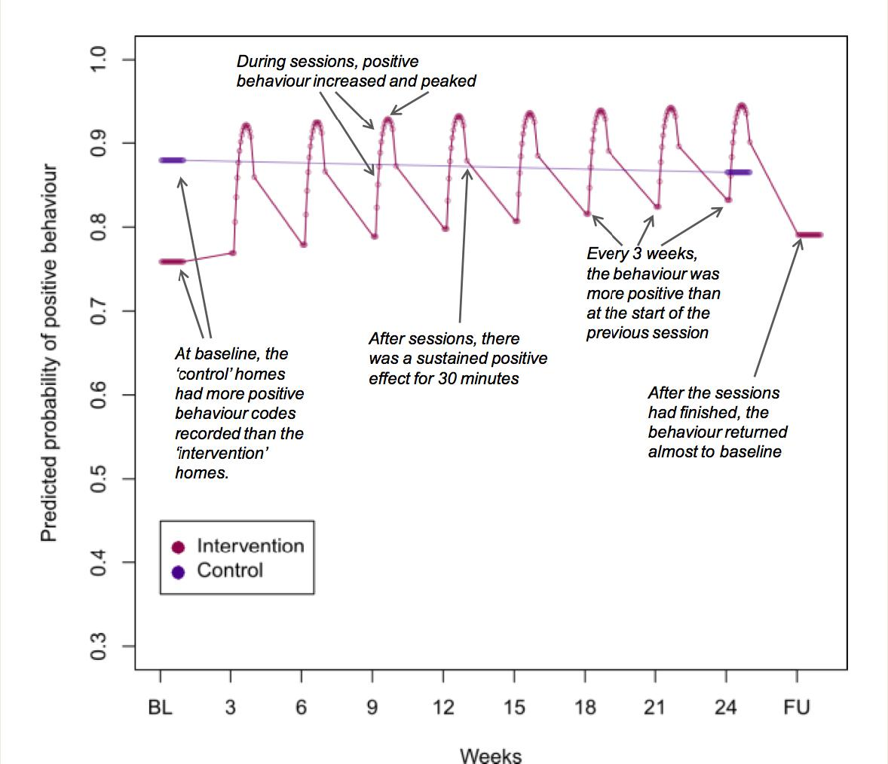
Annotation
CD
During sessions, positive behaviour increased and peaked
Cr!
Predicted probability of positive behaviour
\
Every 3 weeks, the behaviour was more positive than at the start of the previous session
At baseline, the 'control' homes had more positive behaviour codes recorded than the `intervention' homes.
After sessions, there was a sustained positive effect for 30 minutes
After the sessions had finished, the behaviour returned almost to baseline
Intervention
Control
I I
BL
3 6 9 12 15 18 21 24 FU
Weeks

Slide 24
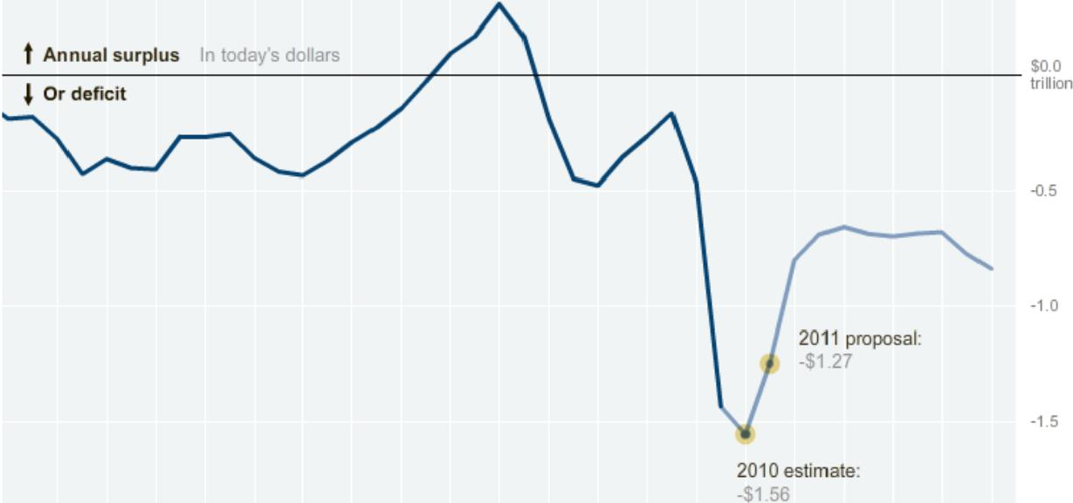
Published February 2, 2010
Budget Forecasts, Compared With Reality
Just two years ago, surpluses were predicted by 2012. How accurate have past White House budget forecasts been?
2 3 4 5 8 NEXT ►
Falling short
President Obama's budget proposal estimates a deficit of $1.6 trillion for the current fiscal year and $1.3 trillion in 2011.
t Annual surplus In today's dollars
$0,0
4 Or deficit
trillion
-0.5
-1.0
2011 proposal:
-$1.27
-1.5
2010 estimate: -$1.56
1982 1986 1990 1994 1998 2002 2006 2010 2020
By AMANDA COX I Send Feedback LINKEDIN 0 SHARE Source: Office of Management and Budget

Slide 25
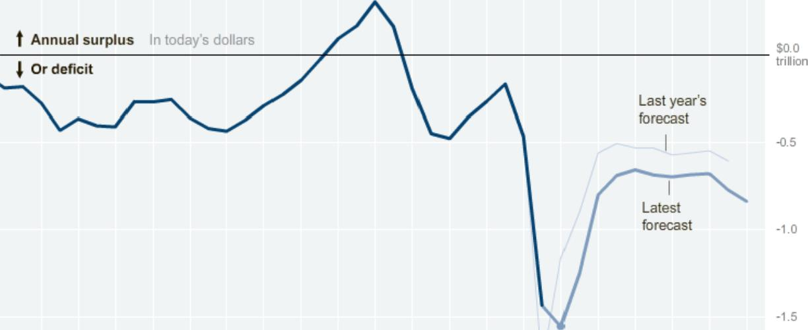
Published: February 2. 2010
Budget Forecasts, Compared With Reality
Just two years ago, surpluses were predicted by 2012. How accurate have past White House budget forecasts been?
El 3 4 5 6 NEXT ►
Forecasts worsen
The forecast for the next decade is somewhat worse than it was a year ago, mostly because of a revised economic outlook.
From 2011 to 2020, a
total deficit of $8.5 trillion is expected.
Annual surplus In today's dollars 4 Or deficit
$0.0
trillion
Last year's forecast
-0.5
Latest forecast
-1.0
-1.5
1982 1986 1990 1994 1998 2002 2006 2010 2020
By AMANDA COX I Send Feedback Source: Office of Management and Budget | LINKEDIN 9 SHARE

Slide 26
Published: February 2. 2010
Budget Forecasts, Compared With Reality
Just two years ago, surpluses were predicted by 2012. How accurate have past White House budget forecasts been?
2 4 5 NEXT ►
Past forecasts |  |  | 1995
Even that may be an understatement. In the last 30 years, about So percent of four-year deficit forecasts have been too optimistic. |  |  |  | $0.0
 |  |  |  | trillion
 |  |  |  | -0.5
The early Clinton budgets — which failed to predict the surpluses that were generated, in part, by a stock market bubble — are the only major exception. | The 1995 forecast for 1999 did not predict a surplus ... | -1.0 -1.5
1982 1986 1990 1994 1998 2002 2005 2010 2020
By AMANDA COX I Send Feedback Source: Office of Management and Budget | LINKEDIN 9 SHARE

Slide 27
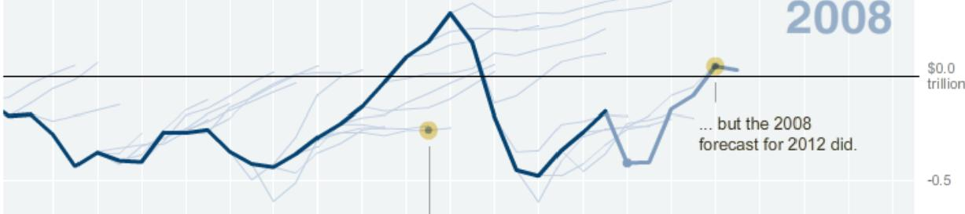
Published: February 2, 2010
Budget Forecasts, Compared With Reality
Just two years ago, surpluses were predicted by 2012. How accurate have past White House budget forecasts been?
2 | 3 05 |  | NEXT ►
Past forecasts
In contrast, just two years ago, the Bush administration projected a surplus by 2012.
2008
$0.0
trillion
... but the 2008
forecast for 2012 did.
The 1995 forecast for 1999
did not predict a surplus ...
-1.0
1932 198€ 1990 1994 2002 2006 2010 2020
By AMANDA COX Send Feedback Source: Office of Management and Budget | LINKEDIN 9 SHARE

Slide 28
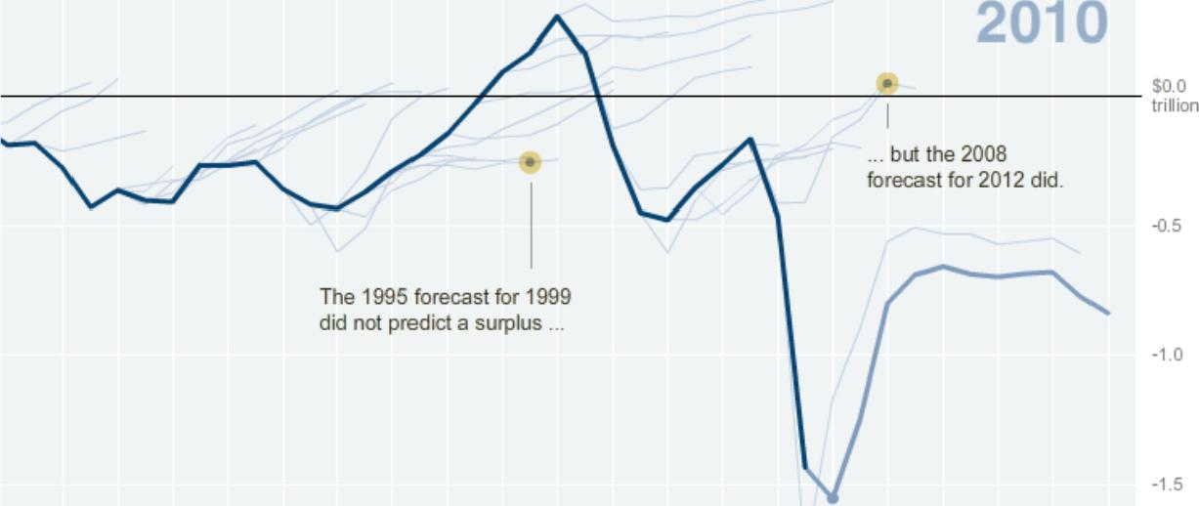
Published: February 2. 2010
Budget Forecasts, Compared With Reality
Just two years ago, surpluses were predicted by 2012. How accurate have past White House budget forecasts been?
2 | 3 | 4 El ⁶ | NEXT ►
Latest forecast
Today, with a better understanding of the severity of the economic downturn, the deficit situation is much more dire.
2010
$0.0
trillion
... but the 2008
forecast for 2012 did.
-0.5
The 1995 forecast for 1999 did not predict a surplus ...
-1.0
-1.5
 | Use the slider to isolate a single year's forecast. 1982 1986 1990 1994 1998 2002 2006 2010 | 2020
By AMANDA COX I Send Feedback Source: Office of Management and Budget |  | LINKEDIN 9 SHARE

Slide 29
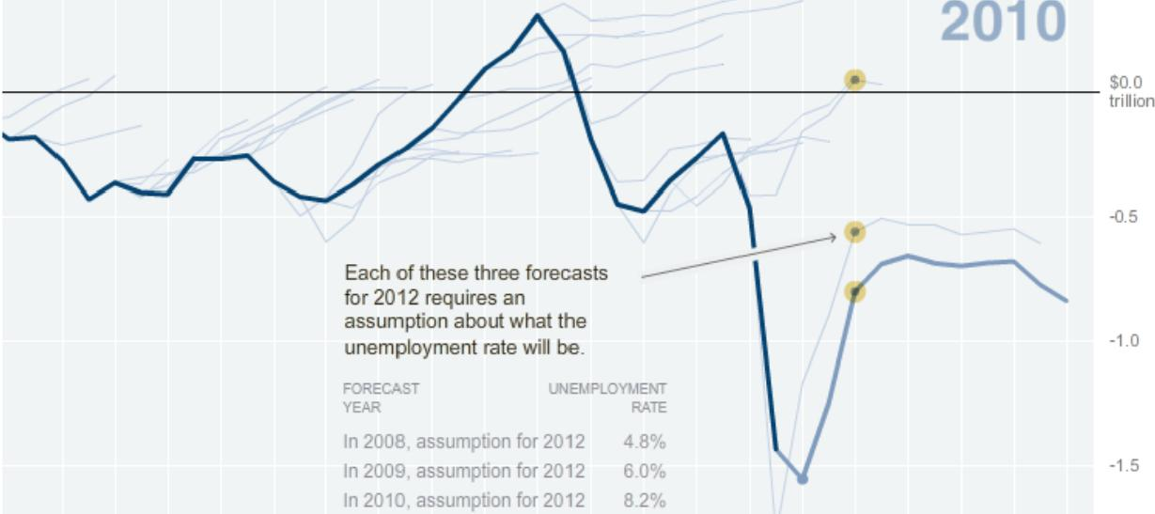
Published: February 2, 2010
Budget Forecasts, Compared With Reality
Just two years ago, surpluses were predicted by 2012. How accurate have past White House budget forecasts been?
2 3 4 5 6 NEXT
Reasons for error
Budget forecasts require assumptions about both policy and the economy, and both can turn out to be spectacularly wrong.
In 2008, for example, the unemployment rate in 2012 was assumed to be 4.8 percent. The most recent assumption is 8.2 percent.
2010
$0.0
trillion
Each of these three forecasts for 2012 requires an assumption about what the unemployment rate will be.
-1.0
FORECAST UNEMPLOYMENT YEAR RATE
In 2008, assumption for 2012 | 4.8%
In 2009, assumption for 2012 | 6.0%
In 2010, assumption for 2012 | 8.2%
-1.5
1982 1986 1990 1994 1998 2002 2006 2010 2020
By AMANDA COX I Send Feedback LINKEDIN Q SHARE
Source: Office of Management and Budget

Slide 30
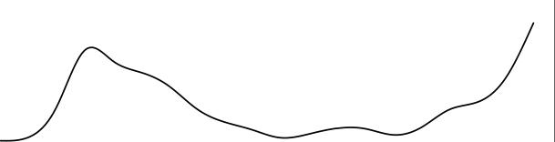

Smoothing
Smoothed with splines
Smoothed with LOESS
CO
CO
C
0
Co
CO
0
C
Ca
0
C
Ca
U)
>,
cc:5 N
ID
'.--.
0
(1) C
0
a3
CO
CO
CD
0
C
(115
0
71"
C
a3
U)
>,
CO N
C)
⁻0
0
2000
2000 2005 2010 2015
2005
2010
2015

Slide 31
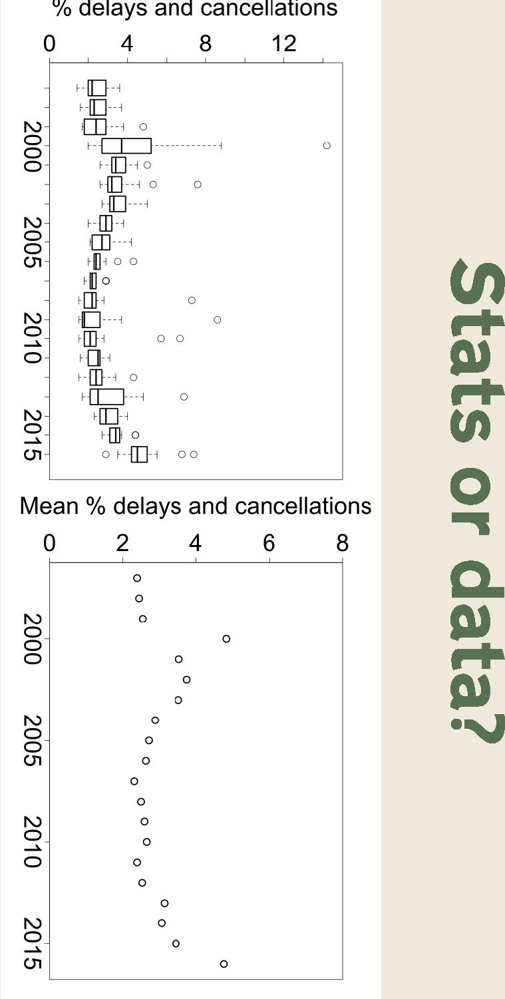
% delays and cancellations
0 4 8 12
N-O_
O
O
F
dip_--1 0
o_
co--H
0 0
0
0 0
F_{a},
F._{ra}., 0
Fit 1--H
F_{ED}
o 00
O
_{or}^{Stats}
data?
rv-
O
O
N.) -
CD
01 -
Mean % delays and cancellations
0 2 4 6 8
0
0
0
0_
0
0
0
0
O
0
N.)
0
0
0
o_
O
U,
0 0 0 O 0
0
O O
O
0
O
O
0

Slide 32
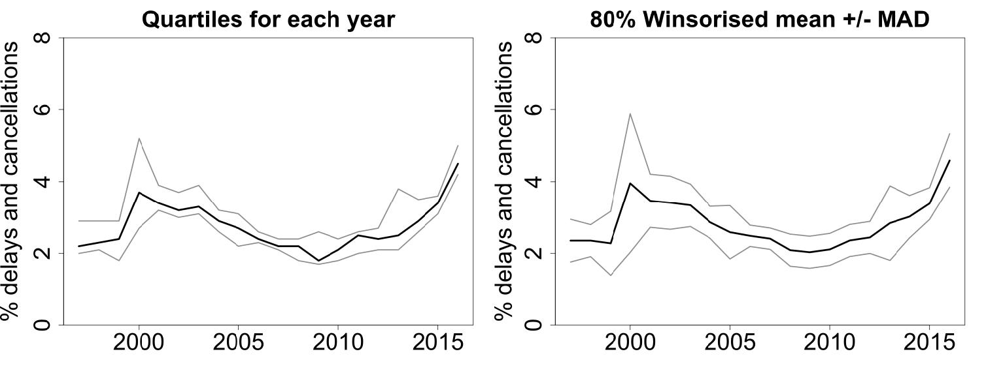
Stats or data?

Slide 33
Coefficients, effects etc
long - History of IV Drug Use⁻ Number of Prior Drug Treatments - Left Treatment Early - Non-white ethnicity - | ⁻0⁻
 |  | ⁻0⁻
 | le
I I 1
0 2 4 6
Odds ratios

Slide 34

Coefficients, effects etc

Slide 35
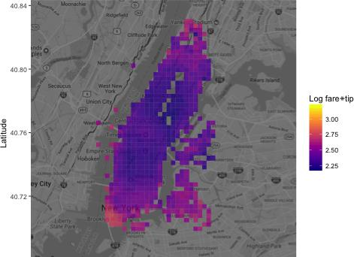
Prediction: random forest 3
All predictors, training set
40.84
40.80•
Log fare•tip
3.00
235
2.50
225
- 40.76
3
40.72-
40.68-
-74⁶.05 -74.00 -73.95 -73.90
Longitude

Slide 36




Prediction: random forest 3
Al1 predictors. trailing set
Jan
Feb
Sat Frl This
Wed Tue Mon Sun
Jun
Jul
Aug
Sat Fr Thu
4 Wed Tue Mon Sun
•
prediction
2.7
2.6
2.6
2.4
2.3
22
I
Out
Nov
Oen
Sat Fn Thu Wed Tue
Mon Sun
I
0 5 10 15 20 0 5 10 15 20 0 5 10 15 20 0 5 10 '5 20
11°

Slide 37




Uncertainty
None | History of addiction treatments: Previous Recent
-
⁰9 -
e9 -
CD c0 _
co • co •
a a
as as
0 0
_S[ Y_{u)}
co
el -
C4- et?
- N
_
N -
O
O 0
short long short long short long
Length of Treatment | Length of Treatment Length of Treatment

Slide 38

Uncertainty

Slide 39
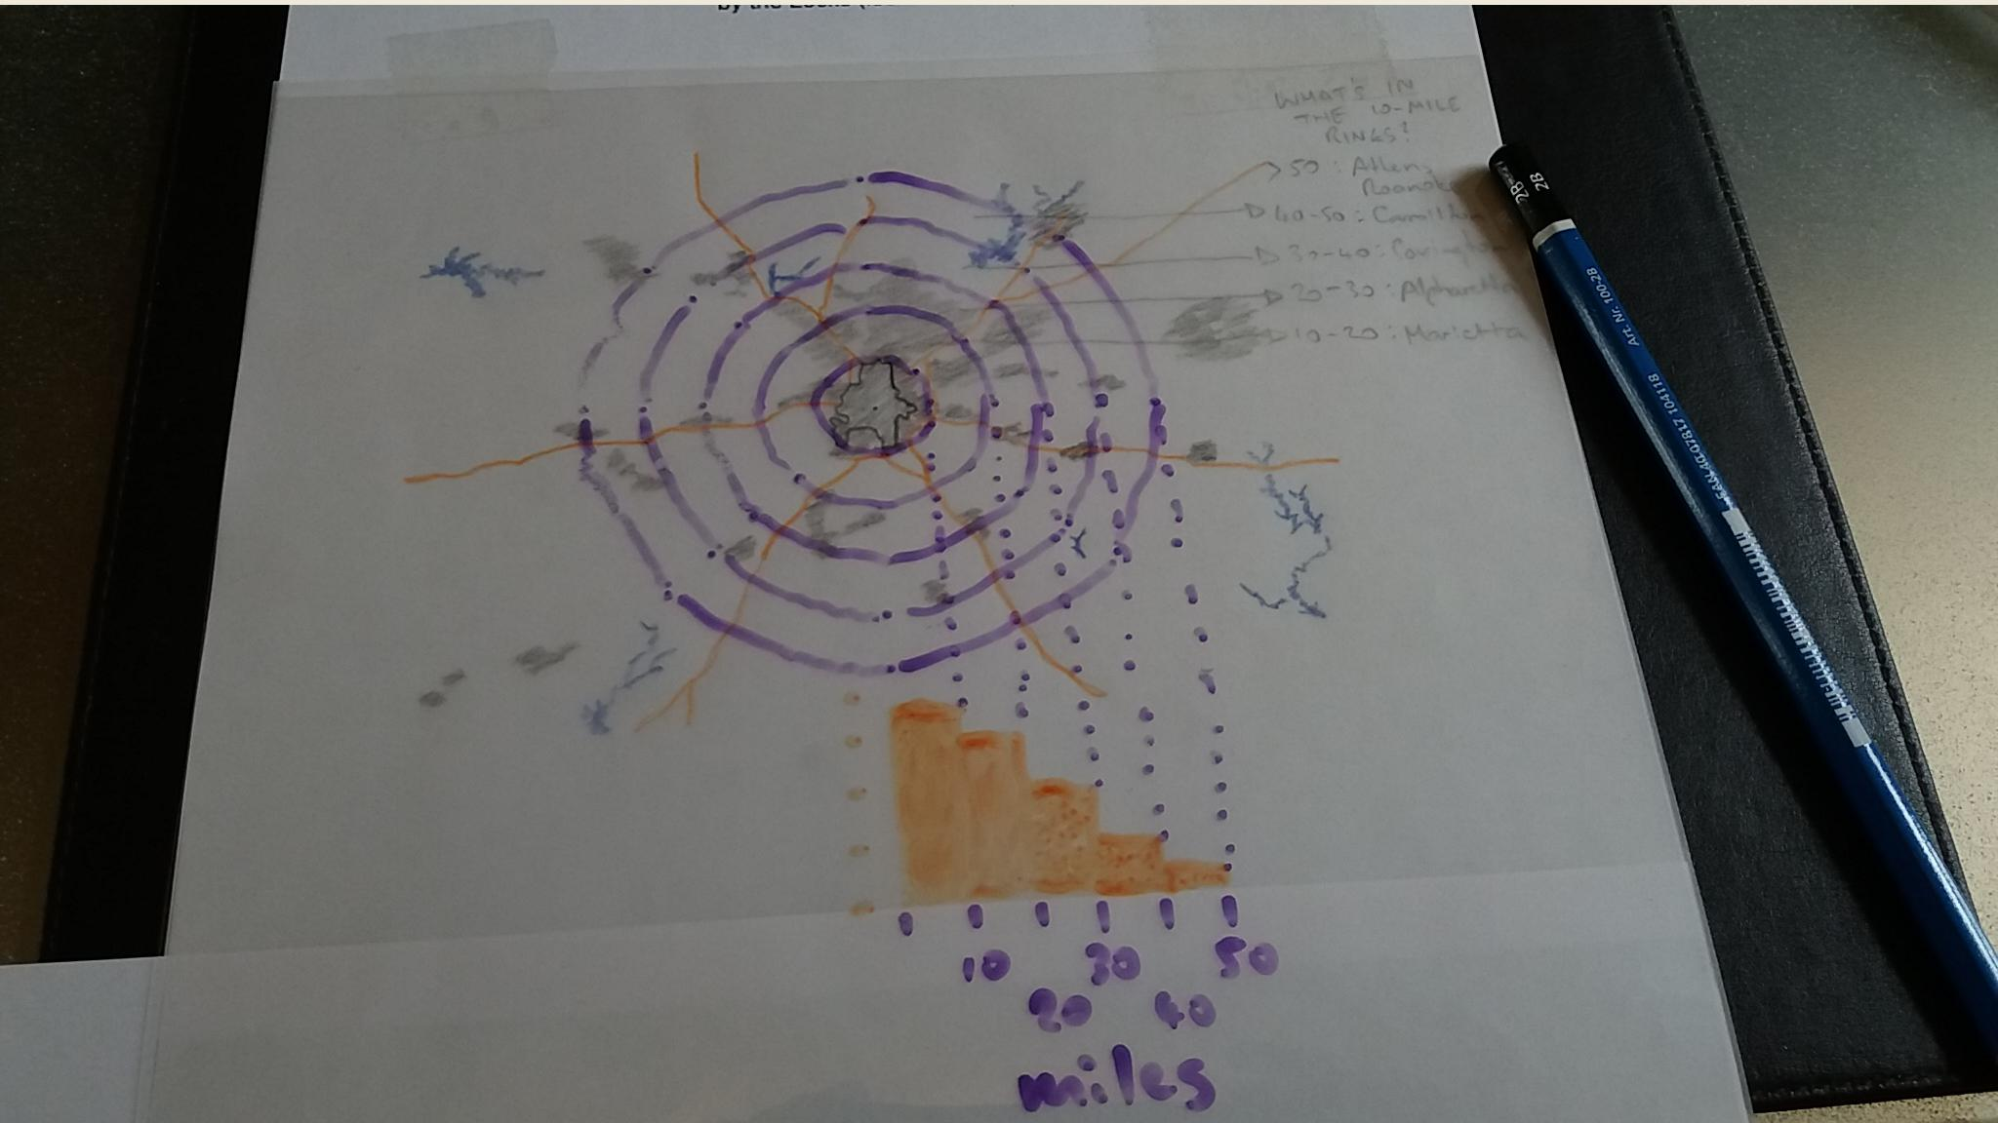
Sketch

Slide 40
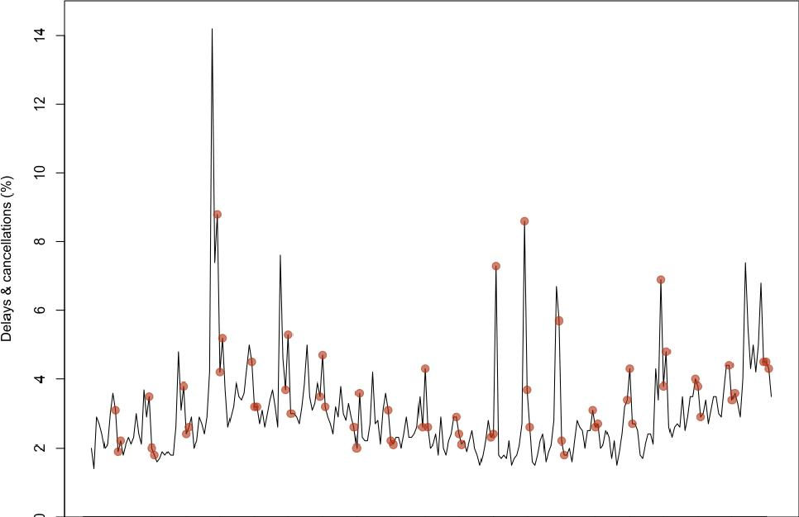
Delays & cancellations (%)
_{i} , • • • • • I
1997 2001 2005 2009 2013 2017
4-week periods
Data from dataportal.orr.gov.uk

Slide 41
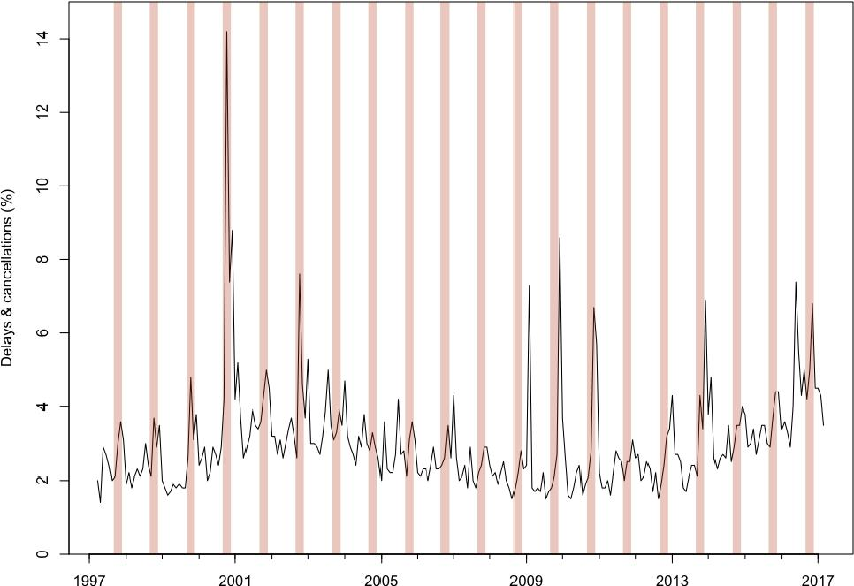
1-
N gr.
Delays & cancellations (%)
O
CO
CD
I
0\
AA
N
N
JLIV
Ow' I
O
1997
2001
2005
2009
2013
2017
4-week periods
Data from dataportal.orr.gov.uk

Slide 42
Delays & cancellations (%)
0 2 4 6 8 10 12 14
O cu 0 3 i^{s} o. rt• (1) 0) D r op ⁻0 9, °¹0 GO 0 | O Ca | a W®®° 0 OC OCO 0 00 CCM) COO 0 COGIDICCCO COCCOICO 0 COMO CC:CO a op .n • 0:La o 0 ocz CC WM 0 OCCOM 0 0 coOCCCO 0 CC 0 CEO COO C 0 • COCODZID ID 0 0 OD

Slide 43
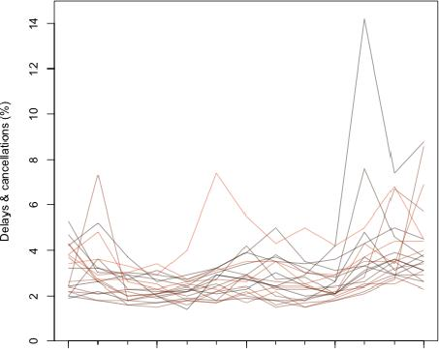
Delays & cancellations (%)
1 4 7 10 13
4-week periods
Data from dataportal.orr.gov.uk

Slide 44
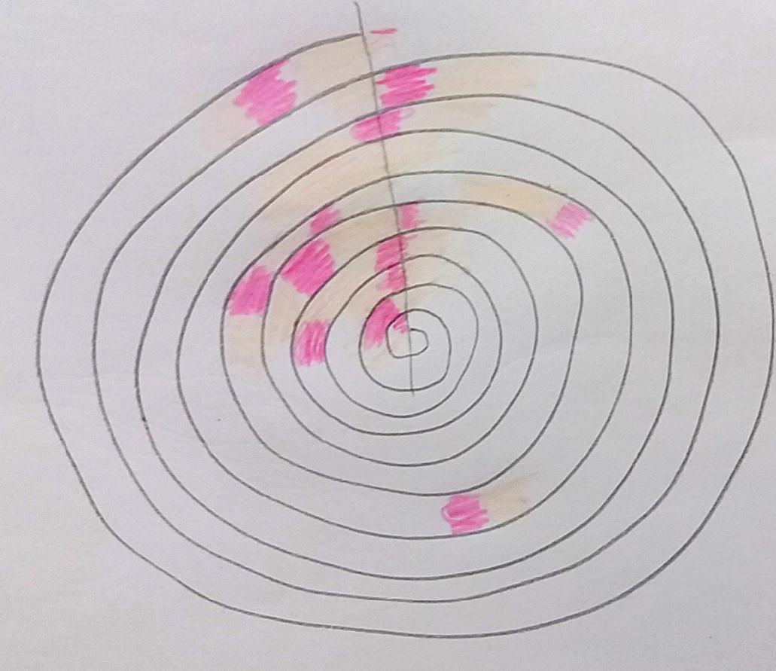
vt_c ^{c})r_e t.-‘

Slide 45


Rail cancellations and significant delays:
London & South East England
co ⁻0 0 ii) a a) CD ₄
Xmas & New Year
} Autumn leaves
Worst three
weeks of
each year
1
} Usually coldest
2000 2005 2010 2015
Year Data from dataportal.orr.gov.uk

Slide 46

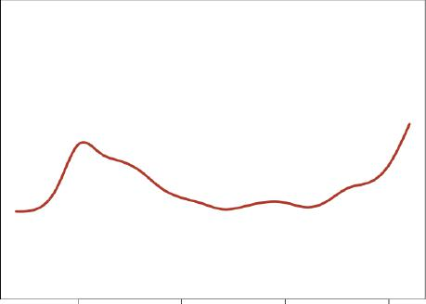
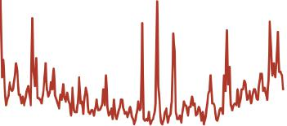
Leaves on the line
Do Autumn leaves delay trains in SE England?
CO
(/)
C
CD
0 C
0
⁻0
C
Cn
CD ⁻CD
CO
71-
CN
Delays and cancellations are
recorded in 4-week periods.
The long-term trend was that
performance improved, then
deteriorated again.
Government subsidy peaked in 2006, and was reduced each year since then.
CD
2000 2005 2010 2015
Data were smoothed using splines
Worst periods of each year
Dec AD_{I} | • | Xmas Autumn
The worst delays have shifted
from Autumn to Winter. Jul -
 | • | •
Leaves are no longer a problem.
Jan -
 | Coldest
2000 20¹05 20¹10 2015
Short-term problems (spikes below) in context
`⁾/0 delays and cancellations
1994-97: Privatisation
1999: Paddington crash
2000: Hatfield crash
2000: Potters Bar crash; speed limits
2002: New infrastructure company
2009-11: Unusually snowy winters
2017: Southern Rail strikes
2000 2005 2010 2015
Data from dataportal.orr.gov.uk

Slide 47

User testing

Slide 48
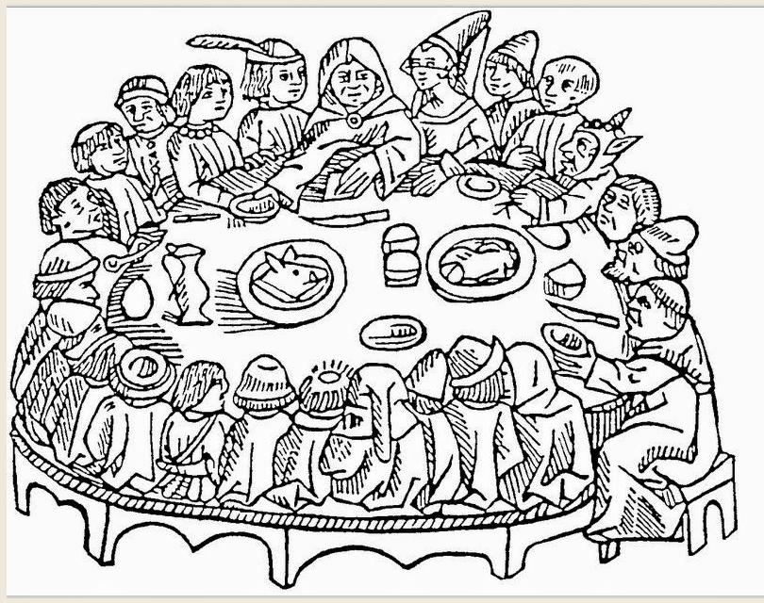
Get out more

Slide 49

Curation

Slide 50

tri.)

Slide 51
Stop)
Donut switch on your
computer.

Slide 52
You need aa clearly defined
question or goal.
You need to understanu
the data's provenance
and weaknesses.
You need theory, prior eviuence
and expert opinion
to underpin your analyses.
Serendipitous uListakes help too.
You need to talk to people for this.
Arid to use analogue tools (sometimes)
You need to visit the source of thy: data
and the setting where your
work will be acted on,
(or ignorud)

