Slide 1
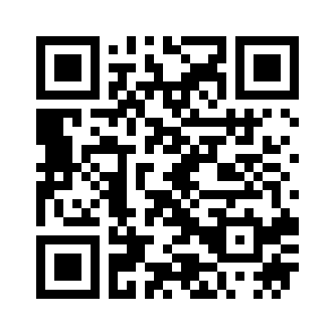
Scan this:
Or go here:
bit.do/socr
Then enter Room Name: MSDLT

